Slide 2
Luke 7:1-10
¹ Now when He concluded all His sayings in the hearing of the people, He entered Capernaum. ² And a certain centurion’s servant, who was dear to him, was sick and ready to die. ³ So when he heard about Jesus, he sent elders of the Jews to Him, pleading with Him to come and heal his servant. ⁴ And when they came to Jesus, they begged Him earnestly, saying that the one for whom He should do this was deserving, ⁵ for he loves our nation, and has built us a synagogue. ⁶ Then Jesus went with them. And when He was already not far from the house, the centurion sent friends to Him, saying to Him, Lord, do not trouble Yourself, for I am not worthy that You should enter under my roof. ⁷ Therefore I did not even think myself worthy to come to You. But say the word, and my servant will be healed. ⁸ For I also am a man placed under authority, having soldiers under me. And I say to one, go, and he goes; and to another, come, and he comes; and to my servant, do this, and he does it. ⁹ When Jesus heard these things, He marveled at him, and turned around and said to the crowd that followed Him, I say to you, I have not found such great faith, not even in Israel! ¹⁰ And those who were sent, returning to the house, found the servant well who had been sick.

Slide 4
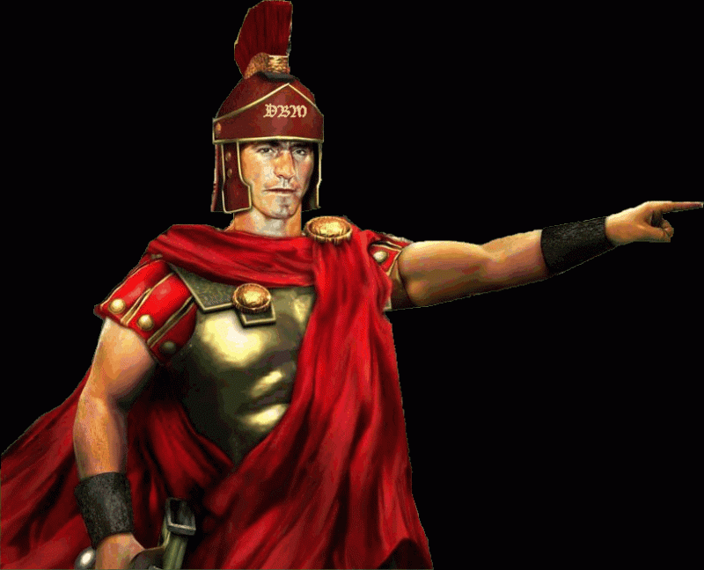
Roman Centurion
In ancient Rome the “Centurion” meant “captain of 100.”
The centurion was usually an Italian career soldier, noted for his skill and courage in battle.
Centurions were the “backbone” of the Roman army. They were the veteran soldiers who commanded 100 foot soldiers, within a legion of
6,000. There were 60 centuries in a legion, each under the command of a centurion.
Centurions worked their way up the ranks as soldiers, and were promoted for their patriotism and valor.

Slide 5
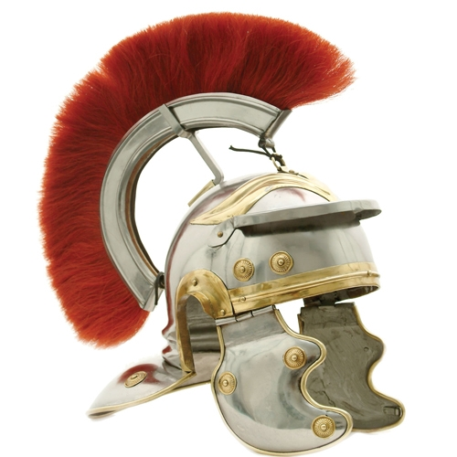
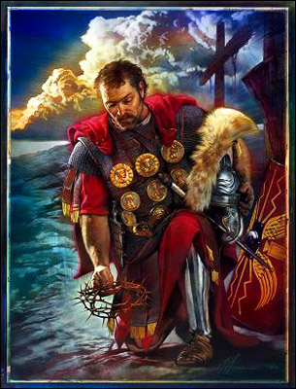
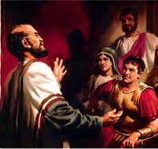
Centurions in the Bible
At the Crucifixion of Christ (Matt 27:54)
Cornelius at Caesarea (Acts 10:1)
This Man at Capernaum (Lk 7:1-10)

Slide 6
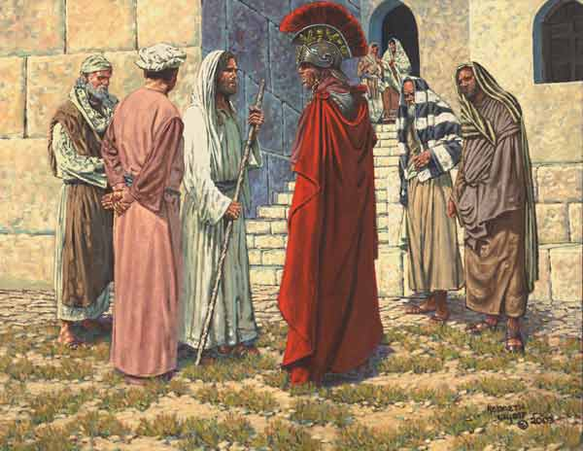
Was Based Upon Evidence
“I say to you, I have not found such great faith, not even in Israel!”
The Faith of the Centurion

Slide 7
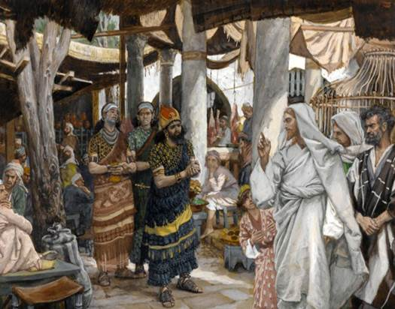
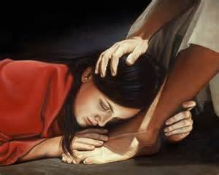
Was Based Upon Evidence
Nobleman of Capernaum
John 4:46-53

Slide 8
Gave Him Great Compassion
Was Based Upon Evidence
The Faith of the Centurion

Slide 9
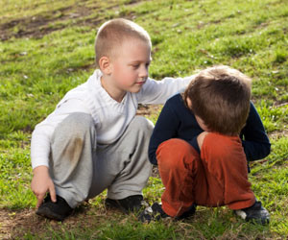
Gave Him Great Compassion
Matthew 22:36-40
Samaritan (Lk 10:30-37)

Slide 10
Gave Him Great Compassion
Produced Great Humility
The Faith of the Centurion

Slide 11
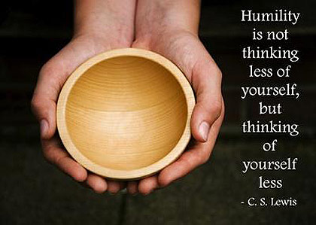
Produced Great Humility
Others

Slide 12
Was simple & Uncomplicated
Produced Great Humility
The Faith of the Centurion

Slide 13
Was simple & Uncomplicated
Anywhere with Jesus
Luke 5:5
“At your Word”

Slide 14
Was simple & Uncomplicated
Was Lived Out Daily
The Faith of the Centurion

Slide 15
Was Lived Out Daily
“When he came and had seen the grace of God” (Ac 11:23).
“it is no longer I who live, but Christ lives in me” (Gal 2:20).
“I will show you my faith by my works” (Jas 2:18).

