Slide 2
Galatians 5:16-21
¹⁶ I say then: Walk in the Spirit, and you shall not fulfill the lust of the flesh. ¹⁷ For the flesh lusts against the Spirit, and the Spirit against the flesh; and these are contrary to one another, so that you do not do the things that you wish. ¹⁸ But if you are led by the Spirit, you are not under the law. ¹⁹ Now the works of the flesh are evident, which are: adultery, fornication, uncleanness, lewdness, ²⁰ idolatry, sorcery, hatred, contentions, jealousies, outbursts of wrath, selfish ambitions, dissensions, heresies, ²¹ envy, murders, drunkenness, revelries, and the like; of which I tell you beforehand, just as I also told you in time past, that those who practice such things will not inherit the kingdom of God.

Slide 4
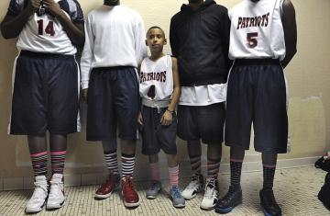
Evaluating the Landscape
“Then the Pharisees and Sadducees came, and testing Him asked that He would show them a sign from heaven. He answered and said to them, when it is evening you say, it will be fair weather, for the sky is red; and in the morning, it will be foul weather today, for the sky is red and threatening. Hypocrites! You know how to discern the face of the sky, but you cannot discern the signs of the times”
(Matt 16:1-3).

Slide 5
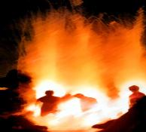
Evaluating the Landscape
^{Romans 3:}
⁹ They are all under sin
¹⁰ There is none righteous
¹¹ There is none who seeks after God
¹² They have all turned aside
¹³ With their tongues they have practiced deceit
¹⁴ Whose mouth is full of cursing and bitterness
¹⁵ Their feet are swift to shed blood
¹⁶ Destruction and misery are in their ways
¹⁷ And the way of peace they have not known
¹⁸ There is no fear of God before their eyes
²³ All have sinned and fall short of the glory of God
^{Romans 1:}
¹⁸ Who suppress the truth in unrighteousness,
²³ Changed the glory of the incorruptible God
²⁴ Lusts of their hearts, to dishonor their bodies
²⁶ For this reason God gave them up to vile passions.
²⁶ For even their women exchanged the natural use for what is against nature.
²⁷ Likewise also the men, . . . burned in their lust for one another, men with men
²⁹ Being filled with all unrighteousness, sexual immorality, wickedness, covetousness, maliciousness; full of envy, murder, strife, deceit, evil-mindedness; they are whisperers,
³⁰ backbiters, haters of God, violent, proud, boasters, inventors of evil things, disobedient to parents,
³¹ undiscerning, untrustworthy, unloving, unforgiving, unmerciful;
“I beseech you therefore, brethren, by the mercies of God, that you present your bodies a living sacrifice, holy, acceptable to God, which is your reasonable service. And do not be conformed to this world, but be transformed by the renewing of your mind, that you may prove what is that good and acceptable and perfect will of God”
(Romans 12:1-2).
“And do this, knowing the time, that now it is high time to awake out of sleep; for now our salvation is nearer than when we first believed . . . Let us walk properly, as in the day, not in revelry and drunkenness, not in lewdness and lust, not in strife and envy. But put on the Lord Jesus Christ, and make no provision for the flesh, to fulfill its lusts.”
(Romans 13:11-14).
Wages of Sin is Death
Romans 6:23

Slide 6
Evaluating the Landscape
Hebrews 11
¹³ These all died in faith, not having received the promises, but having seen them afar off were assured of them, embraced them and confessed that they were strangers and pilgrims on the earth. ¹⁴ For those who say such things declare plainly that they seek a homeland. ¹⁵ And truly if they had called to mind that country from which they had come out, they would have had opportunity to return. ¹⁶ But now they desire a better, that is, a heavenly country. Therefore God is not ashamed to be called their God, for He has prepared a city for them.
1 Peter 2
¹¹ Beloved, I beg you as sojourners and pilgrims, abstain from fleshly lusts which war against the soul, ¹² having your conduct honorable among the Gentiles, that when they speak against you as evildoers, they may, by your good works which they observe, glorify God in the day of visitation.
Hebrews 11
¹³ These all died in faith, not having received the promises, but having seen them afar off were assured of them, embraced them and confessed that they were strangers and pilgrims on the earth. ¹⁴ For those who say such things declare plainly that they seek a homeland. ¹⁵ And truly if they had called to mind that country from which they had come out, they would have had opportunity to return. ¹⁶ But now they desire a better, that is, a heavenly country. Therefore God is not ashamed to be called their God, for He has prepared a city for them.
1 Peter 2
¹¹ Beloved, I beg you as sojourners and pilgrims, abstain from fleshly lusts which war against the soul, ¹² having your conduct honorable among the Gentiles, that when they speak against you as evildoers, they may, by your good works which they observe, glorify God in the day of visitation.

Slide 7
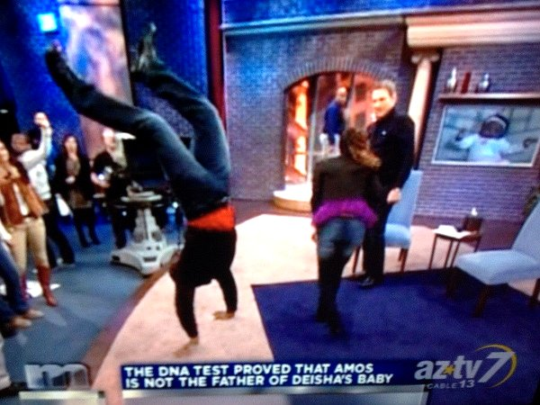
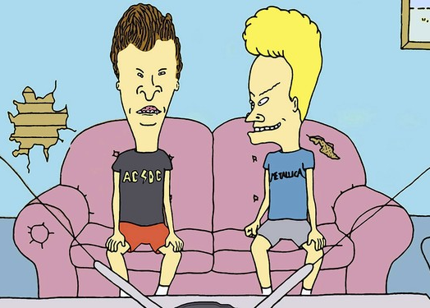
Evaluating the Landscape

Slide 8
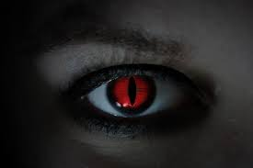
Evaluating the Landscape
prince of the power of the air

Slide 10
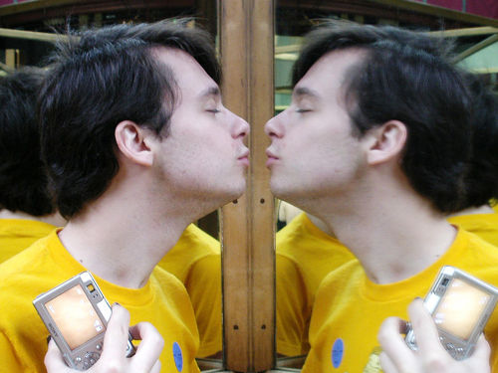
Narcissism

Slide 11
Moral
Relativism

Slide 12
SECULARISM

Slide 13
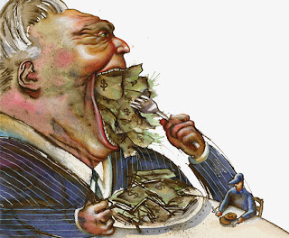
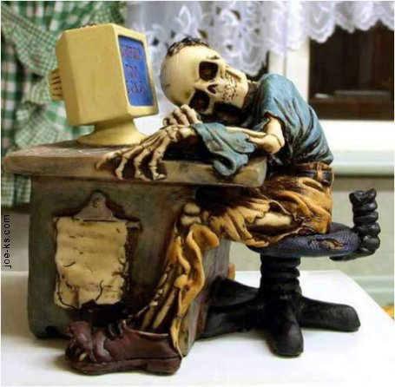
1 Timothy 6:9-10
Matthew 6:30-31
Materialism
Ephesians 6:4
Materialism
Luke 12:19-21

Slide 14
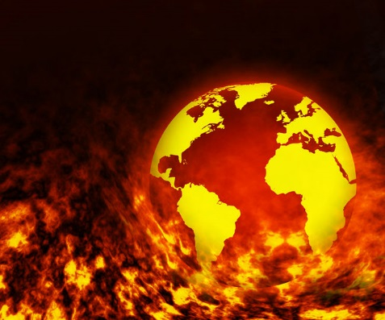
“Do not love the world or the things in the world. If anyone loves the world, the love of the Father is not in him. For all that is in the world—the lust of the flesh, the lust of the eyes, and the pride of life—is not of the Father but is of the world. And the world is passing away, and the lust of it; but he who does the will of God abides forever” (1 Jn 2:15-17).

