Slide 2
1 Peter 5:5-11
⁵ Likewise you younger people, submit yourselves to your elders. Yes, all of you be submissive to one another, and be clothed with humility, for God resists the proud, but gives grace to the humble. ⁶ Therefore humble yourselves under the mighty hand of God, that He may exalt you in due time, ⁷ casting all your care upon Him, for He cares for you. ⁸ Be sober, be vigilant; because your adversary the devil walks about like a roaring lion, seeking whom he may devour. ⁹ Resist him, steadfast in the faith, knowing that the same sufferings are experienced by your brotherhood in the world. ¹⁰ But may the God of all grace, who called us to His eternal glory by Christ Jesus, after you have suffered a while, perfect, establish, strengthen, and settle you. ¹¹ To Him be the glory and the dominion forever and ever. Amen.

Slide 4
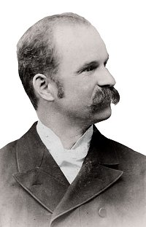
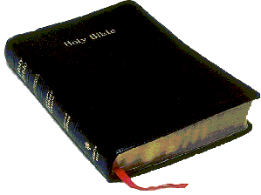
Therefore humble yourselves under the mighty hand of God, that He may exalt you in due time, casting all your care upon Him, for He cares for you.
(1 Peter 5:6-7)
Frank Ellsworth Graeff
(wrote more than 200 hymns)
“Does Jesus Care”
1901

Slide 5
The Mighty Hand Of God
“. . . whom You have brought out of Egypt with a mighty hand” (Deut 9:26).
“. . . humble yourselves under the mighty hand of God” (1 Peter 5:6)

Slide 6
Cast Your Burden on the Lord
“Cast your burden on the Lord, and He shall sustain you . . .” (Psalm 55:22)
“. . . casting all your care upon Him, for He cares for you.” (1 Peter 5:7)

Slide 7
Does Jesus Care
Does Jesus care when my heart is pained too deeply for mirth or song, as the burdens press, and the cares distress and the way grows weary and long?

Slide 8
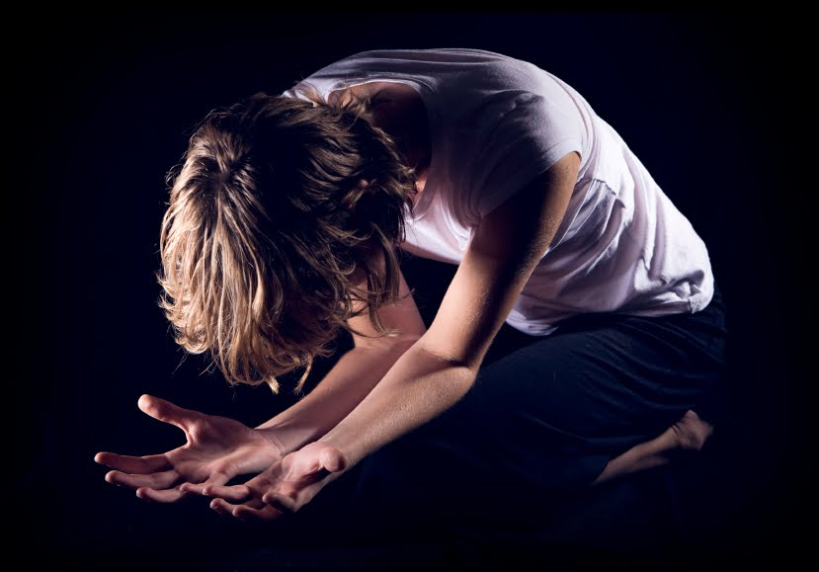
Man who is born of woman is of few days and full of trouble. (Job 14:1)
Yet man is born to trouble, as the sparks fly upward. (Job 5:7)
In the world you will have tribulation . . . (John 16:33)

Slide 9
Does Jesus Care
Does Jesus care when my way is dark with a nameless dread and fear? As the daylight fades into deep night shades, does He care enough to be near?

Slide 10
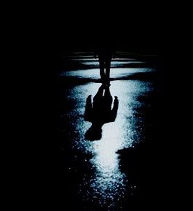
. . . whereas you do not know what will happen tomorrow. For what is your life? It is even a vapor that appears for a little time and then vanishes away. (James 4:13-14)
Therefore do not worry about tomorrow, for tomorrow will worry about its own things. Sufficient for the day is its own trouble. (Matthew 6:34)

Slide 11
Does Jesus Care
Does Jesus care when I've said ‘goodbye’ to the dearest on earth to me, and my sad heart aches till it nearly breaks, is it aught to Him? Does He see?

Slide 12
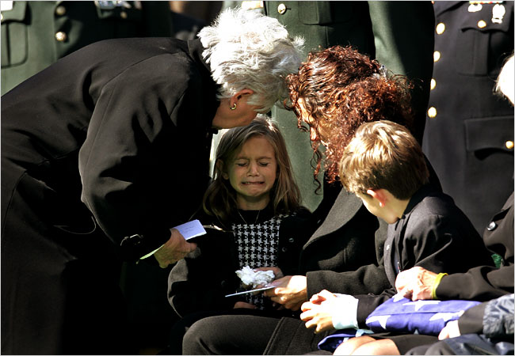
While he was still speaking, another also came and said, your sons and daughters were eating and drinking wine in their oldest brother’s house, and suddenly a great wind came from across the wilderness and struck the four corners of the house, and it fell on the young people, and they are dead . . . (Job 1:18-19)
Then the king was deeply moved, and went up to the chamber over the gate, and wept. And as he went, he said thus: O my son Absalom—my son, my son Absalom—if only I had died in your place! O Absalom my son, my son! (2 Samuel 18:33)

Slide 13
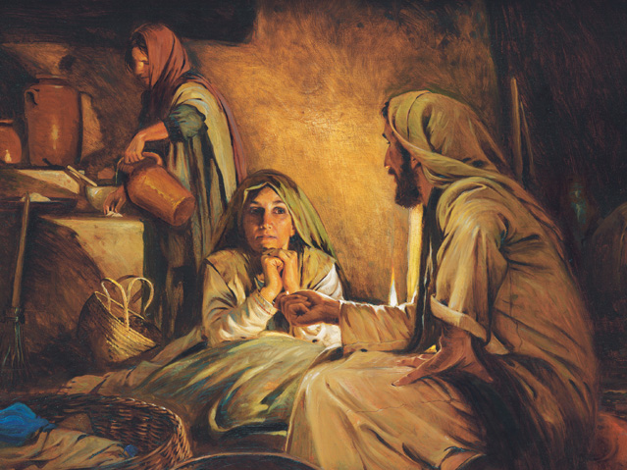
Does Jesus Care
But Martha was distracted with much serving, and she approached Him and said, Lord, do You not care that my sister has left me to serve alone? Therefore tell her to help me. (Luke 10:40)

Slide 14
Does Jesus Care
Then, when Mary came where Jesus was, and saw Him, she fell down at His feet, saying to Him, Lord, if You had been here, my brother would not have died. (John 11:32)

Slide 15
Does Jesus Care
And a great windstorm arose, and the waves beat into the boat, so that it was already filling. But He was in the stern, asleep on a pillow. And they awoke Him and said to Him, teacher, do You not care that we are perishing? (Mark 4:37-38)

Slide 16
Does Jesus Care
Oh yes, He cares, I know He cares, His heart is touched with my grief;
When the days are weary, the long nights dreary,
I know my Savior cares.
He cares.
Oh yes, He cares, I know He cares, His heart is touched with my grief;
When the days are weary, the long nights dreary,
I know my Savior cares.
He cares.

Slide 17
I Know My Savior Cares
Even though He does not immediately respond to my needs!
Even though I might be required to drink the bitter “cup.”
I Know, because of Calvary—Romans 8:32
He who did not spare His own Son, but delivered Him up for us all, how shall He not with Him also freely give us all things? (Romans 8:32)

Slide 18
In this you greatly rejoice, though now for a little while, if need be, you have been grieved by various trials, that the genuineness of your faith, being much more precious than gold that perishes, though it is tested by fire, may be found to praise, honor, and glory at the revelation of Jesus Christ, whom having not seen you love. (1 Peter 1:6-8)
Did we not cast three men bound into the midst of the fire? . . . Look! . . . I see four men loose, walking in the midst of the fire; and they are not hurt, and the form of the fourth is like the Son of God. (Daniel 3:24-25)

