Slide 2
John 5:1-9
¹ After this there was a feast of the Jews, and Jesus went up to Jerusalem. ² Now there is in Jerusalem by the Sheep Gate a pool, which is called in Hebrew, Bethesda, having five porches. ³ In these lay a great multitude of sick people, blind, lame, paralyzed, waiting for the moving of the water. ⁴ For an angel went down at a certain time into the pool and stirred up the water; then whoever stepped in first, after the stirring of the water, was made well of whatever disease he had. ⁵ Now a certain man was there who had an infirmity thirty-eight years. ⁶ When Jesus saw him lying there, and knew that he already had been in that condition a long time, He said to him, do you want to be made well? ⁷ The sick man answered Him, Sir, I have no man to put me into the pool when the water is stirred up; but while I am coming, another steps down before me. ⁸ Jesus said to him, rise, take up your bed and walk. ⁹ And immediately the man was made well, took up his bed, and walked. And that day was the Sabbath.

Slide 4
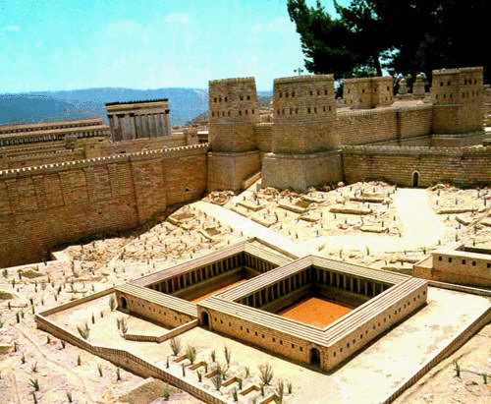
John 5:1-4
After this there was a feast of the Jews, and Jesus went up to Jerusalem. Now there is in Jerusalem by the Sheep Gate a pool, which is called in Hebrew, Bethesda, having five porches. In these lay a great multitude of sick people, blind, lame, paralyzed, waiting for the moving of the water. For an angel went down at a certain time into the pool and stirred up the water; then whoever stepped in first, after the stirring of the water, was made well of whatever disease he had.
John 5:1-4
After this there was a feast of the Jews, and Jesus went up to Jerusalem. Now there is in Jerusalem by the Sheep Gate a pool, which is called in Hebrew, Bethesda, having five porches. In these lay a great multitude of sick people, blind, lame, paralyzed, waiting for the moving of the water. For an angel went down at a certain time into the pool and stirred up the water; then whoever stepped in first, after the stirring of the water, was made well of whatever disease he had.
Pool of Bethesda

Slide 5
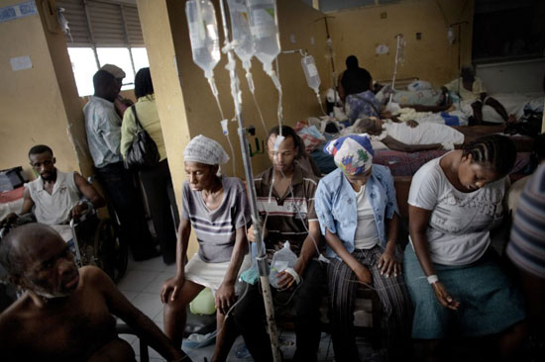
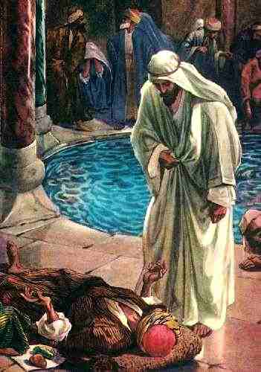
John 5:5-6
Now a certain man was there who had an infirmity thirty-eight years. When Jesus saw him lying there, and knew that he already had been in that condition a long time, He said to him,
“Do you want to be made well?”
The sick man answered Him, Sir, I have no man to put me into the pool when the water is stirred up; but while I am coming, another steps down before me. (Vs 7).
What did the man answer?
Yes, I want to be healed.
Yes, I want to be made new.
Yes, I want to walk, jump and run.

Slide 6
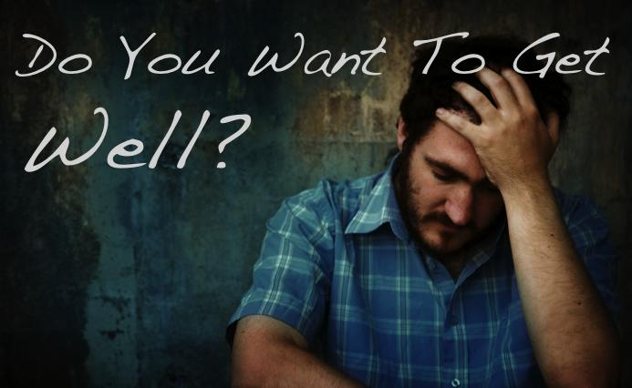
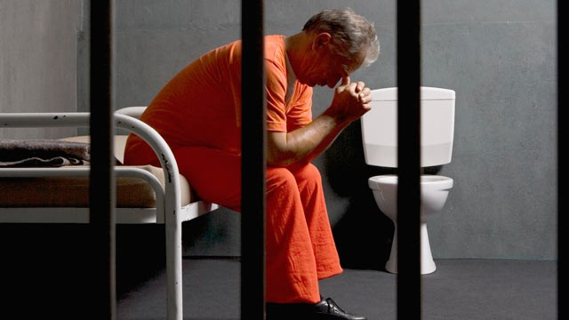
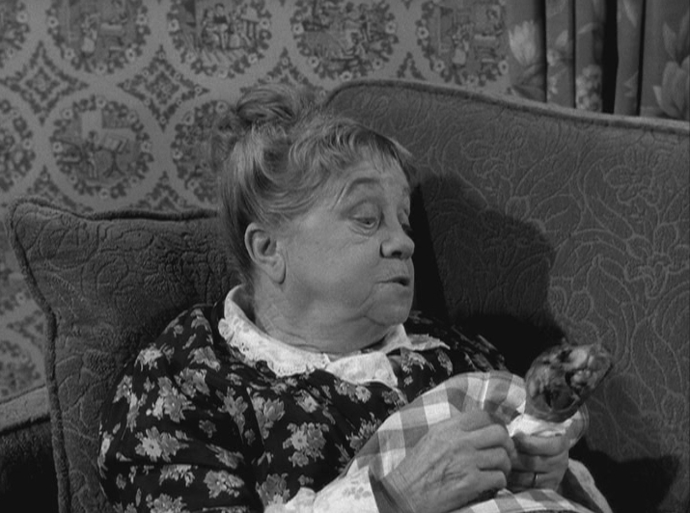
“She enjoys poor health”
“Men are anxious to improve their circumstances, but are unwilling to improve themselves; they therefore remain bound.” James Allen, British Philosopher and Poet

Slide 7
John 5:5-6
Now a certain man was there who had an infirmity thirty-eight years. When Jesus saw him lying there, and knew that he already had been in that condition a long time, He said to him,
“Do you want to be made well?”
The sick man answered Him, Sir, I have no man to put me into the pool when the water is stirred up; but while I am coming, another steps down before me. (Vs 7).

Slide 8
Or do I secretly enjoy victimhood?
Or do I keep blaming someone else for my difficulties?
Or am I afraid to “get well?”
Or do I just want relief—instead of a cure?

Slide 9
Do you really want your marriage to be better?
Do you really want to break your addictions / habits?
Do you really want to become more spiritual?
Do you really want your children to be more devout?
Do you really want to be saved?

