Slide 2
2 Timothy 4:9-16
⁹ Be diligent to come to me quickly; ¹⁰ for Demas has forsaken me, having loved this present world, and has departed for Thessalonica—Crescens for Galatia, Titus for Dalmatia. ¹¹ Only Luke is with me. Get Mark and bring him with you, for he is useful to me for ministry. ¹² And Tychicus I have sent to Ephesus. ¹³ Bring the cloak that I left with Carpus at Troas when you come—and the books, especially the parchments. ¹⁴ Alexander the coppersmith did me much harm. May the Lord repay him according to his works. ¹⁵ You also must beware of him, for he has greatly resisted our words. ¹⁶ At my first defense no one stood with me, but all forsook me. May it not be charged against them.

Slide 4
a time of new beginnings
But those who wait on the Lord shall renew their strength; They shall mount up with wings like eagles,

Slide 5
Attend services better
Read the Bible every day
Increase my contribution
Have family devotionals
Be more diligent in prayer
Going to be more spiritual

Slide 6
Demas had renounced his faith,
Crescens & Titus are serving elsewhere,
Tychicus is in Ephesus (only Luke is here),
Alexander the coppersmith working against Paul,
No one came to his defense,
Without his books and winter clothing,
Date of execution not yet set—come quickly!
Didn’t Think It Would Be Like This

Slide 7
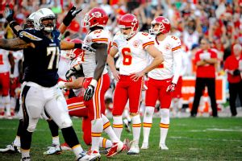

Slide 8
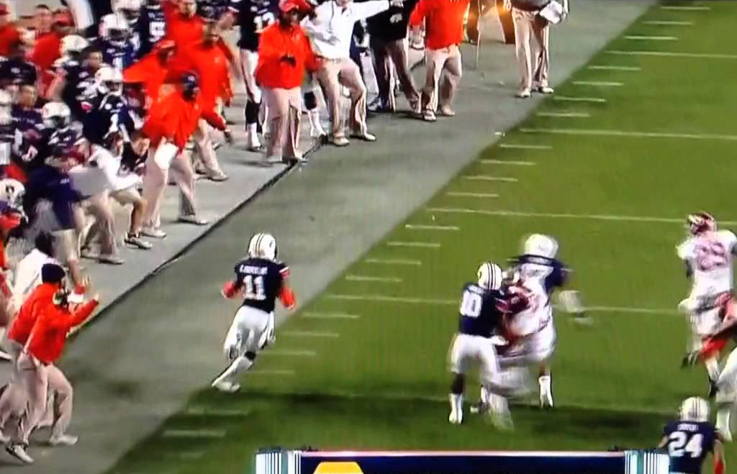

Slide 9
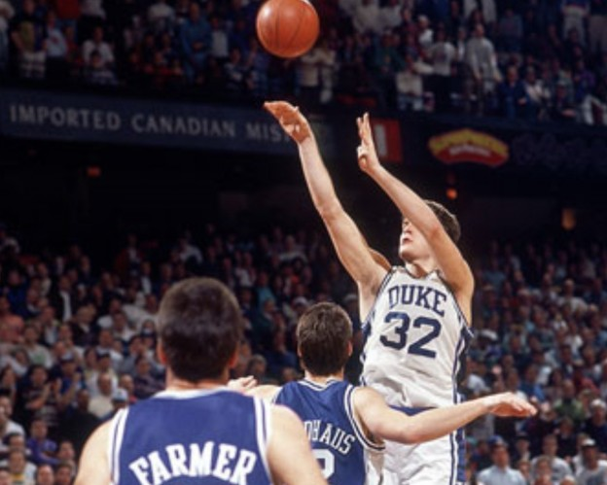

Slide 10
Battle the same Temptations as in 2013
Endure the same Faulty Believers as in 2013
Struggle with the Testing of our Faith as in 2013
Move Beyond Behavioral Reform (Rom 12:1-2; Eph 4:23-24; Phil 4:8; Heb 12:1)
Do Not Place Faith/Confidence in Men (2 Tim 4:10, 14; Gal 2:11-13; 2 Cor 10:12)
Remember your Troubles were not left behind (Jn 16:33; Psa 51:5; 1 Pet 1:6-7)

