Slide 2
Acts 9:1-6
¹ Then Saul, still breathing threats and murder against the disciples of the Lord, went to the high priest ² and asked letters from him to the synagogues of Damascus, so that if he found any who were of the Way, whether men or women, he might bring them bound to Jerusalem. ³ As he journeyed he came near Damascus, and suddenly a light shone around him from heaven. ⁴ Then he fell to the ground, and heard a voice saying to him, Saul, Saul, why are you persecuting Me? ⁵ And he said, who are You, Lord? Then the Lord said, I am Jesus, whom you are persecuting. It is hard for you to kick against the goads. ⁶ So he, trembling and astonished, said, Lord, what do You want me to do? Then the Lord said to him, arise and go into the city, and you will be told what you must do.

Slide 4
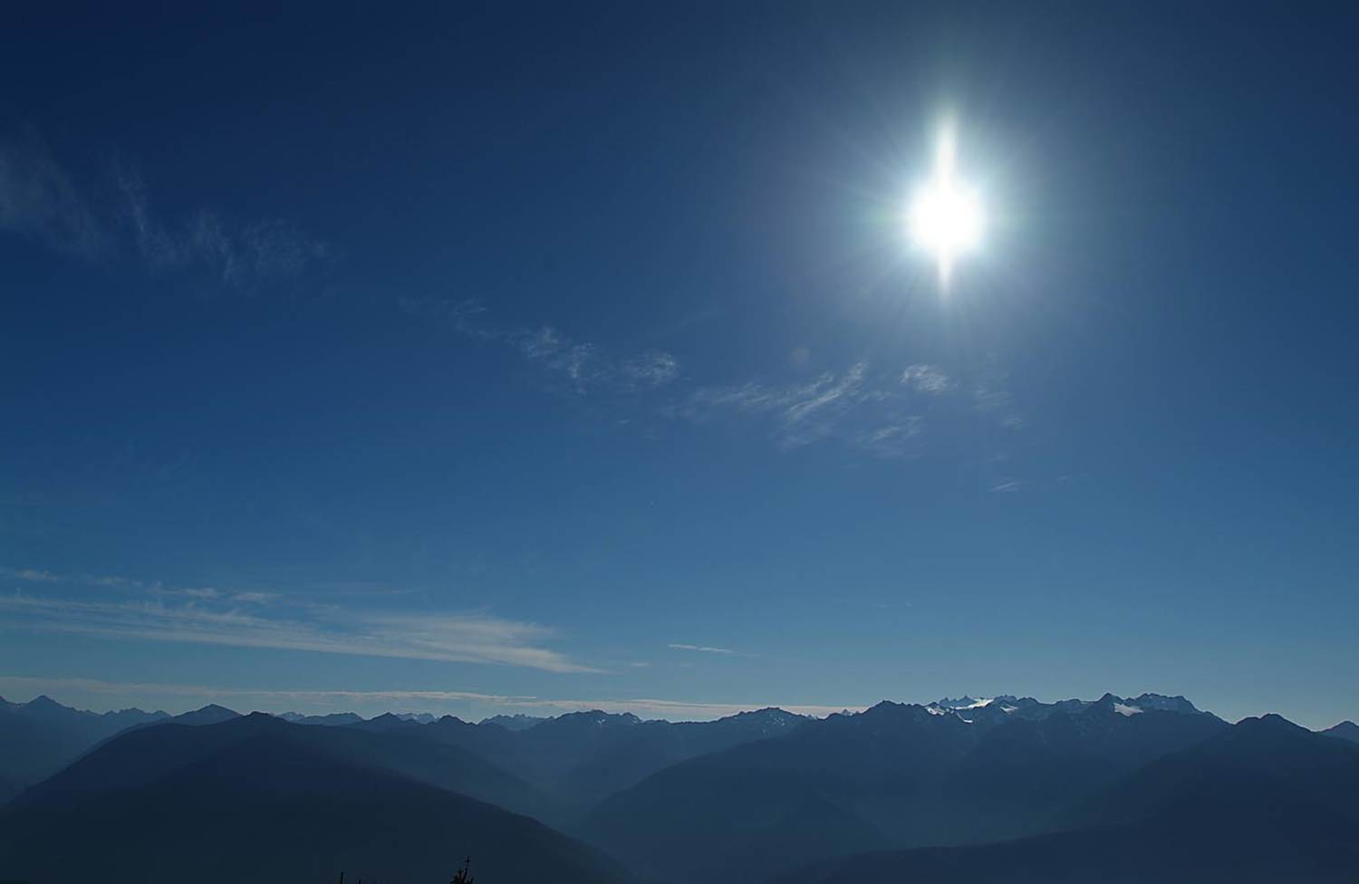
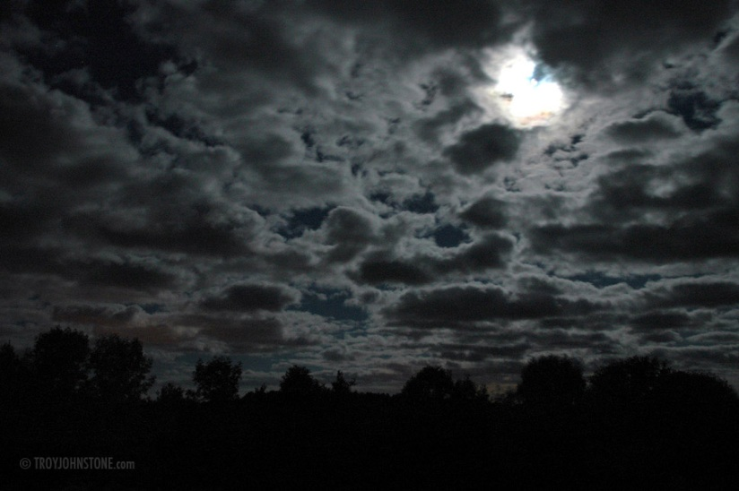
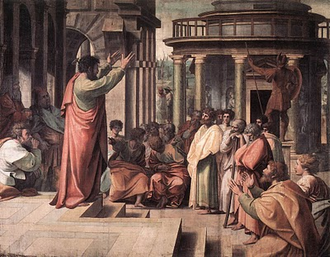
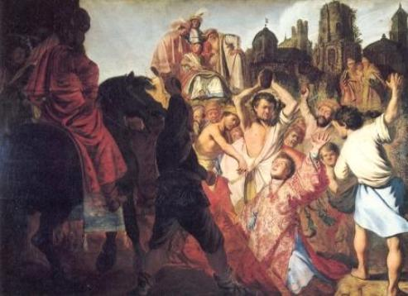
Saul of Tarsus
“Then they cried out with a loud voice, stopped their ears, and ran at him with one accord; and they cast him out of the city and stoned him. And the witnesses laid down their clothes at the feet of a young man named Saul”
(Acts 7:57-58)
“So, as much as is in me, I am ready to preach the gospel to you who are in Rome also. For I am not ashamed of the gospel of Christ, for it is the power of God to salvation for everyone who believes, for the Jew first and also for the Greek”
(Romans 1:15-16).

Slide 5
Conversion of Saul
Status Quo: Acts 9:1-2, Jewish Faith; Persecuting Christians; Sinner
New Information: Acts 9:3-5, Jesus is raised, Jesus is Lord
Chaos Sets In: Acts 9:6, 9, 11, Couldn’t eat; Constant Prayer
Different Attitude: Acts 9:6; 26:19; 22:16, Believed & Baptized
New Normal: Acts 9:20-23, Serving Christ in His kingdom
“Although I was formerly a blasphemer, a persecutor, and an insolent man; but I obtained mercy because I did it ignorantly in unbelief. And the grace of our Lord was exceedingly abundant, with faith and love which are in Christ Jesus.
(1 Timothy 1:13-14

