Slide 2
Matthew 11:1-6
¹ Now it came to pass, when Jesus finished commanding His twelve disciples, that He departed from there to teach and to preach in their cities. ² And when John had heard in prison about the works of Christ, he sent two of his disciples ³ and said to Him, are You the Coming One, or do we look for another? ⁴ Jesus answered and said to them, go and tell John the things which you hear and see: ⁵ The blind see and the lame walk; the lepers are cleansed and the deaf hear; the dead are raised up and the poor have the gospel preached to them. ⁶ And blessed is he who is not offended because of Me.

Slide 5
I believe Jesus established one church, and that only the obedient are added to it—but there are such good people in other churches.
I believe in the power of prayer—but what good did prayer do for my mother? She was a devout Christian and yet she died in spite of prayers.
I believe God exists and that He is good—but then I lose my job, and with no insurance my wife is unable to afford the operation doctors say she must have.
I believe the Bible is the inspired word of God—but is it possible that some books were left out, such as the gospel of Judas?
DOUBT

Slide 6
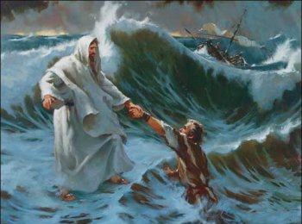
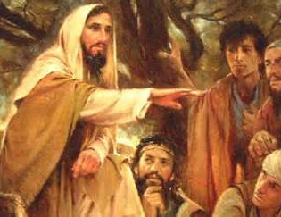
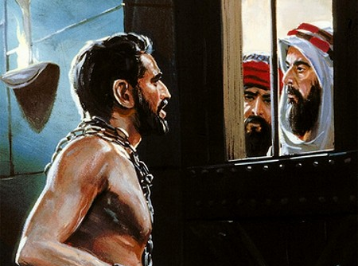
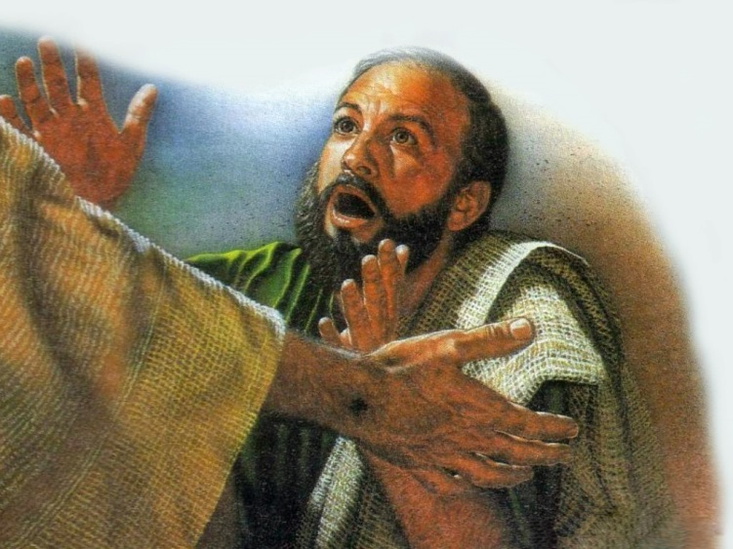
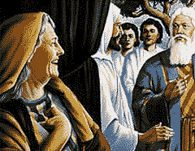
Doubters
. . . he was afraid; and beginning to sink he cried out, saying, Lord, save me! And immediately Jesus stretched out His hand and caught him, and said to him, O you of little faith, why did you doubt? (Matthew 14:30-31)
Therefore Sarah laughed within herself, saying, after I have grown old, shall I have pleasure, my lord being old also? (Genesis 18:12)
And when John had heard in prison about the works of Christ, he sent two of his disciples and said to Him, are You the Coming One, or do we look for another? (Matthew 11:2-3)
Then the eleven disciples went away into Galilee, to the mountain which Jesus had appointed for them. When they saw Him, they worshiped Him; but some doubted. (Matthew 28:17)
But if You can do anything, have compassion on us and help us.
(Mark 9:22)
Unless I see in His hands the print of the nails, and put my finger into the print of the nails, and put my hand into His side, I will not believe. (John 19:25)

Slide 7
Types of Doubt
Intellectual Doubt
Imagination Doubt
Emotional Doubt

Slide 8
Admit you are struggling with doubt (Mark 9:17-24)
Choose to believe (John 20:28-29)
“Borrow” some faith (Acts 4:36-37; Hebrews 10:24-25)
Act on your faith not your doubts (Luke 5:5)
Doubt your doubts not your faith (Hebrews 11:17-19)
Realize there some things you will never understand (Isa 55:9; Job 38:4)
Trust the Lord despite the storm (2 Tim 1:12: Acts 27:25; Mark 9:24)

