Slide 2
Psalm 127:1-5
¹ Unless the Lord builds the house, they labor in vain who build it; unless the Lord guards the city, the watchman stays awake in vain. ² It is vain for you to rise up early, to sit up late, to eat the bread of sorrows; for so He gives His beloved sleep. ³ Behold, children are a heritage from the Lord, The fruit of the womb is a reward. ⁴ Like arrows in the hand of a warrior, so are the children of one’s youth. ⁵ Happy is the man who has his quiver full of them; They shall not be ashamed, but shall speak with their enemies in the gate.

Slide 4
A Heritage from the LORD

Slide 5
The “Rights” of Children
“But if anyone does not provide for his own, and especially for those of his household, he has denied the faith and is worse than an unbeliever,” (1 Tim 5:8).
“For the children ought not to lay up for the parents, but the parents for the children,” (2 Cor 12:14).

Slide 6
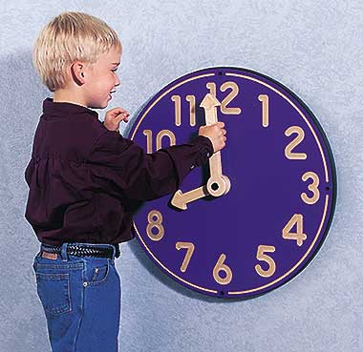
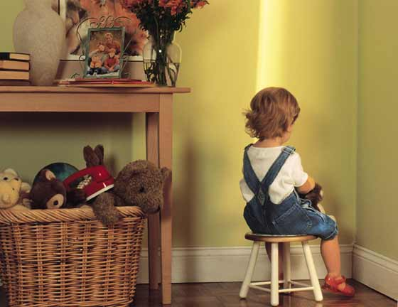
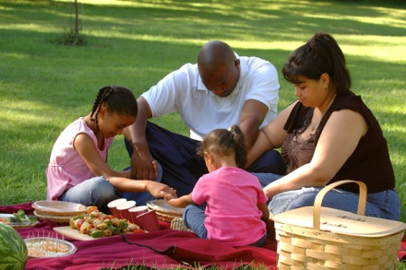
The “Rights” of Children
A Right to your Time
A Right to Proper Development
A Right to be Disciplined
A Right to Good Role Models

