Slide 2
Joshua 14:7-12
⁷ I was forty years old when Moses the servant of the Lord sent me from Kadesh Barnea to spy out the land, and I brought back word to him as it was in my heart. ⁸ Nevertheless my brethren who went up with me made the heart of the people melt, but I wholly followed the Lord my God. ⁹ So Moses swore on that day, saying, surely the land where your foot has trodden shall be your inheritance and your children’s forever, because you have wholly followed the Lord my God. ¹⁰ And now, behold, the Lord has kept me alive, as He said, these forty-five years, ever since the Lord spoke this word to Moses while Israel

Slide 3
Joshua 14:7-12
wandered in the wilderness; and now, here I am this day, eighty-five years old. ¹¹ As yet I am as strong this day as on the day that Moses sent me; just as my strength was then, so now is my strength for war, both for going out and for coming in. ¹² Now therefore, give me this mountain of which the Lord spoke in that day; for you heard in that day how the Anakim were there, and that the cities were great and fortified. It may be that the Lord will be with me, and I shall be able to drive them out as the Lord said.

Slide 5
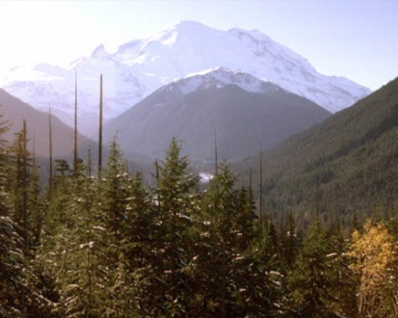
Joshua 14:7-12
wandered in the wilderness; and now, here I am this day, eighty-five years old. ¹¹ As yet I am as strong this day as on the day that Moses sent me; just as my strength was then, so now is my strength for war, both for going out and for coming in. ¹² Now therefore, give me this mountain of which the Lord spoke in that day; for you heard in that day how the Anakim were there, and that the cities were great and fortified. It may be that the Lord will be with me, and I shall be able to drive them out as the Lord said.
wandered in the wilderness; and now, here I am this day, eighty-five years old. ¹¹ As yet I am as strong this day as on the day that Moses sent me; just as my strength was then, so now is my strength for war, both for going out and for coming in. ¹² Now therefore, give me this mountain of which the Lord spoke in that day; for you heard in that day how the Anakim were there, and that the cities were great and fortified. It may be that the Lord will be with me, and I shall be able to drive them out as the Lord said.

Slide 6
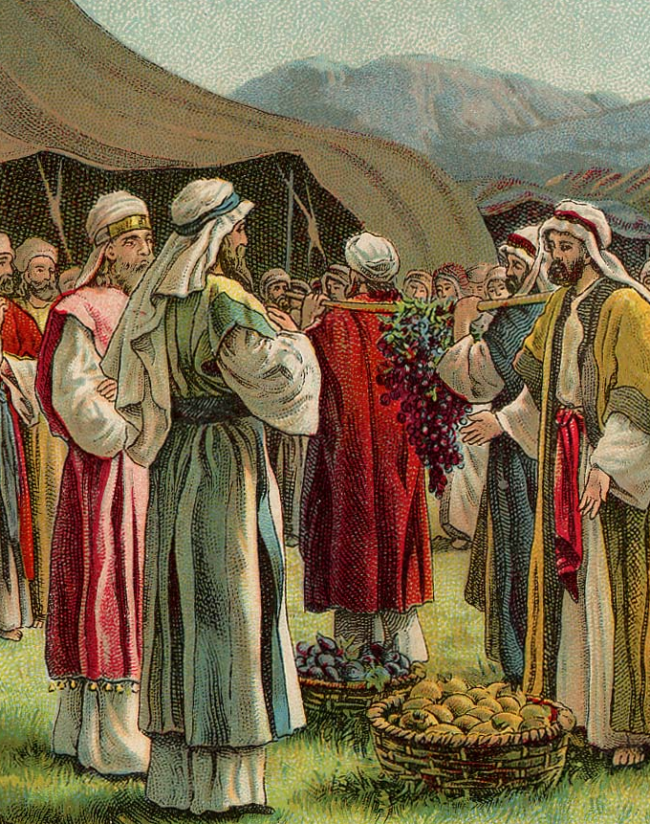
Spies’ Report
Numbers 13
³⁰ Then Caleb quieted the people before Moses, and said, let us go up at once and take possession, for we are well able to overcome it.
³¹ But the men who had gone up with him said, we are not able to go up against the people, for they are stronger than we. ³² And they gave the children of Israel a bad report of the land which they had spied out, saying, the land through which we have gone as
spies is a land that devours its inhabitants, and all the people whom we saw in it are men of great stature. ³³ There we saw the giants (the descendants of Anak came from the giants); and we were like grasshoppers in our own sight, and so we were in their sight.
²⁷ It truly flows with milk and honey, and this is its fruit. ²⁸ Nevertheless the people who dwell in the land are strong; the cities are fortified and very large; moreover we saw the descendants of Anak there. ²⁹ The Amalekites dwell in the land of the South; the Hittites, the Jebusites, and the Amorites dwell in the mountains; and the Canaanites dwell by the sea and along the banks of the Jordan.

Slide 7
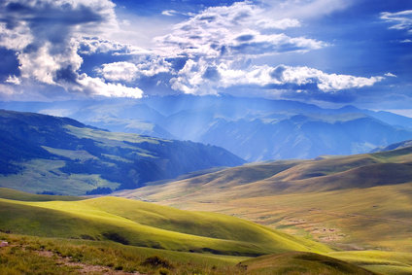
Caleb’s Mountain
Caleb’s Mountain
Because he had a different spirit in him (Vs 7; Num 14:24)
Because he wholly followed the Lord (Vs 8; Num 14:9)
Because he understood God’s purpose (Vs 10; Num 14:30)
Because he refused to use age as an excuse (Vs 11)
Because he patiently waited on God (Vs 12; Num 14:30)
“Now therefore, give me this mountain of which the Lord spoke in that day . . .”

Slide 8
Blessed be the God and Father of our Lord Jesus Christ, who according to His abundant mercy has begotten us again to a living hope through the resurrection of Jesus Christ from the dead, to an inheritance incorruptible and undefiled and that does not fade away, reserved in heaven for you, who are kept by the power of God through faith for salvation ready to be revealed in the last time.
(1 Peter 1:3-5)

