Slide 2
Matthew 23:16-22
¹⁶ Woe to you, blind guides, who say, whoever swears by the temple, it is nothing; but whoever swears by the gold of the temple, he is obliged to perform it. ¹⁷ Fools and blind! For which is greater, the gold or the temple that sanctifies the gold? ¹⁸ And, whoever swears by the altar, it is nothing; but whoever swears by the gift that is on it, he is obliged to perform it. ¹⁹ Fools and blind! For which is greater, the gift or the altar that sanctifies the gift? ²⁰ Therefore he who swears by the altar, swears by it and by all things on it. ²¹ He who swears by the temple, swears by it and by Him who dwells in it. ²² And he who swears by heaven, swears by the throne of God and by Him who sits on it.

Slide 4
Jesus Knew Some Fools
“Fools and blind! For which is greater, the gold or the temple that sanctifies the gold?” (Matthew 23:17)
“Fools and blind! For which is greater, the gift or the altar that sanctifies the gift?” (Matthew 23:19)

Slide 5
Jesus Knew Some Fools
“Now five of them were wise, and five were foolish. Those who were foolish took their lamps and took no oil with them, but the wise took oil in their vessels with their lamps. But while the bridegroom was delayed, they all slumbered and slept.” (Matthew 25:2-5)

Slide 6
Jesus Knew Some Fools
“Then He said to them, O foolish ones, and slow of heart to believe in all that the prophets have spoken! Ought not the Christ to have suffered these things and to enter into His glory? And beginning at Moses and all the Prophets, He expounded to them in all the Scriptures the things concerning Himself.” (Luke 24:25-27)

Slide 7
Jesus Knew Some Fools
“But everyone who hears these sayings of Mine, and does not do them, will be like a foolish man who built his house on the sand: and the rain descended, the floods came, and the winds blew and beat on that house; and it fell. And great was its fall.” (Matthew 7:26-27)

Slide 8
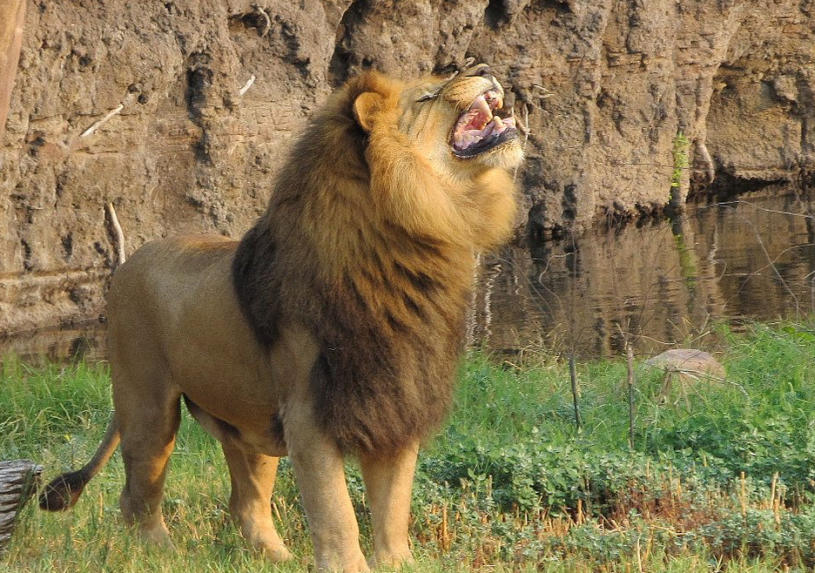
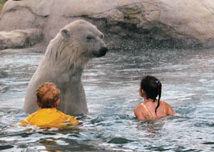
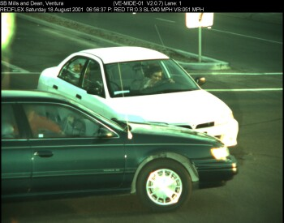
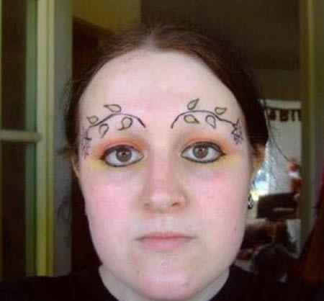
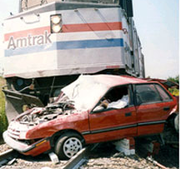
Some Very Foolish Decisions

Slide 9
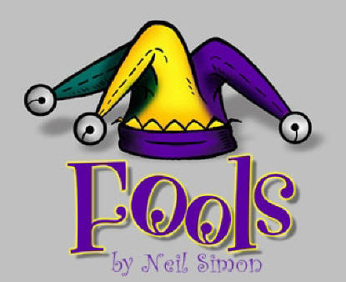
Bible

Slide 10
Bible Fools
Those Who Deny the Existence of God ~ Psalm 14:1
Those Who “Cherry-Pick” the Bible ~ Luke 24:25-27
Those Who Mock (Lampoon) Sin ~ Proverbs 14:9
Those Who Trust in Their Own Heart ~ Proverbs 28:26
Those Who Are Covetous ~ Luke 12:16-21; (Vs 15)

Slide 11
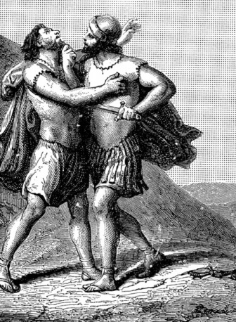
Do Not Die as a Fool
Then David said to Joab and to all the people who were with him, tear your clothes, gird yourselves with sackcloth, and mourn for Abner. And King David followed the coffin. So they buried Abner in Hebron; and the king lifted up his voice and wept at the grave of Abner, and all the people wept. And the king sang a lament over Abner and said:
Should Abner die as a fool dies? Your hands were not bound nor your feet put into fetters; as a man falls before wicked men, so you fell. Then all the people wept over him again.
(2 Samuel 3:33)
Then David said to Joab and to all the people who were with him, tear your clothes, gird yourselves with sackcloth, and mourn for Abner. And King David followed the coffin. So they buried Abner in Hebron; and the king lifted up his voice and wept at the grave of Abner, and all the people wept. And the king sang a lament over Abner and said:
Should Abner die as a fool dies? Your hands were not bound nor your feet put into fetters; as a man falls before wicked men, so you fell. Then all the people wept over him again.
(2 Samuel 3:33)

