Slide 2
2 Kings 4:1-7
¹ A certain woman of the wives of the sons of the prophets cried out to Elisha, saying, your servant my husband is dead, and you know that your servant feared the Lord. And the creditor is coming to take my two sons to be his slaves. ² So Elisha said to her, what shall I do for you? Tell me, what do you have in the house? And she said, your maidservant has nothing in the house but a jar of oil. ³ Then he said, go, borrow vessels from everywhere, from all your neighbors—empty vessels; do not gather just a few. ⁴ And when you have come in, you shall shut the door behind you and your sons; then pour it into all those vessels, and set aside the full ones. ⁵ So she went from him and shut the door behind her and her sons, who brought the vessels to her; and she poured it out. ⁶ Now it came to pass, when the vessels were full, that she said to her son, bring me another vessel. And he said to her, there is not another vessel. So the oil ceased. ⁷ Then she came and told the man of God. And he said, go, sell the oil and pay your debt; and you and your sons live on the rest.

Slide 4
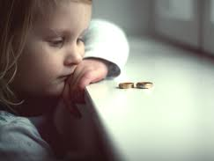
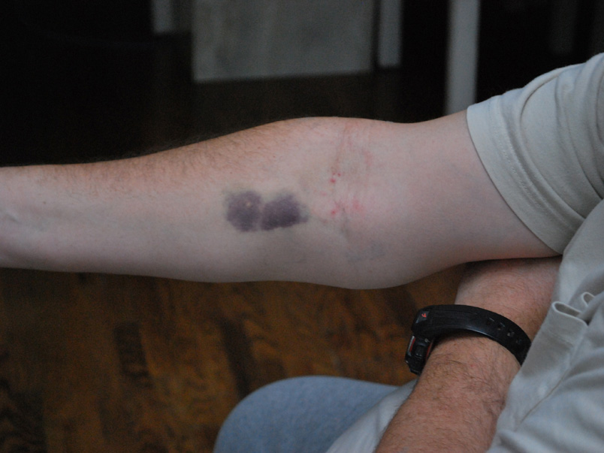
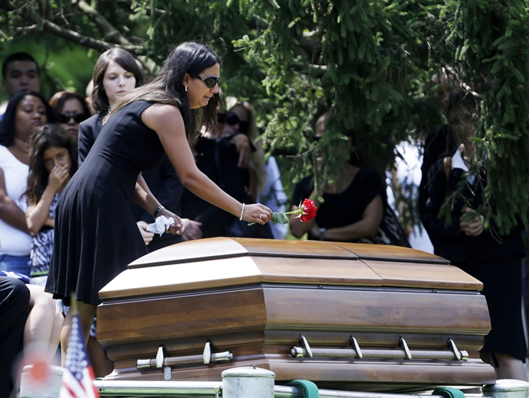
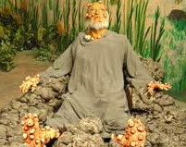
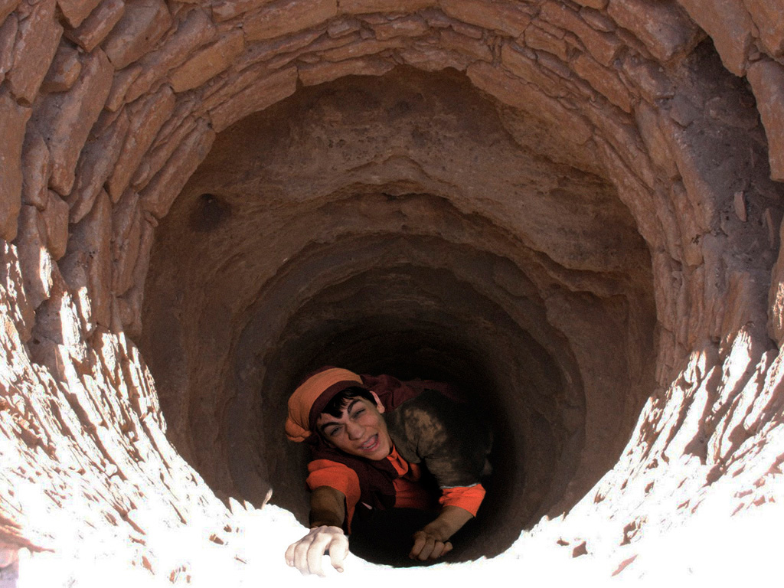
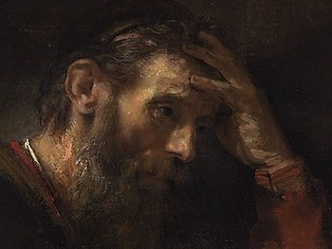
At the End of the Rope
Joseph
Job
At the End of the Rope
Peter
Paul

Slide 5
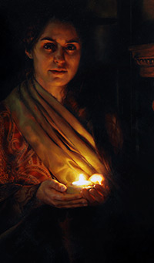
At the End of the Rope—2 Ki 4:1-7
Despair (A certain woman . . . cried out to Elisha, vs 1).
Death (My husband is dead, vs 1).
Debt (The creditor is coming to take my two sons to be his slaves, vs 1).
Devotion (You know that your servant [my husband] feared the Lord, vs 1).

Slide 6
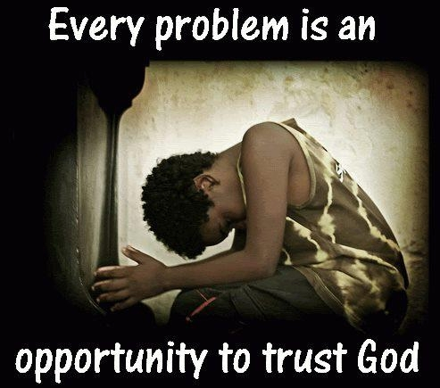
She Took Her Problems To God
What do you want (expect to be) done?
What do you have in the house (to ease the situation)?

Slide 7
Her Faith Was Greatly Tested
Then he said, go, borrow vessels from everywhere, from all your neighbors—empty vessels; do not gather just a few. And when you have come in, you shall shut the door behind you and your sons; then pour it into all those vessels, and set aside the full ones (2 Ki 4:3-4).

Slide 8
She Learned to Fully Trust God
So she went from him and shut the door behind her and her sons, who brought the vessels to her; and she poured it out. Now it came to pass, when the vessels were full, that she said to her son, bring me another vessel. And he said to her, there is not another vessel. So the oil ceased. Then she came and told the man of God. And he said, go, sell the oil and pay your debt; and you and your sons live on the rest (2 Ki 4:5-7)

