Slide 2
Ephesians 6:10-20
¹⁰ Finally, my brethren, be strong in the Lord and in the power of His might. ¹¹ Put on the whole armor of God, that you may be able to stand against the wiles of the devil. ¹² For we do not wrestle against flesh and blood, but against principalities, against powers, against the rulers of the darkness of this age, against spiritual hosts of wickedness in the heavenly places. ¹³ Therefore take up the whole armor of God, that you may be able to withstand in the evil day, and having done all, to stand. ¹⁴ Stand therefore, having girded your waist with truth, having put on the breastplate of righteousness, ¹⁵ and having shod your feet with the preparation of the gospel of peace; ¹⁶ above all, taking the shield of faith with which you will be able to quench all the fiery darts of the wicked one. ¹⁷ And take the helmet of salvation, and the sword of the Spirit, which is the word of God; ¹⁸ praying always with all prayer and supplication in the Spirit, being watchful to this end with all perseverance and supplication for all the saints— ¹⁹ and for me, that utterance may be given to me, that I may open my mouth boldly to make known the mystery of the gospel, ²⁰ for which I am an ambassador in chains; that in it I may speak boldly, as I ought to speak.

Slide 4
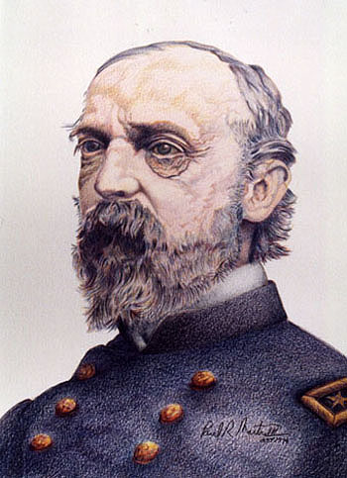
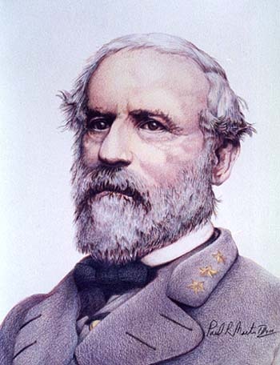
Battle of Gettysburg
July 1-3, 1863
George G. Meade
Robert E. Lee

Slide 5
³ For though we walk in the flesh, we do not war according to the flesh. ⁴ For the weapons of our warfare are not carnal but mighty in God . . .
(2 Corinthians 10:3-4)
Who ever goes to war at his own expense? (1 Cor 9:7).
You may wage the good warfare (1 Tim 1:18).
You therefore must endure hardship as a good soldier of Jesus Christ. No one engaged in warfare entangles himself with the affairs of this life, that he may please him who enlisted him as a soldier. (2 Tim 2:3-4).

Slide 6
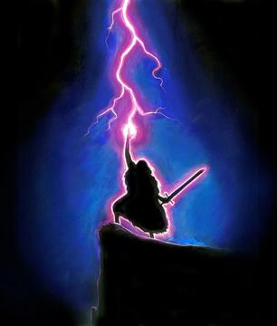
spiritual hosts of wickedness in the heavenly places.
Eph 6:12
For we do not wrestle against flesh and blood . . .
Eph 6:12
but against principalities, against powers . . .
Eph 6:12
the rulers of the darkness of this age . . .
Eph 6:12
Deborah & Barak vs. Canaanites
Samson vs. Philistines
For your very SOUL
David vs. Goliath

Slide 7
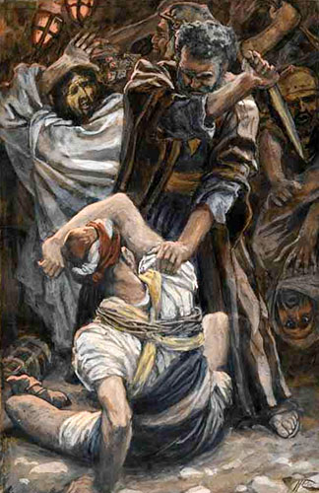
“My kingdom is not of this world. If My kingdom were of this world, My servants would fight, so that I should not be delivered to the Jews; but now My kingdom is not from here.” (John 18:36)
“Then they came and laid hands on Jesus and took Him. ⁵¹ And suddenly, one of those who were with Jesus stretched out his hand and drew his sword, struck the servant of the high priest, and cut off his ear. ⁵² But Jesus said to him, put your sword in its place, for all who take the sword will perish by the sword. ⁵³ Or do you think that I cannot now pray to My Father, and He will provide Me with more than twelve legions of angels? ⁵⁴ How then could the Scriptures be fulfilled, that it must happen thus?”
(Matthew 26:50-54)

Slide 8
Joshua’s Army

Slide 9
Gideon’s Army

Slide 10
Israel’s Army

Slide 11
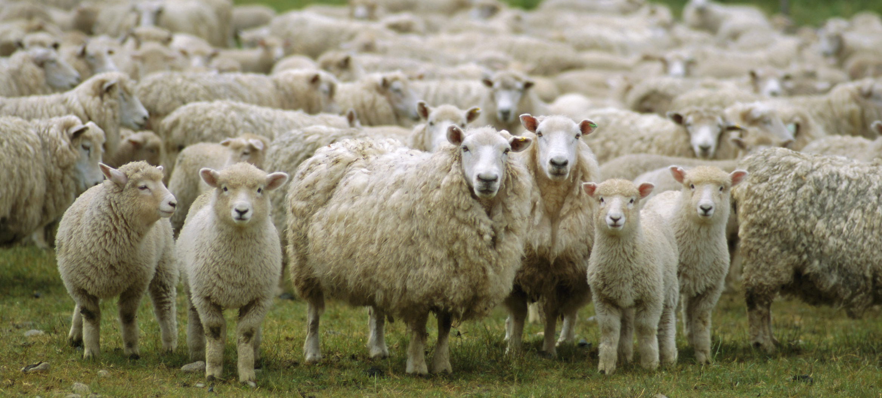
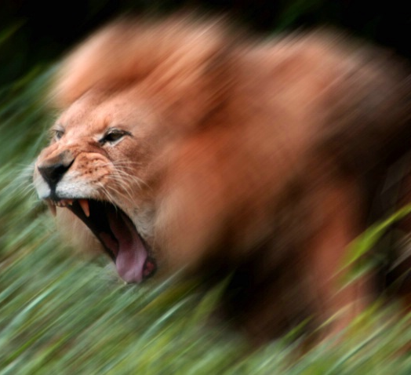
As it is written: For Your sake we are killed all day long; we are accounted as sheep for the slaughter. Yet in all these things we are more than conquerors through Him who loved us.
(Romans 8:36-37).
It is He who has made us, and not we ourselves; we are His people and the sheep of His pasture (Psalm 100:3).
For He is our God, and we are the people of His pasture, and the sheep of His hand (Psalm 95:7).
Go your way; behold, I send you out as lambs among wolves (Luke 10:3).
1 Peter 5:8
³ For though we walk in the flesh, we do not war according to the flesh. ⁴ For the weapons of our warfare are not carnal but mighty in God . . .
(2 Corinthians 10:3-4)

Slide 12
Forces of Satan
Lust of the Flesh
Lust of the Eyes
Pride of Life

Slide 13
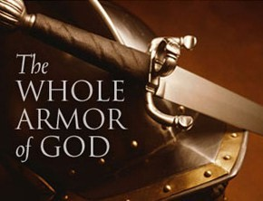

Slide 14
¹⁰ Finally, my brethren, be strong in the Lord and in the power of His might. ¹¹ Put on the whole armor of God, that you may be able to stand against the wiles of the devil. ¹² For we do not wrestle against flesh and blood, but against principalities, against powers, against the rulers of the darkness of this age, against spiritual hosts of wickedness in the heavenly places. ¹³ Therefore take up the whole armor of God, that you may be able to withstand in the evil day, and having done all, to stand. ¹⁴ Stand therefore, having girded your waist with truth, having put on the breastplate of righteousness, ¹⁵ and having shod your feet with the preparation of the gospel of peace; ¹⁶ above all, taking the shield of faith with which you will be able to quench all the fiery darts of the wicked one. ¹⁷ And take the helmet of salvation, and the sword of the Spirit, which is the word of God; ¹⁸ praying always with all prayer and supplication in the Spirit,

