Slide 2
Ezekiel 16:44-50
⁴⁴ Indeed everyone who quotes proverbs will use this proverb against you: Like mother, like daughter! ⁴⁵ You are your mother’s daughter, loathing husband and children; and you are the sister of your sisters, who loathed their husbands and children; your mother was a Hittite and your father an Amorite. ⁴⁶ Your elder sister is Samaria, who dwells with her daughters to the north of you; and your younger sister, who dwells to the south of you, is Sodom and her daughters. ⁴⁷ You did not walk in their ways nor act according to their abominations; but, as if that were too little, you became more corrupt than they in all your ways. ⁴⁸ As I live, says the Lord God, neither your sister Sodom nor her daughters have done as you and your daughters have done. ⁴⁹ Look, this was the iniquity of your sister Sodom: She and her daughter had pride, fullness of food, and abundance of idleness; neither did she strengthen the hand of the poor and needy. ⁵⁰ And they were haughty and committed abomination before Me; therefore I took them away as I saw fit.

Slide 4
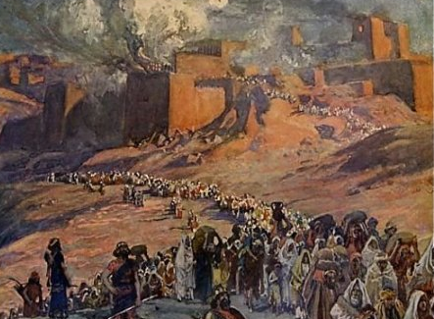
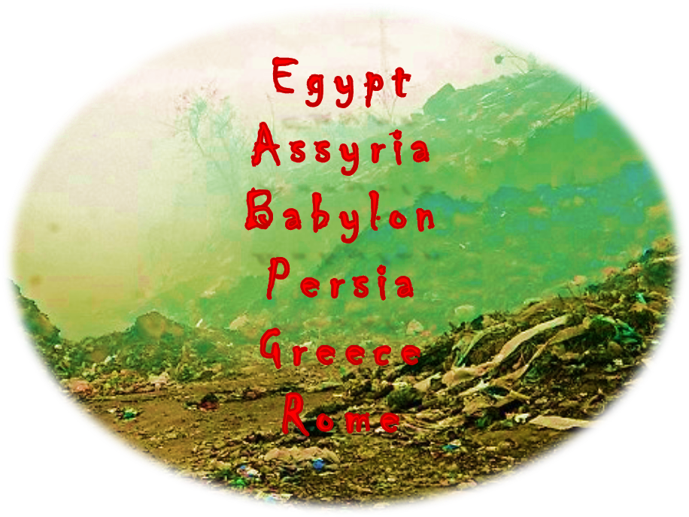
Righteousness exalts a nation, but sin
is a reproach to any people
Proverbs 14:34
Righteousness exalts a nation, but sin
is a reproach to any people
Proverbs 14:34
Moral Character no different from people before you (Ezek 16:2-3)
They had broken their covenant/promise with God (Ezek 16:8,15)
Their sins had become worse than sins of Sodom (Ezek 16:47-48)

Slide 5
Righteousness exalts a nation, but sin
is a reproach to any people
Proverbs 14:34
Star Spangled Banner
Francis Scott Key (1814)
O, thus be it ever when freemen shall stand,
Between their loved homes and the war's desolation;
Blest with victory and peace, may the heaven-rescued land
Praise the Power that hath made and preserved us a nation!
Then conquer we must, when our cause is just,
And this be our motto: "In God is our trust"
And the star-spangled banner in triumph shall wave
O'er the land of the free and the home of the brave!
George Washington’s Farewell Address
1796
Of all the dispositions and habits which lead to political prosperity, religion and morality are indispensable supports. In vain would that man claim the tribute of patriotism, who should labor to subvert these great pillars of human happiness, these firmest props of the duties of men and citizens . . . And let us with caution indulge the supposition that morality can be maintained without religion. Whatever may be conceded to the influence of refined education on minds of peculiar structure, reason and experience both forbid us to expect that national morality can prevail in exclusion of religious principle.
Declaration of Independence
When in the Course of human events, it becomes necessary for one people to dissolve the political bands which have connected them with another, and to assume among the powers of the earth, the separate and equal station to which the Laws of Nature and of Nature's God entitle them, a decent respect to the opinions of mankind requires that they should declare the causes which impel them to the separation.
We hold these truths to be self-evident, that all men are created equal, that they are endowed by their Creator with certain unalienable Rights, that among these are Life, Liberty and the pursuit of Happiness . . .
America The Beautiful
Katharine Lee Bates (1895)
O beautiful for spacious skies, for amber waves of grain, for purple mountain majesties above the fruited plain! America! America! God shed his grace on thee and crown thy good with brotherhood from sea to shining sea!
O beautiful for pilgrim feet whose stern impassioned stress a thoroughfare of freedom beat across the wilderness! America! America! God mend thine every flaw; confirm thy soul in self-control, thy liberty in law!

Slide 6
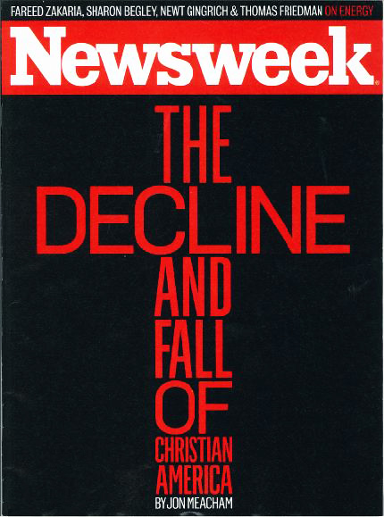
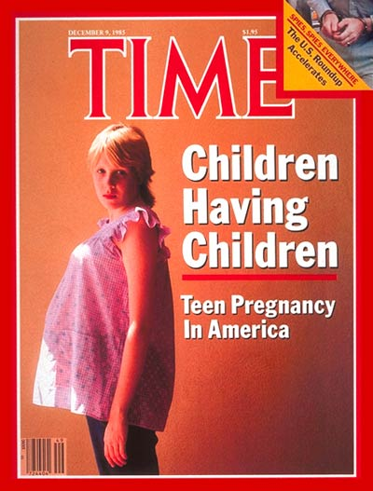
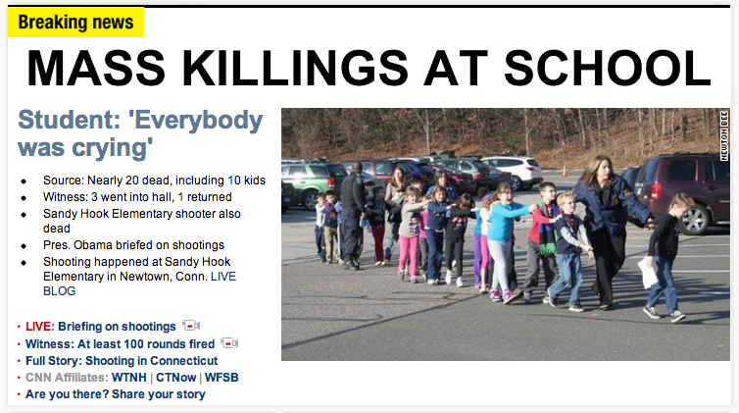
Is America
falling
apart?

Slide 7
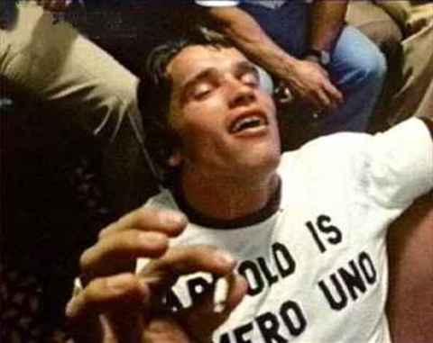
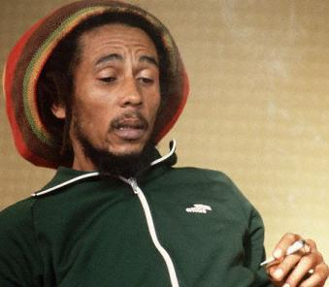
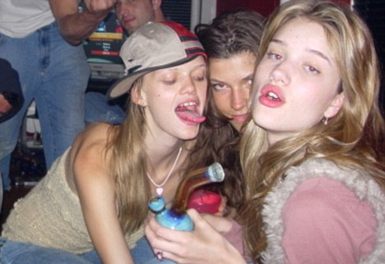
Is America
falling
apart?

Slide 8
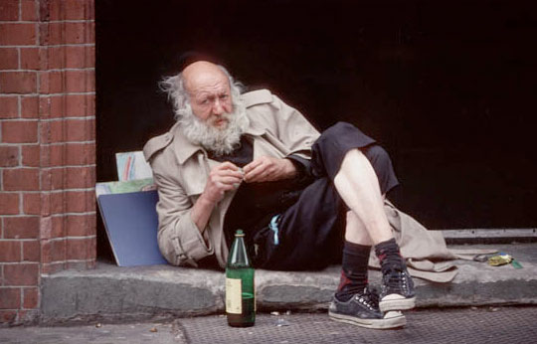
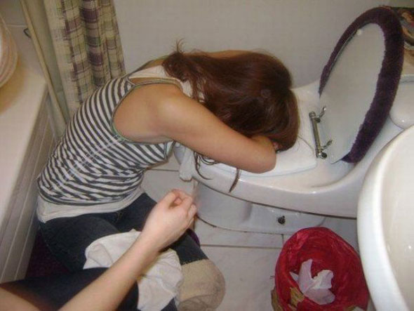
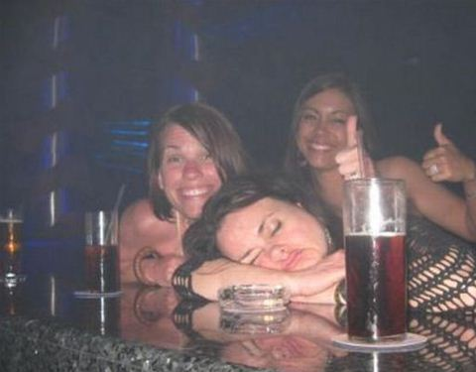
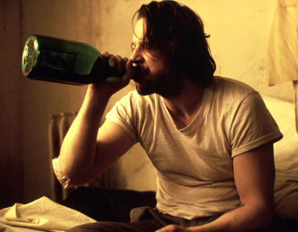
Is America
falling
apart?

Slide 9
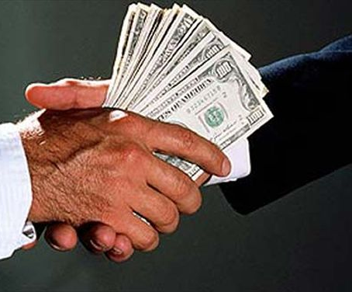
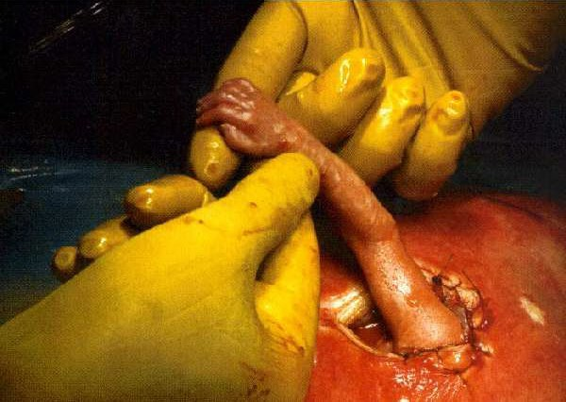
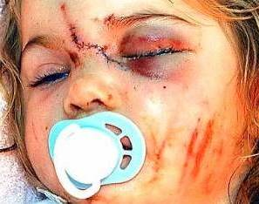
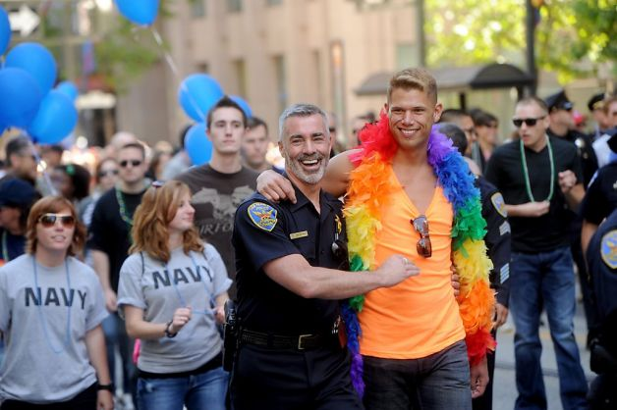
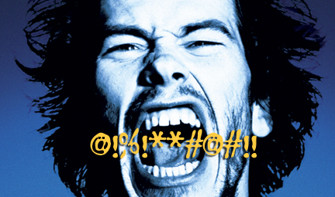
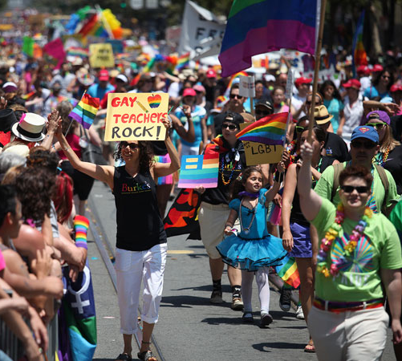
Is America
falling
apart?
Abortion
Child
Abuse
Corrupt
Politicians
Divorce
Homosexuality
Lesbianism
Dishonesty
“Shacking Up”

Slide 10
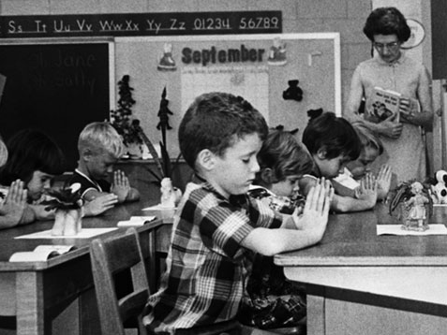
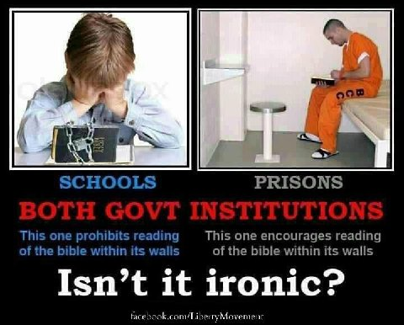
A Florida school teacher humiliated a 12-year-old boy in front of an entire class after she caught him reading the Bible during free reading time.
The teacher, at Park Lakes Elementary School in Fort Lauderdale, ordered Giovanni Rubeo to pick up the telephone on her desk and call his parents.
As the other students watched, the teacher left a terse message on the family’s answering machine.
“I noticed that he has a book – a religious book – in the classroom,” she said on the recording. “He’s not permitted to read those books in my classroom.”

Slide 11
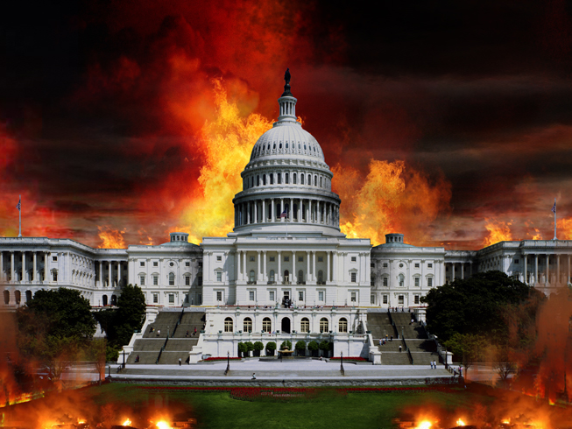
Righteousness exalts a nation, but sin
is a reproach to any people
Proverbs 14:34
Is America
falling
apart?
Ezekiel 16:49
Filled With Pride
Fullness of Bread
Abundance of Idleness
Neglecting the Poor

