Slide 2
1 Peter 1:3-9
³ Blessed be the God and Father of our Lord Jesus Christ, who according to His abundant mercy has begotten us again to a living hope through the resurrection of Jesus Christ from the dead, ⁴ to an inheritance incorruptible and undefiled and that does not fade away, reserved in heaven for you, ⁵ who are kept by the power of God through faith for salvation ready to be revealed in the last time. ⁶ In this you greatly rejoice, though now for a little while, if need be, you have been grieved by various trials, ⁷ that the genuineness of your faith, being much more precious than gold that perishes, though it is tested by fire, may be found to praise, honor, and glory at the revelation of Jesus Christ, ⁸ whom having not seen you love. Though now you do not see Him, yet believing, you rejoice with joy inexpressible and full of glory, ⁹ receiving the end of your faith—the salvation of your souls.

Slide 4
“Therefore, if anyone is in Christ, he is a new creation; old things have passed away; behold, all things have become new”
(2 Corinthians 5:17).

Slide 6
Blessed are those who mourn, for they shall be comforted (Matt 5:4)

Slide 7
. . . be clothed with humility, for God resists the proud,
but gives grace to the humble
( 1 Pet 5:5)

Slide 8
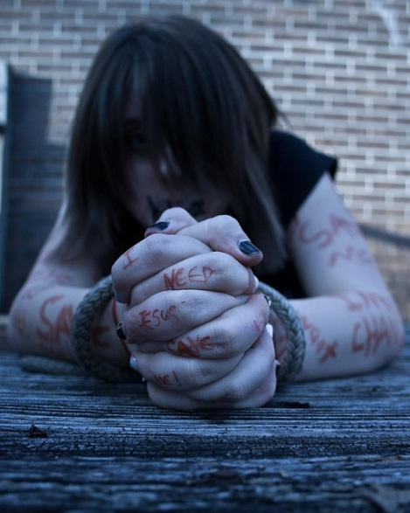
Though your sins are like scarlet, they shall be as white as snow; though they are red like crimson, they shall be as wool
(Isa 1:18)

Slide 9
Although I was formerly a blasphemer, a persecutor, and an insolent man; but I obtained mercy because I did it ignorantly in unbelief. And the grace of our Lord was exceedingly abundant, with faith and love which are in Christ Jesus (1 Tim 1:13-14).
Although I was formerly a blasphemer, a persecutor, and an insolent man; but I obtained mercy because I did it ignorantly in unbelief. And the grace of our Lord was exceedingly abundant, with faith and love which are in Christ Jesus (1 Tim 1:13-14).
Many will say to Me in that day, Lord, Lord, have we not prophesied in Your name, cast out demons in Your name, and done many wonders in Your name? And then I will declare to them, I never knew you; depart from Me, you who practice lawlessness!
(Matt 7:22-23)

Slide 10
Romans 5:6-10
Galatians 2:20
John 4:6-19
Luke 7:36-50
A Living Hope
Heaven
Salvation of Souls

Slide 11
Blessed be the God and Father of our Lord Jesus Christ, who according to His abundant mercy has begotten us again to a living hope through the resurrection of Jesus Christ from the dead . . .
(1 Pet 1:3)

