Slide 2
1 Corinthians 16:13-18
13 Watch, stand fast in the faith, be brave, be strong. 14 Let all that you do be done with love. 15 I urge you, brethren-- you know the household of Stephanas, that it is the firstfruits of Achaia, and that they have devoted themselves to the ministry of the saints–16 that you also submit to such, and to everyone who works and labors with us. 17 I am glad about the coming of Stephanas, Fortunatus, and Achaicus, for what was lacking on your part they supplied. 18 For they refreshed my spirit and yours. Therefore acknowledge such men.

Slide 4
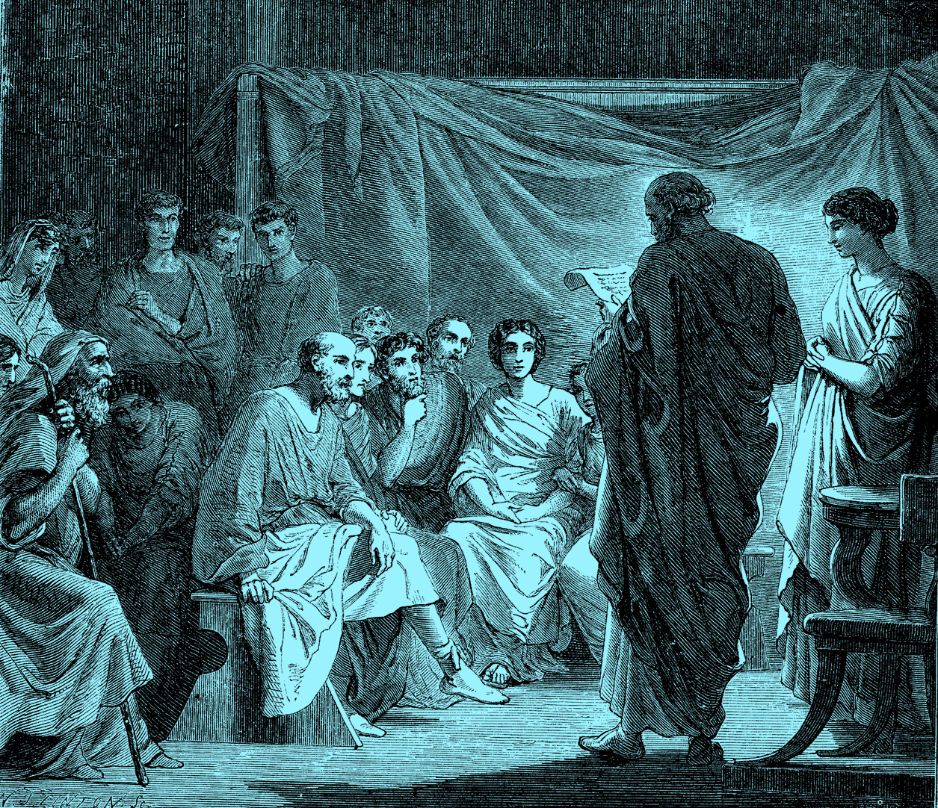
1 Corinthians 16:15-16
I urge you, brethren—you know the household of Stephanas, that it is the firstfruits of Achaia, and that they have devoted themselves to the ministry of the saints—that you also submit to such, and to everyone who works and labors with us.
Stephanas, along with his family, was baptized by Paul (1 Cor 1:16). He lived in Corinth and was among the first converts there.

Slide 5
1 Corinthians 16:15-16
I urge you, brethren—you know the household of Stephanas, that it is the firstfruits of Achaia, and that they have devoted themselves to the ministry of the saints—that you also submit to such, and to everyone who works and labors with us.
Addicted themselves (KJV)
Spending their lives (TLB)
tassoô (Greek), to arrange in an orderly manner, that is, assign or dispose to a certain position or lot:—addict, appoint, determine, ordain, set.
Fanatical devotees to the ministry.
Addicted themselves to the ministry.

Slide 6
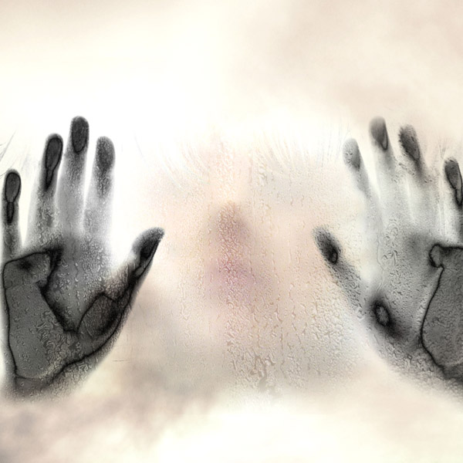
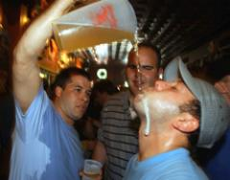
Many Are Devoted / Addicted To:
Alcohol

Slide 7
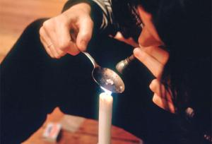
Many Are Devoted / Addicted To:
Narcotics

Slide 8
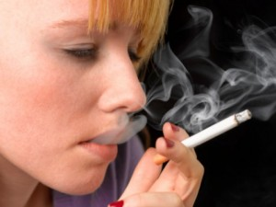
Many Are Devoted / Addicted To:
Tobacco

Slide 9

Many Are Devoted / Addicted To:

Slide 10
Many Are Devoted / Addicted To:
Gambling

Slide 11

Many Are Devoted / Addicted To:
Fornication/ Adultery

Slide 12
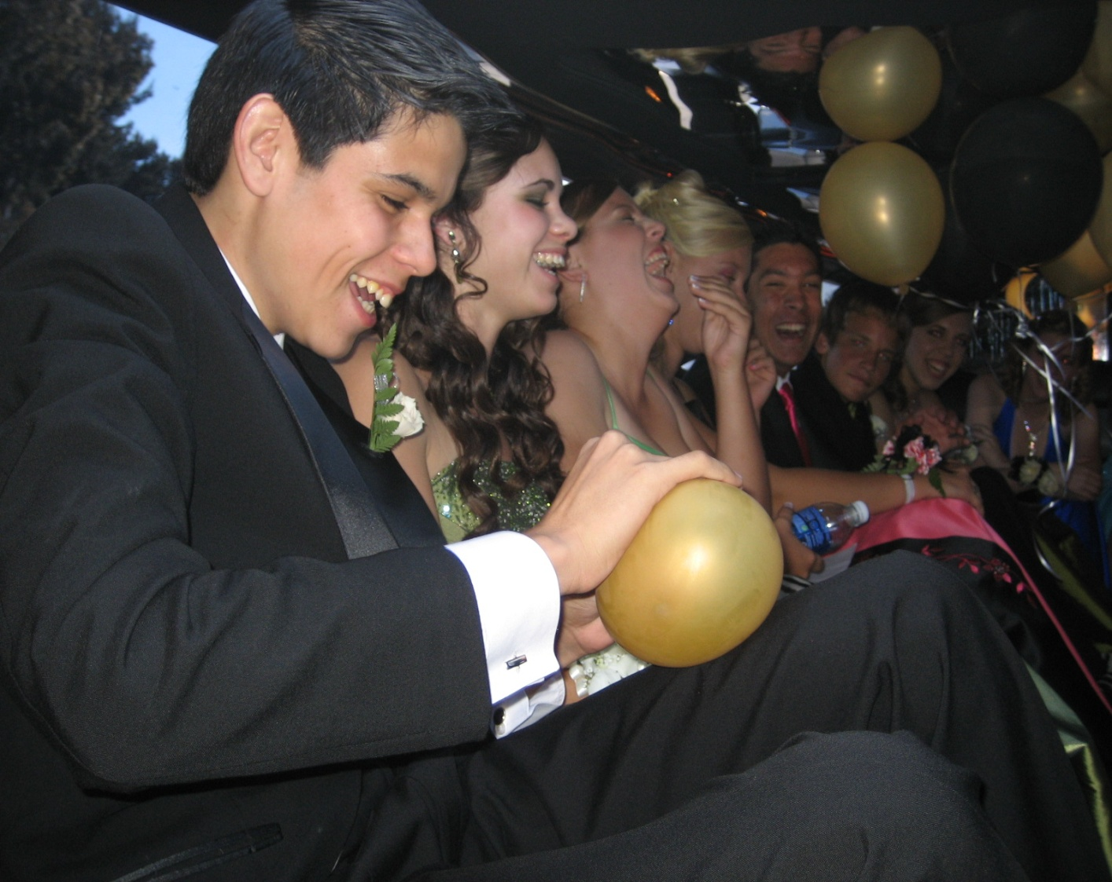
Many Are Devoted / Addicted To:
Pleasure

Slide 13

Many Are Devoted / Addicted To:
Work

Slide 14

The Mind Of Christ
Disciples need to be Addicted to:

Slide 15
The Mind Of Christ
Existed in the form of God (6)
Did not consider holding on to it (6)
Made Himself “of no reputation” (7)
Took the form of a bondservant / man (7)
He humbled Himself in obedience (8)
Even dying on the cross (8)
Philippians 2:5
Let this mind be in you which was also in Christ Jesus

Slide 16
Biblical Morality
Disciples need to be Addicted to:

Slide 17

Biblical Morality
Modest in Clothing Worn
1 Timothy 2:9-10
Honest in all Associations
2 Corinthians 8:21
Sense of Shame
Jeremiah 6:15
Brave enough to be Different
1 Peter 4:4
Gentle and Kindhearted
Romans 12:10
Self-Controlled
1 Corinthians 9:25
Romans 12:1-2
. I beseech you therefore, brethren, by the mercies of God, that you present your bodies a living sacrifice, holy, acceptable to God, which is your reasonable service.
. And do not be conformed to this world, but be transformed by the renewing of your mind, that you may prove what is that good and acceptable and perfect will of God.

Slide 18
Worshiping God
Disciples need to be Addicted to:

Slide 19
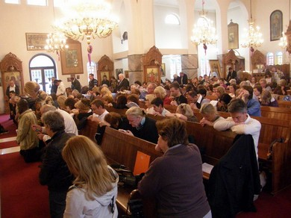
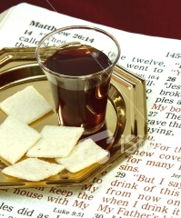
Worshiping God
Luke 4:16
Acts 2:42
Acts 11:26
Heb 10:25

Slide 20
Evangelism
Disciples need to be Addicted to:

Slide 21
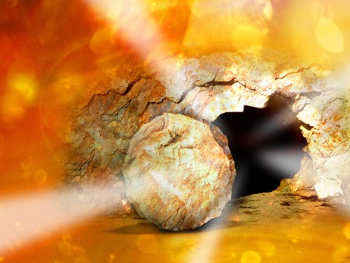
Evangelism
Matthew 28:18-20
2 Timothy 2:2
Acts 8:1-4
Acts 16:5
1 Corinthians 16:15

Slide 22
The Mind Of Christ
Biblical Morality
Worshiping God
Evangelism
Disciples need to be Addicted to:

