Slide 2
Acts 20:26-32
²⁶ Therefore I testify to you this day that I am innocent of the blood of all men. ²⁷ For I have not shunned to declare to you the whole counsel of God. ²⁸ Therefore take heed to yourselves and to all the flock, among which the Holy Spirit has made you overseers, to shepherd the church of God which He purchased with His own blood. ²⁹ For I know this, that after my departure savage wolves will come in among you, not sparing the flock. ³⁰ Also from among yourselves men will rise up, speaking perverse things, to draw away the disciples after themselves. ³¹ Therefore watch, and remember that for three years I did not cease to warn everyone night and day with tears. ³² So now, brethren, I commend you to God and to the word of His grace, which is able to build you up and give you an inheritance among all those who are sanctified.

Slide 5
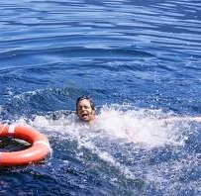

Slide 6
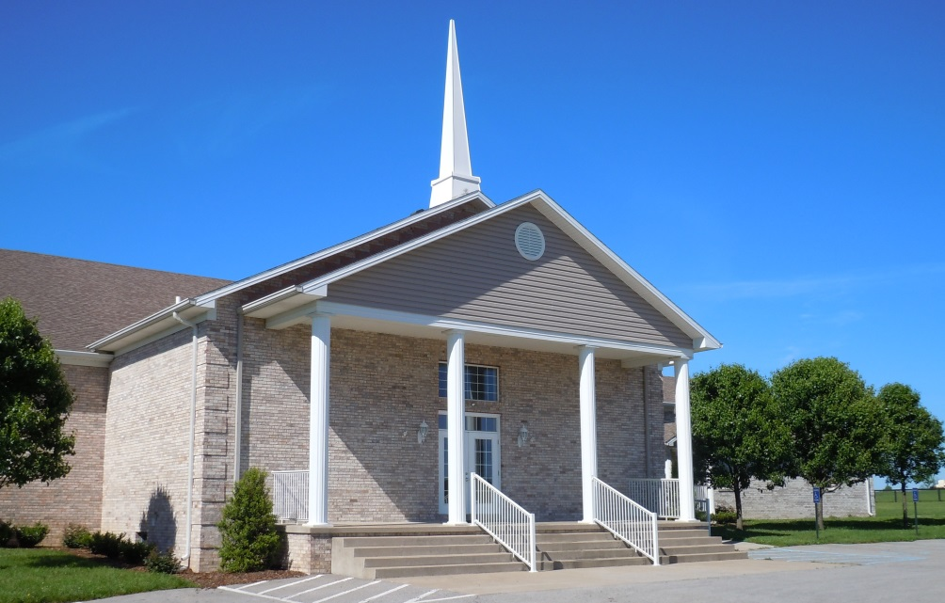
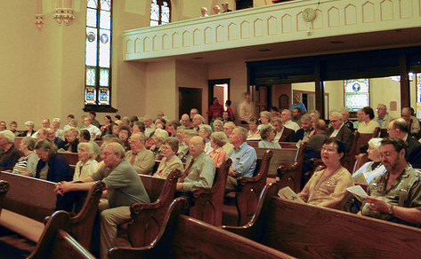
A building for public worship
A public divine worship
A Denomination

Slide 7
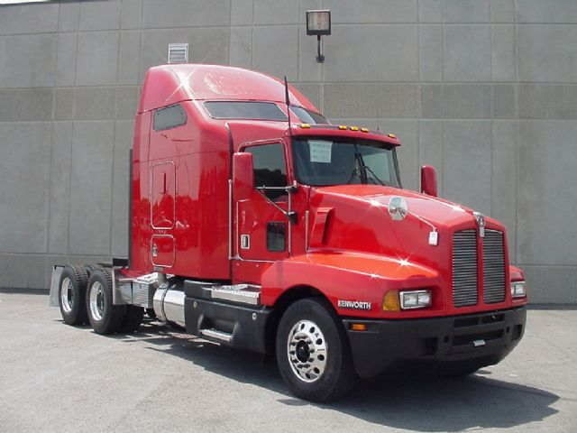
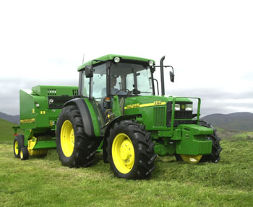
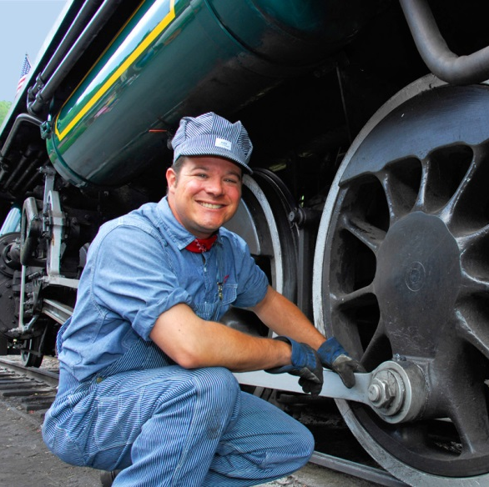
UNDERSTANDING
ENGINEER
TRACTOR

Slide 8
UNDERSTANDING

Slide 9
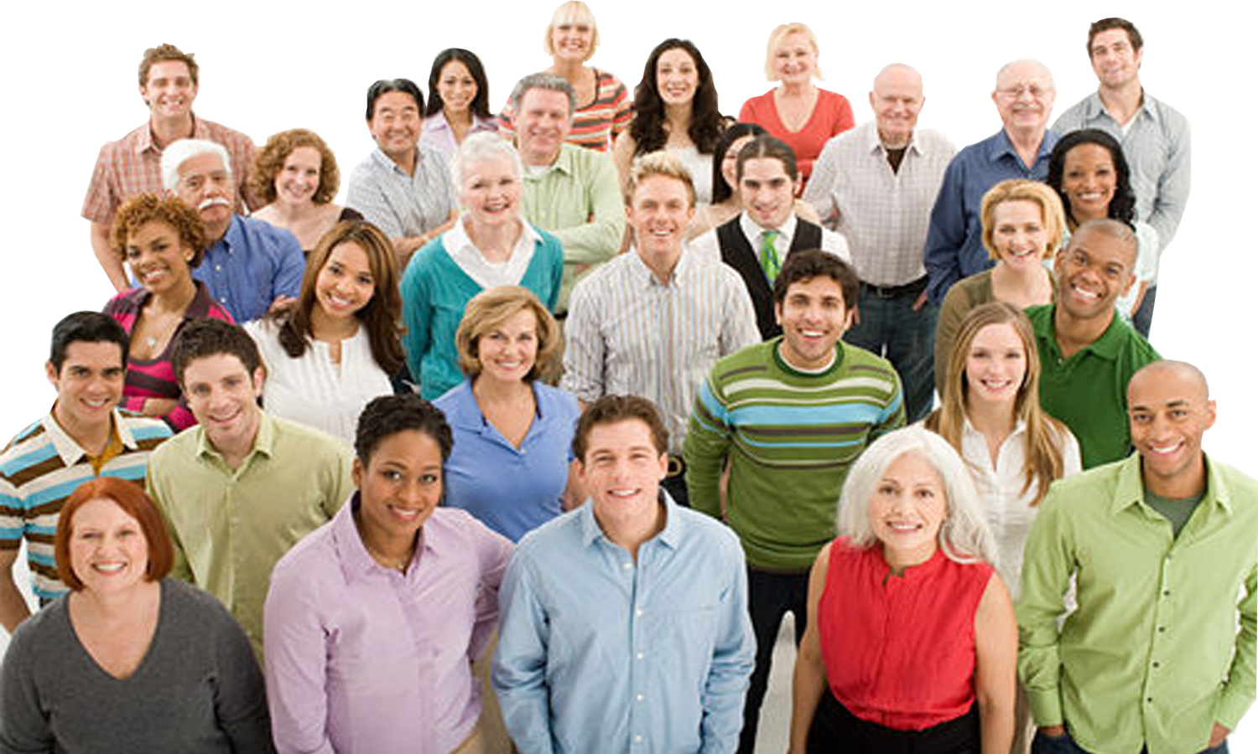
UNDERSTANDING
The English word church translates the Greek word ekklesia (ecclesia).
This word is actually two Greek words kaleo (to call), with the prefix ek (out).
The word means:
"the called out ones."
Matt 18:17
Acts 5:11
Acts 8:1
Acts 8:3

Slide 10
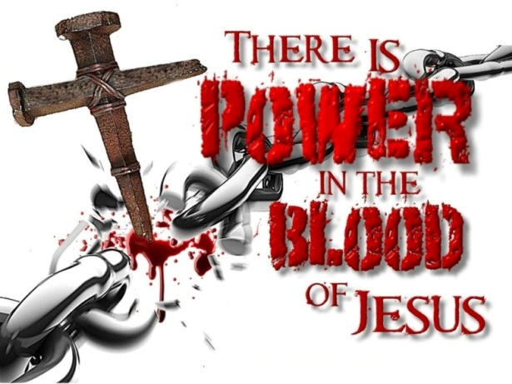
UNDERSTANDING
“. . . shepherd the church of God which He purchased with His own blood.”
(Acts 20:28)
“. . . knowing that you were not redeemed with corruptible things, like silver or gold, from your aimless conduct received by tradition from your fathers, but with the precious blood of Christ, as of a lamb without blemish and without spot.”
(1 Pet 1:18-19)

Slide 11
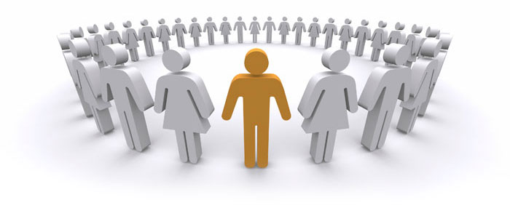
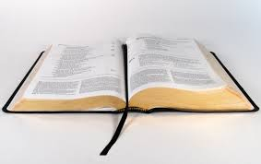
UNDERSTANDING
Individually
“Christian”
“And the Lord added to the church daily those who were being saved.”
(Acts 2:47)
Collectively
“Church”
“Or do you not know that as many of us as were baptized into Christ Jesus were baptized into His death?” (Rom 6:3)
“He called you by our gospel, for the obtaining of the glory of our Lord Jesus Christ.”
(2 Thess 2:14)
“Repent, and let every one of you be baptized in the name of Jesus Christ for the remission of sins . . .” (Acts 2:38)
“And a great many people were added to the Lord . . . and the disciples were first called Christians in Antioch” (Acts 11:24-26)

Slide 12
UNDERSTANDING
“To the church of God which is at Corinth, to those who are sanctified in Christ Jesus, called to be saints, with
all who in every place call on the name of Jesus Christ
our Lord” (1 Cor 1:2).
Corinth
Philippi
Antioch
Jerusalem
Ephesus
Danville

Slide 13
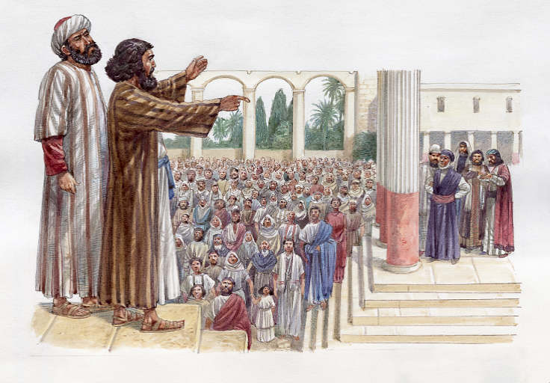
UNDERSTANDING
²⁰ But . . . when they had come to Antioch, spoke to the Hellenists, preaching the Lord Jesus. ²¹ And the hand of the Lord was with them, and a great number believed and turned to the Lord. ²² Then news of these things came to the ears of the church in Jerusalem, and they sent out Barnabas to go as far as Antioch. ²³ When he came and had
seen the grace of God, he was glad, and encouraged them all that with purpose of heart they should continue with the Lord . . . ²⁵ Then Barnabas departed for Tarsus to seek Saul. ²⁶ And when he had found him, he brought him to Antioch. So it was that for a whole year they assembled with the church and taught a great many people. And the disciples were first called Christians in Antioch. (Acts 11:20-26)

Slide 14
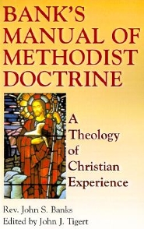
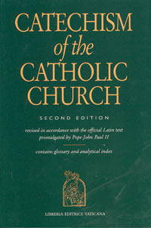
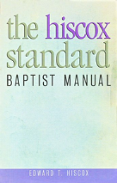
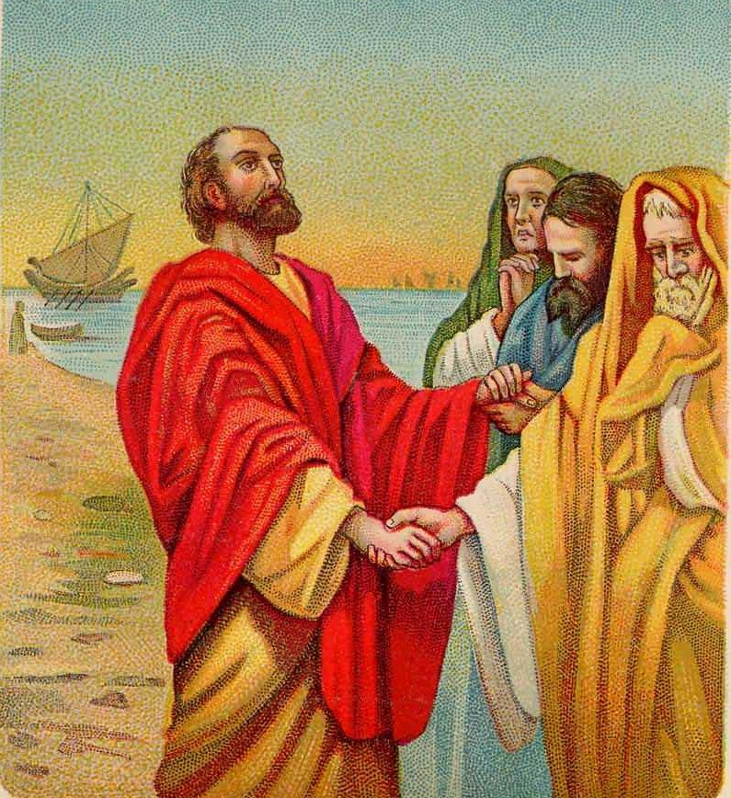
THE ONLY GUIDE FOR THE
So now, brethren, I commend you to God and to the word of His grace, which is able to build you up and give you an inheritance among all those who are sanctified. (Acts 20:32)
“. . . you may learn in us not to think beyond what is written . . .
For this reason I have sent Timothy to you, who is my beloved and faithful son in the Lord, who will remind you of my ways in Christ, as I teach everywhere in every church”
(1 Cor 4:6, 17)

Slide 15
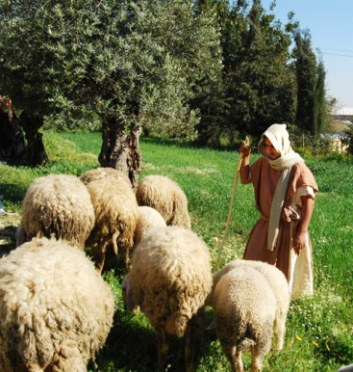
THE ORGANIZATION FOR A LOCAL
“From Miletus he (Paul) sent to Ephesus and called for the elders of the church . . . Therefore take heed to yourselves and to all the flock, among which the Holy Spirit has made you overseers, to shepherd the church of God”
(Acts 20:17, 28).
“To all the saints in Christ Jesus who are in Philippi, with the bishops and deacons . . .
(Phil 1:1)

Slide 16
Men and women called by the gospel into fellowship with Christ
Men and women answering the call were baptized into the death of Christ
Men and women who are purchased by the saving blood of Christ
Men and women in a certain location working within a local organized body
Men and women who have entrusted themselves to following the scriptures

