Slide 2
Psalm 51:10-17
¹⁰ Create in me a clean heart, O God, and renew a steadfast spirit within me. ¹¹ Do not cast me away from Your presence, and do not take Your Holy Spirit from me. ¹² Restore to me the joy of Your salvation, and uphold me by Your generous Spirit. ¹³ Then I will teach transgressors Your ways, and sinners shall be converted to You. ¹⁴ Deliver me from the guilt of bloodshed, O God, the God of my salvation, and my tongue shall sing aloud of Your righteousness. ¹⁵ O Lord, open my lips, and my mouth shall show forth Your praise. ¹⁶ For You do not desire sacrifice, or else I would give it; You do not delight in burnt offering. ¹⁷ The sacrifices of God are a broken spirit, A broken and a contrite heart—These, O God, You will not despise.

Slide 4
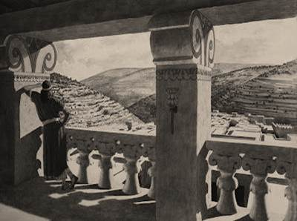
Then it happened one evening that David arose from his bed and walked on the roof of the king’s house. And from the roof he saw a woman bathing, and the woman was very beautiful to behold. So David sent and inquired about the woman. And someone said, is this not Bathsheba, the daughter of Eliam, the wife of Uriah the Hittite? Then David sent messengers, and took her; and she came to him, and he lay with her, for she was cleansed from her impurity; and she returned to her house. And the woman conceived; so she sent and told David, and said, I am with child. (2 Samuel 11:2-5)
Then it happened one evening that David arose from his bed and walked on the roof of the king’s house. And from the roof he saw a woman bathing, and the woman was very beautiful to behold. So David sent and inquired about the woman. And someone said, is this not Bathsheba, the daughter of Eliam, the wife of Uriah the Hittite? Then David sent messengers, and took her; and she came to him, and he lay with her, for she was cleansed from her impurity; and she returned to her house. And the woman conceived; so she sent and told David, and said, I am with child. (2 Samuel 11:2-5)

Slide 5
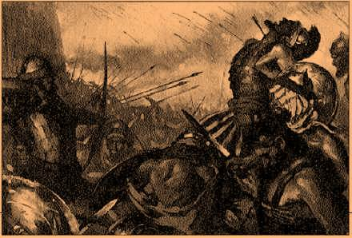
In the morning it happened that David wrote a letter to Joab and sent it by the hand of Uriah. And he wrote in the letter, saying, set Uriah in the forefront of the hottest battle, and retreat from him, that he may be struck down and die. So it was, while Joab besieged the city, that he assigned Uriah to a place where he knew there were valiant men. Then the men of the city came out and fought with Joab. And some of the people of the servants of David fell; and Uriah the Hittite died also. (2 Samuel 11:14-17)
In the morning it happened that David wrote a letter to Joab and sent it by the hand of Uriah. And he wrote in the letter, saying, set Uriah in the forefront of the hottest battle, and retreat from him, that he may be struck down and die. So it was, while Joab besieged the city, that he assigned Uriah to a place where he knew there were valiant men. Then the men of the city came out and fought with Joab. And some of the people of the servants of David fell; and Uriah the Hittite died also. (2 Samuel 11:14-17)

Slide 6
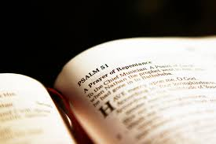
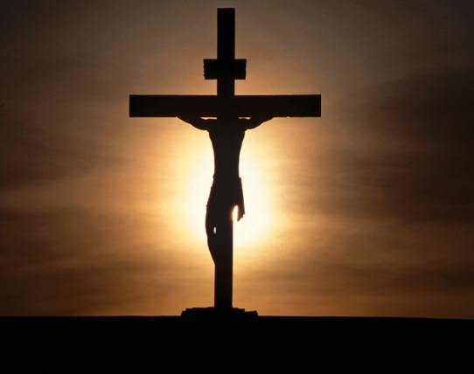
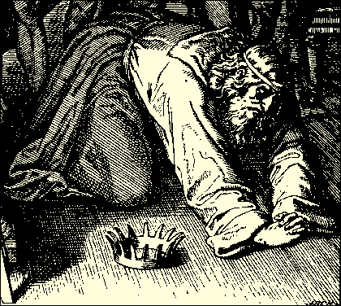
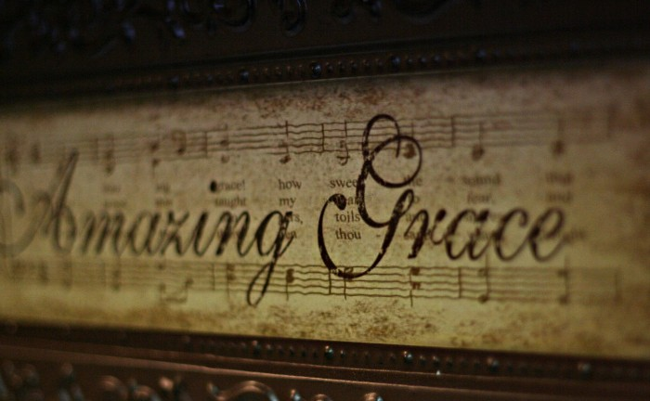
A Glimpse into God’s Grace
“For He made Him who knew no sin to be sin for us, that we might become the righteousness of God in Him” (2 Cor 5:21).
“And he arose and came to his father. But when he was still a great way off, his father saw him and had compassion, and ran and fell on his neck and kissed him. And the son said to him, Father, I have sinned against heaven and in your sight, and am no longer worthy to be called your son. But the father said to his servants, bring out the best robe and put it on him, and put a ring on his hand and sandals on his feet. And bring the fatted calf here and kill it, and let us eat and be merry; for this my son was dead and is alive again; he was lost and is found. And they began to be merry.”
(Luke 15:20-24)
“And he arose and came to his father. But when he was still a great way off, his father saw him and had compassion, and ran and fell on his neck and kissed him. And the son said to him, Father, I have sinned against heaven and in your sight, and am no longer worthy to be called your son. But the father said to his servants, bring out the best robe and put it on him, and put a ring on his hand and sandals on his feet. And bring the fatted calf here and kill it, and let us eat and be merry; for this my son was dead and is alive again; he was lost and is found. And they began to be merry.”
(Luke 15:20-24)
Admit the Need for Mercy (Psa 51:1, 16)
Acknowledge the Sin (Psa 51:3)
Assume Responsibility (Psa 51:4)
Accept God’s Forgiveness (Psa 51:7-12)

