Slide 2
Luke 16:19-31
¹⁹ There was a certain rich man who was clothed in purple and fine linen and fared sumptuously every day. ²⁰ But there was a certain beggar named Lazarus, full of sores, who was laid at his gate, ²¹ desiring to be fed with the crumbs which fell from the rich man’s table. Moreover the dogs came and licked his sores. ²² So it was that the beggar died, and was carried by the angels to Abraham’s bosom. The rich man also died and was buried. ²³ And being in torments in Hades, he lifted up his eyes and saw Abraham afar off, and Lazarus in his bosom. ²⁴ Then he cried and said, father Abraham, have mercy on me, and send Lazarus that he may dip the tip of his finger in water and cool my tongue; for I am tormented in this flame. ²⁵ But Abraham said, son, remember that in your lifetime you received your good things, and likewise Lazarus evil things; but now he is comforted and you are tormented. ²⁶ And besides all this, between us and you there is a great gulf fixed, so that those who want to pass from here to you cannot, nor can those from there pass to us. ²⁷ Then he said, I beg you therefore, father, that you would send him to my father’s house, ²⁸ for I have five brothers, that he may testify to them, lest they also come to this place of torment. ²⁹ Abraham said to him, they have Moses and the prophets; let them hear them. ³⁰ And he said, no, father Abraham; but if one goes to them from the dead, they will repent. ³¹ But he said to him, if they do not hear Moses and the prophets, neither will they be persuaded though one rise from the dead.

Slide 4
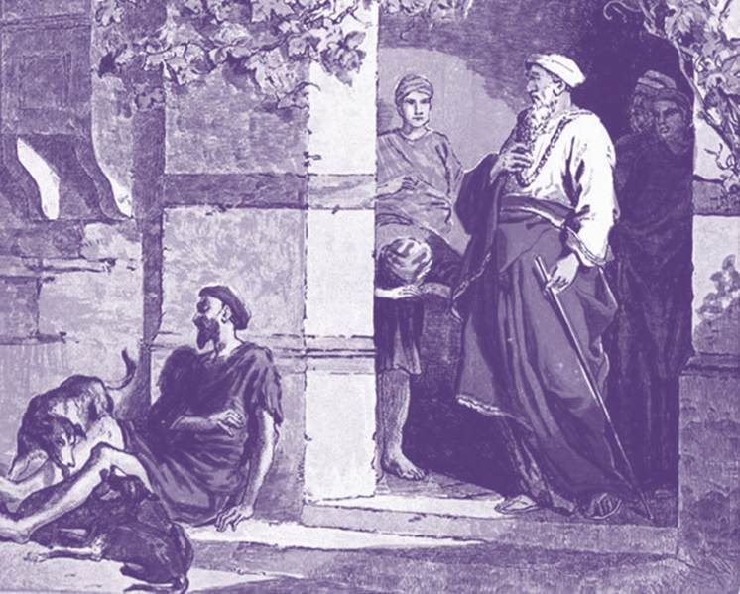
The Rich Man and Lazarus
Is it a Parable?
Not called a parable.
Does not bear parabolic characteristics
Why only one name given?
Poor man is named (Lazarus- “Whom God Helps”).
Rich man unnamed (“Dives” –Rich).
Jews: Phineas
Egyptians: Amenophis
Perhaps unnamed because his name is not recorded in heaven.
Hades vs Hell
Hades (Vs-23) is the place one goes immediately upon death (Unseen realm of the dead).
Paradise (Ac 2:27; Lk 23:43).
Torment (Lk 16:24).
Hell (gehenna) Matt 23:33; Matt 25:46

Slide 6
There was a certain rich man who was clothed in purple and fine linen and fared sumptuously every day. (Vs-19)
The rich man also died and was buried (Vs-22)
I have five brothers, that he may testify to them, lest they also come to this place of torment (Vs-28)
Abundant Riches
Abraham said to him, they have Moses and the prophets; let them hear them. (Vs-29)
I have five brothers (Vs 28)
A Large family
And being in torments in Hades, he lifted up his eyes . . . (Vs-23)
A Loved One Died
A Loved One Lost
All Brothers Lost
Rejected Salvation

