Slide 2
Psalm 127:1-7
¹ Unless the Lord builds the house, they labor in vain who build it; unless the Lord guards the city, the watchman stays awake in vain. ² It is vain for you to rise up early, to sit up late, to eat the bread of sorrows; for so He gives His beloved sleep. ³ Behold, children are a heritage from the Lord, the fruit of the womb is a reward. ⁴ Like arrows in the hand of a warrior, so are the children of one’s youth. ⁵ Happy is the man who has his quiver full of them; they shall not be ashamed, but shall speak with their enemies in the gate.

Slide 4
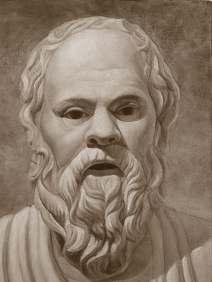
Rebellion at Home
Withdrawing from family and spending more time with friends.
Rejection of rules and curfews.
Problems at School (cutting classes, missing school, drop in grades).
Substance Abuse (alcohol, drugs).
Change in Appearance/Interest.
Argumentative (quick to anger, overly defensive).
Running away from Home.
"Our youth now love luxury, they have bad manners, contempt for authority; they show disrespect for elders, and love to chatter in place of exercise. Children are now tyrants, not the servants of their households. They no longer rise when elders enter the room. They contradict their parents, chatter before company, gobble up their food and tyrannize their teachers."
Socrates

Slide 5
Rebellion at Home
The Generation after Egypt— “When all that generation had been gathered to their fathers, another generation arose after them who did not know the Lord nor the work which He had done for Israel” (Judges 2:10).
Sons of Eli— “Now Eli was very old; and he heard everything his sons did to all Israel, and how they lay with the women who assembled at the door of the tabernacle of meeting” (2 Sam 2:22).
Sons of Samuel– “But his sons did not walk in his ways; they turned aside after dishonest gain, took bribes, and perverted justice” (1 Sam 8:3).
The Prodigal– “A certain man had two sons. And the younger of them said to his father, father, give me the portion of goods that falls to me. So he divided to them his livelihood. And not many days after, the younger son gathered all together, journeyed to a far country . . .” (Luke 15:11-12).

Slide 6
Rebellion at Home
Abraham— “For I have known him, in order that he may command his children and his household after him, that they keep the way of the Lord, to do righteousness and justice, that the Lord may bring to Abraham what He has spoken to him” (Gen 18:19).
Joshua— “. . . choose for yourselves this day whom you will serve, whether the gods which your fathers served that were on the other side of the River, or the gods of the Amorites, in whose land you dwell. But as for me and my house, we will serve the Lord” (Joshua 24:15).
All Fathers– “And you, fathers, do not provoke your children to wrath, but bring them up in the training and admonition of the Lord” (Eph 6:4).

Slide 7
A Christian Home
God give us Christian homes!
Homes where the Bible is loved and taught,
Homes where the Master’s will is sought,
Homes crowned with beauty Your love has wrought;
God give us Christian homes!
Homes where the children are led to know
Christ in His beauty who loves them so,
Homes where the altar fires burn and glow;
God give us Christian homes!

Slide 8
A Christian Home
Parental Authority is Respected
Spirituality is Expected
Art of Sacrifice is Detected
Godly Morality is Perfected

