Slide 2
Proverbs 4:20-27
²⁰ My son, give attention to my words; incline your ear to my sayings. ²¹ Do not let them depart from your eyes; keep them in the midst of your heart; ²² For they are life to those who find them, and health to all their flesh. ²³ Keep your heart with all diligence, for out of it spring the issues of life. ²⁴ Put away from you a deceitful mouth, and put perverse lips far from you. ²⁵ Let your eyes look straight ahead, and your eyelids look right before you. ²⁶ Ponder the path of your feet, and let all your ways be established. ²⁷ Do not turn to the right or the left; remove your foot from evil.

Slide 4
Hindsight is always 20/20
I wish I had not quit school
I regret not calling more often
I wish I knew then what I know now
I wish I had not married so young
I wish I didn’t have this tattoo
I wish I had not said that

Slide 5
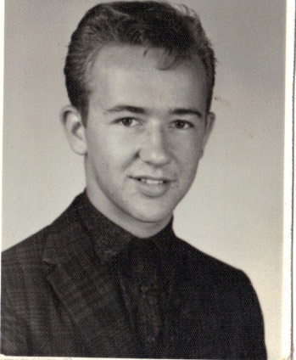
Knowing Then What I Know Now
I would have avoided many sins & mistakes!
I would have become a Christian sooner!
I would have been a better son, husband & father!

Slide 6
Knowing Now What I Need To Know
My son, give attention to my words; incline your ear to my sayings. Do not let them depart from your eyes; keep them in the midst of your heart; For they are life to those who find them, and health to all their flesh.
Proverbs 4:20-22)
Challenge to Young People

Slide 7
Become Christians in your Youth ~ Eccl 12:1
Grow Up Spiritually ~ Eph 4:15: 2 Pet 3:18
Be Content in All Things ~ Phil 4:11; Rom 9:20
Make Friends of other Christians ~ Rom 12:10
Flee Youthful Lusts ~ 2 Tim 2:22
253 Converts
Under 20 – 138
20-30 -- 85
31-40 -- 22
41-50 -- 4
51-60 -- 3
61-70 -- 1
Over 70 -- 0

Slide 8
One Life: One Chance to Get it Right
Let us hear the conclusion of the whole matter: Fear God and keep His commandments, for this is man’s all. For God will bring every work into judgment, including every secret thing, whether good or evil.
Ecclesiastes 12:13-14

