Slide 2
Judges 2:7-10
⁷ So the people served the Lord all the days of Joshua, and all the days of the elders who outlived Joshua, who had seen all the great works of the Lord which He had done for Israel. ⁸ Now Joshua the son of Nun, the servant of the Lord, died when he was one hundred and ten years old. ⁹ And they buried him within the border of his inheritance at Timnath Heres, in the mountains of Ephraim, on the north side of Mount Gaash. ¹⁰ When all that generation had been gathered to their fathers, another generation arose after them who did not know the Lord nor the work which He had done for Israel.

Slide 4
Why Am I a Christian?

Slide 5
“Raised in the Church”
“Inherited my Faith”

Slide 6
“When all that generation had been gathered to their fathers, another generation arose after them who did not know the Lord . . . and they forsook the Lord God of their fathers”
(Judges 2:10, 12).

Slide 7
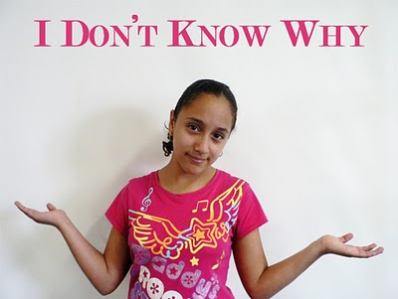
Taught them How, but not Why
1 Peter 3:15

Slide 8
They were never convicted of Sin
John 16:8

Slide 9
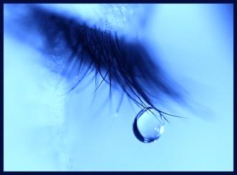
Is no Concept of Godly Sorrow
2 Corinthians 7:10

Slide 10
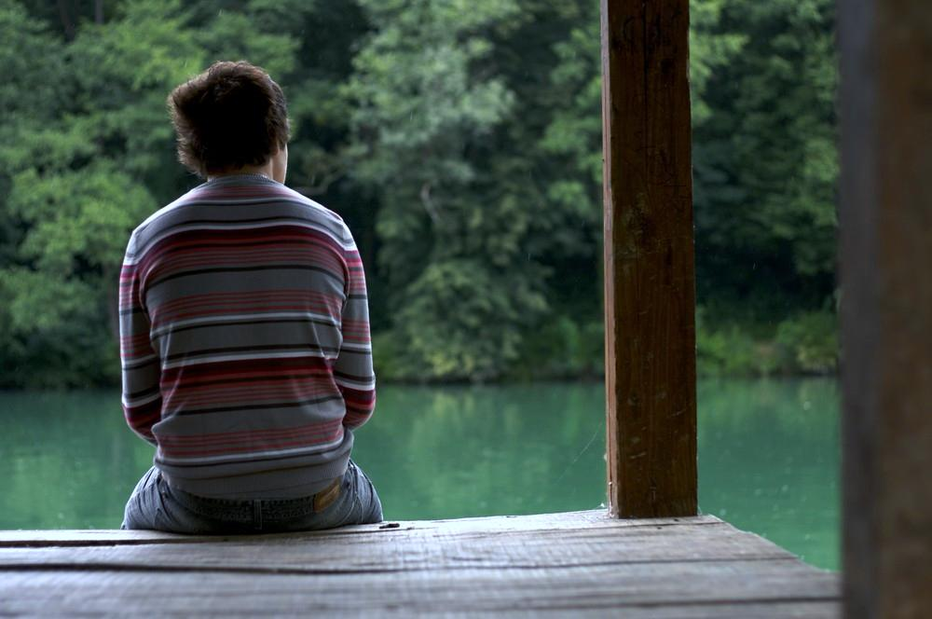
Never Appreciated God’s Grace
“For by grace you have been saved through faith, and that not of yourselves; it is the gift of God, not of works, lest anyone should boast”
Eph 2:8-9

Slide 11
Never Exposed to Work Ethic
“For we are His workmanship, created in Christ Jesus for good works, which God prepared beforehand that we should walk in them”
Eph 2:10

Slide 12
Why Am I a Christian?
I chose to Believe—Heb 11:6
I chose to Repent—Acts 2:38
I chose to confess—Rom 10:9
I chose to be baptized—Mk 16:16
I choose to live faithfully—Rev 2:10
“I call to remembrance the genuine faith that is in you, which dwelt first in your grandmother Lois and your mother Eunice, and I am persuaded is in you also” (2 Tim 1:5).

