Slide 2
^{John 19:25-27}
²⁵ Now there stood by the cross of Jesus His mother, and His mother’s sister, Mary the wife of Clopas, and Mary Magdalene. ²⁶ When Jesus therefore saw His mother, and the disciple whom He loved standing by, He said to His mother, woman, behold your son! ²⁷ Then He said to the disciple, behold your mother! And from that hour that disciple took her to his own home.

Slide 4
Father, forgive them, for they do not know what they do (Lk 23:34).
Assuredly, I say to you, today you will be with Me in Paradise
(Lk 23:43).
Woman, behold your son! Behold your mother!
(Jn 19:26-27)
Seven Sayings
Of Jesus
From The Cross

Slide 5
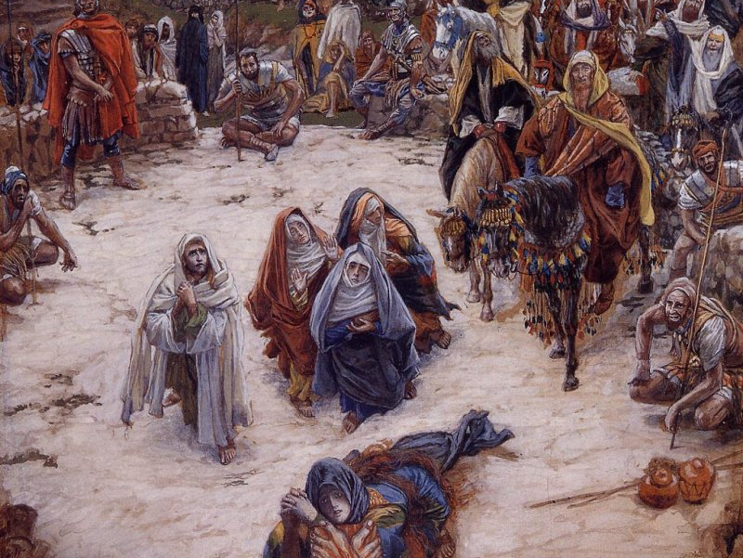
Woman, behold your son! Behold your mother!” (John 19:26-27)
Many other Women
Mary, wife of Clopas
Mary Magdalene
Jesus’ Aunt

Slide 6
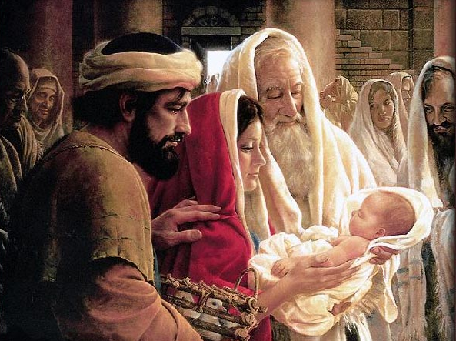
We Learn:
Woman, behold your son! Behold your mother!” (John 19:27)
Then Simeon blessed them, and said to Mary His mother, behold, this Child is destined for the fall and rising of many in Israel, and for a sign which will be spoken against (yes, a sword will pierce through your own soul also), that the thoughts of many hearts may be revealed (Luke 2:34-35).
Even in death Jesus honored his Parents
Reputation Suffered (Matt 1:18-19)
Born in an animal stable (Lk 2:7)
Herod’s plan to kill Him (Matt 2:9)
Had to flee to Egypt (Matt 2:13-15)
Endured His trial (Matt 27:22)
Witnessed the mockery (Matt 27:39)
Now watching Him die (Jn 19:25)
Even in death Jesus focused on Others

