Slide 2
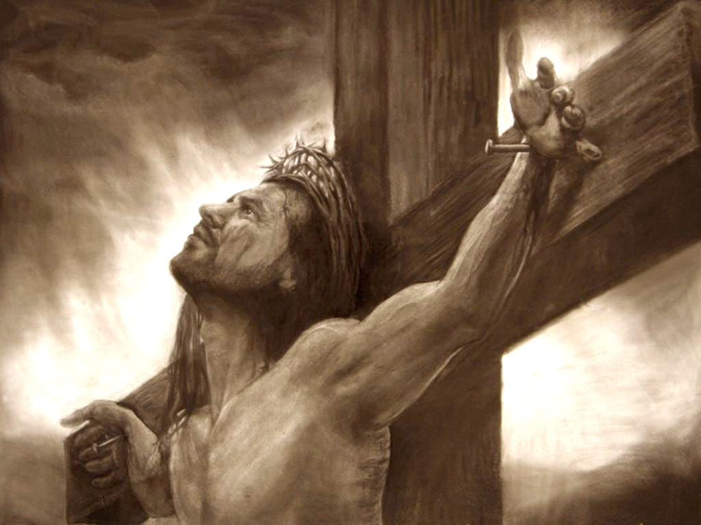
^{Luke 23:32-43}
³² There were also two others, criminals, led with Him to be put to death. ³³ And when they had come to the place called Calvary, there they crucified Him, and the criminals, one on the right hand and the other on the left. ³⁴ Then Jesus said, Father, forgive them, for they do not know what they do. And they divided His garments and cast lots. ³⁵ And the people stood looking on. But even the rulers with them sneered, saying, He saved others; let Him save Himself if He is the Christ, the chosen of God. ³⁶ The soldiers also mocked Him, coming and offering Him sour wine, ³⁷ and saying, if You are the King of the Jews, save Yourself. ³⁸ And an inscription also was written over Him in letters of Greek, Latin, and Hebrew: THIS IS THE KING OF THE JEWS. ³⁹ Then one of the criminals who were hanged blasphemed Him, saying, if You are the Christ, save Yourself and us. ⁴⁰ But the other, answering, rebuked him, saying, do you not even fear God, seeing you are under the same condemnation? ⁴¹ And we indeed justly, for we receive the due reward of our deeds; but this Man has done nothing wrong. ⁴² Then he said to Jesus, Lord, remember me when You come into Your kingdom. ⁴³ And Jesus said to him, assuredly, I say to you, today you will be with Me in Paradise.

Slide 4
6 Hours ~ 9:AM – 3:PM
“Father, forgive them, for they do not know what they do” (Luke 23:34).

Slide 5
Then two robbers were crucified with Him, one on the right and another on the left . . . Even the robbers who were crucified with Him reviled Him with the same thing. (Matt 27:38, 44).
With Him they also crucified two robbers, one on His right and the other on His left . . . Even those who were crucified with Him reviled Him. (Mk 15:27, 32).
There were also two others, criminals, led with Him to be put to death. And when they had come to the place called Calvary, there they crucified Him, and the criminals, one on the right hand and the other on the left. (Lk 23:32-33).
And He, bearing His cross, went out to a place called the Place of a Skull, which is called in Hebrew, Golgotha, where they crucified Him, and two others with Him, one on either side, and Jesus in the center. (Jn 19:17-18)

Slide 6
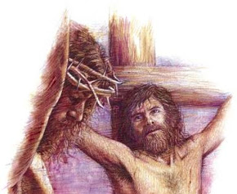
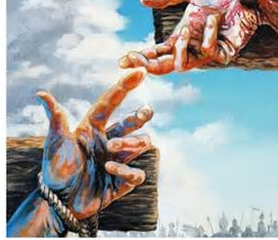
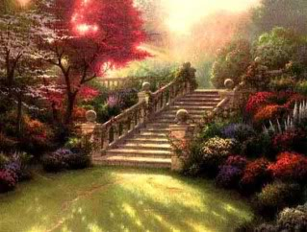
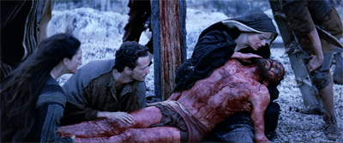
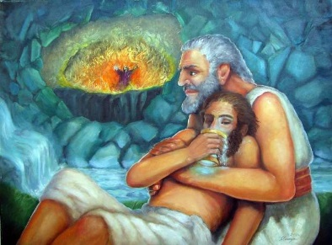
But the other, answering, rebuked him, saying, do you not even fear God, seeing you are under the same condemnation? And we indeed justly, for we receive the due reward of our deeds; but this Man has done nothing wrong. Then he said to Jesus, Lord, remember me when You come into Your kingdom. And Jesus said to him, assuredly, I say to you, today you will be with Me in Paradise.
(Luke 23:40-43)
But, what about baptism?
Matthew 3:4-6
John 4:1-3
Galatians 4:4
Hebrew 9:16-17
Luke 7:44-48
TODAY: Acts 22:16
Today

Slide 7
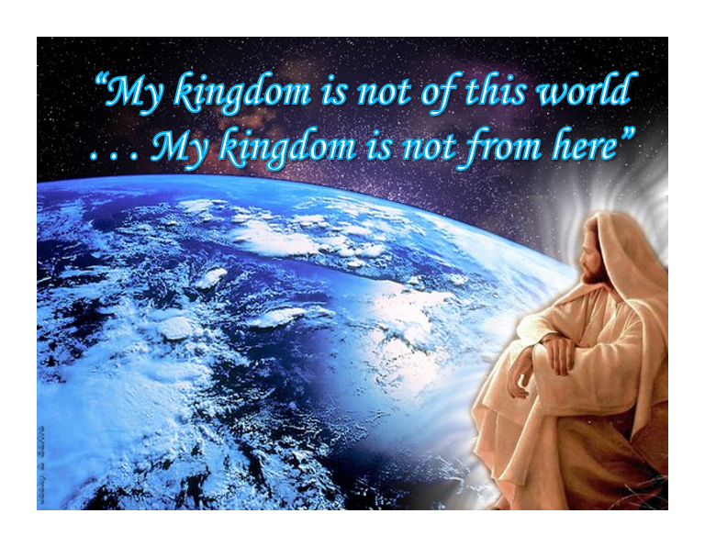
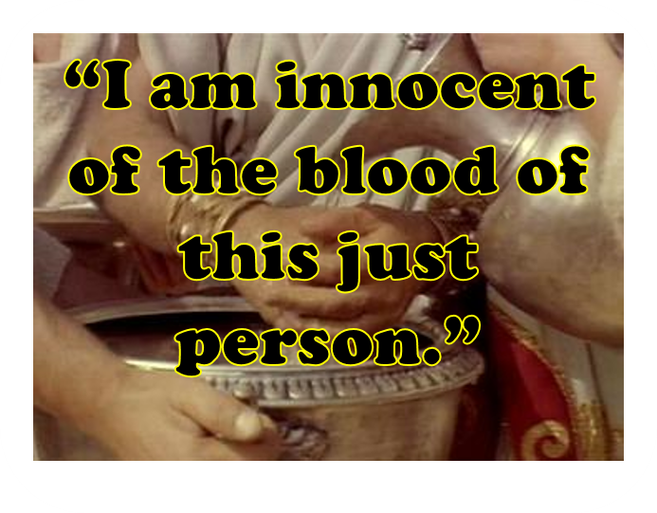
But the other, answering, rebuked him, saying, do you not even fear God, seeing you are under the same condemnation? And we indeed justly, for we receive the due reward of our deeds; but this Man has done nothing wrong. Then he said to Jesus, Lord, remember me when You come into Your kingdom. And Jesus said to him, assuredly, I say to you, today you will be with Me in Paradise.
(Luke 23:40-43)
Voltaire: “I am abandoned by God and man…I shall go to hell.”
Thomas Paine: “I would give worlds, if I had them, that the ‘Age of Reason’ had never been published. Oh, God, save me; for I am at the edge of hell alone…”

Slide 8
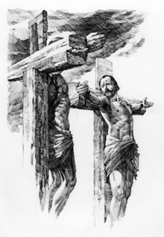
Timeless Lessons
Do not adopt the “mob mentality”
Be conscious of and admit your own sins
Go to the only source of salvation
Salvation at the 11th Hour is Possible

