Slide 2
Luke 23:32-38
³² There were also two others, criminals, led with Him to be put to death. ³³ And when they had come to the place called Calvary, there they crucified Him, and the criminals, one on the right hand and the other on the left. ³⁴ Then Jesus said, Father, forgive them, for they do not know what they do. And they divided His garments and cast lots. ³⁵ And the people stood looking on. But even the rulers with them sneered, saying, He saved others; let Him save Himself if He is the Christ, the chosen of God. ³⁶ The soldiers also mocked Him, coming and offering Him sour wine, ³⁷ and saying, if You are the King of the Jews, save Yourself. ³⁸ And an inscription also was written over Him in letters of Greek, Latin, and Hebrew: THIS IS THE KING OF THE JEWS.

Slide 4
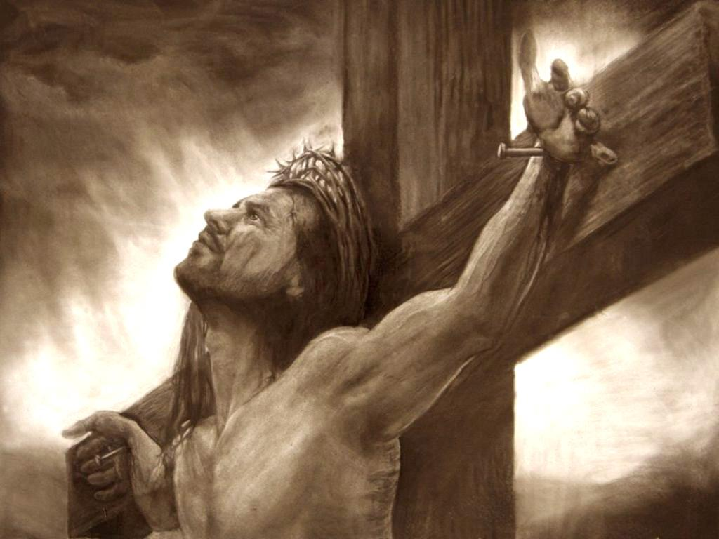
Luke 23:32-38
³² There were also two others, criminals, led with Him to be put to death. ³³ And when they had come to the place called Calvary, there they crucified Him, and the criminals, one on the right hand and the other on the left. ³⁴ Then Jesus said, Father, forgive them, for they do not know what they do. And they divided His garments and cast lots. ³⁵ And the people stood looking on. But even the rulers with them sneered, saying, He saved others; let Him save Himself if He is the Christ, the chosen of God. ³⁶ The soldiers also mocked Him, coming and offering Him sour wine, ³⁷ and saying, if You are the King of the Jews, save Yourself. ³⁸ And an inscription also was written over Him in letters of Greek, Latin, and Hebrew: THIS IS THE KING OF THE JEWS.
there they crucified Him

Slide 5
“And He, bearing His cross, went out to a place called the Place of a Skull, which is called in Hebrew, Golgotha, where they crucified Him, and two others with Him, one on either side, and Jesus in the center.” (John 19:17-18)

Slide 6
The Betrayal
“Then one of the twelve, called Judas Iscariot, went to the chief priests and said, what are you willing to give me if I deliver Him to you? And they counted out to him thirty pieces of silver. So from that time he sought opportunity to betray Him.” (Matt 26:14-16)

Slide 7
He who dipped his hand with Me in the dish will betray Me. (Matt 26:23)
The Last Supper
Then Judas, who was betraying Him, answered and said,
“Rabbi, is it I?”
(Matt 26:25)

Slide 8
The Arrest
“Now His betrayer had given them a sign, saying, whomever I kiss, He is the One; seize Him. Immediately he went up to Jesus and said, greetings, Rabbi! and kissed Him. But Jesus said to him, friend, why have you come? Then they came and laid hands on Jesus and took Him.” (Matt 26:48-50)

Slide 9
The Trial
“Pilate said to them, whom do you want me to release to you? Barabbas, or Jesus who is called Christ? For he knew that they had handed Him over because of envy.” (Matt 27:17-18)

Slide 10
The Beatings
“Then he released Barabbas to them; and when he had scourged Jesus, he delivered Him to be crucified.” (Matt 27:26)

Slide 11
The Ridiculing
“And they stripped Him and put a scarlet robe on Him. When they had twisted a crown of thorns, they put it on His head, and a reed in His right hand. And they bowed the knee before Him and mocked Him, saying, hail, King of the Jews! Then they spat on Him, and took the reed and struck Him on the head. And when they had mocked Him, they took the robe off Him, put His own clothes on Him, and led Him away to be crucified.” (Matt 27:28-31)

Slide 12
Dead Man Walking
“Now as they came out, they found a man of Cyrene, Simon by name. Him they compelled to bear His cross. And when they had come to a place called Golgotha, that is to say, Place of a Skull . . .” (Matt 27:32-33)

Slide 13
The Crucifixion
“Then they crucified Him . . . ”
(Matt 27:35)

Slide 14
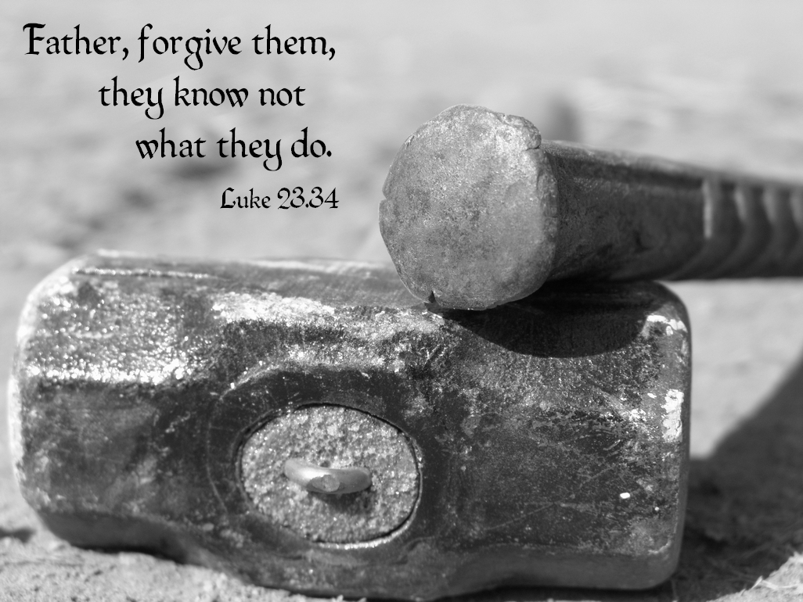
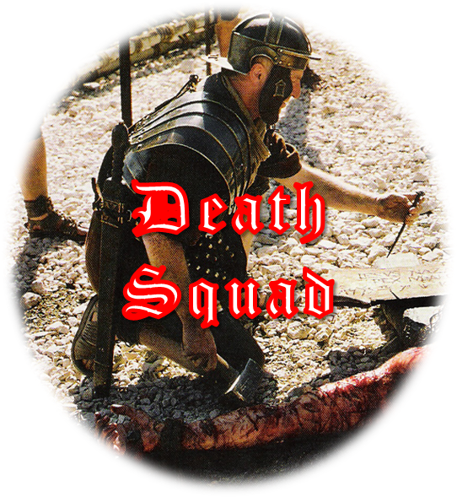
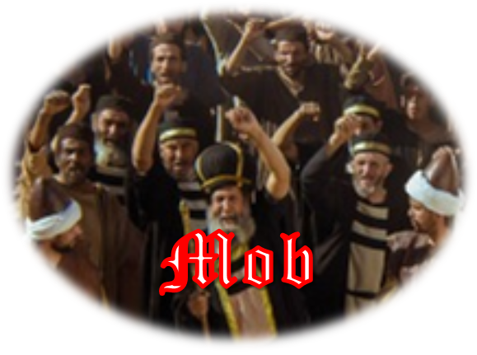
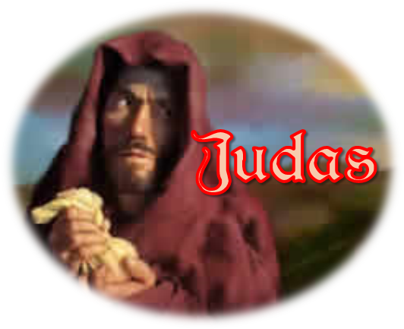
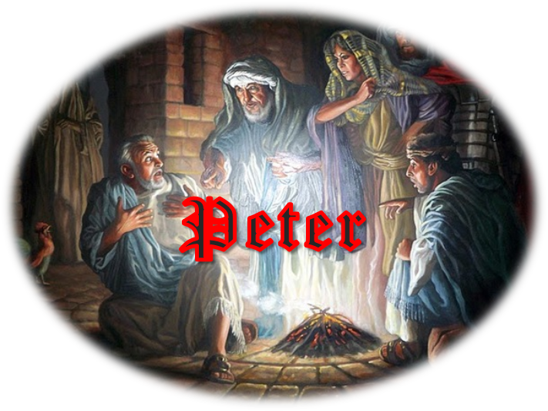
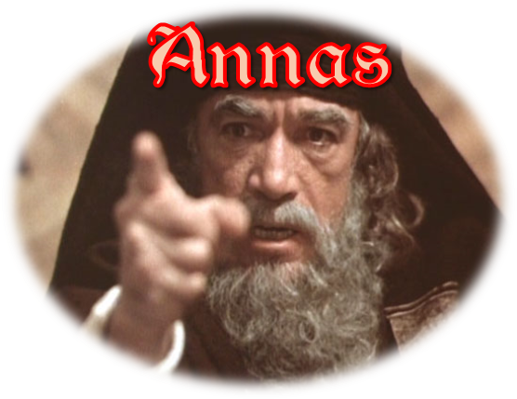
“I am a worm, and no man; A reproach of men, and despised by the people. All those who see Me ridicule Me; they shoot out the lip, they shake the head, saying, He trusted in the Lord, let Him rescue Him; let Him deliver Him, since He
delights in Him!”
(Psa 22:6-7)
“. . . and divided His garments, casting lots . . . Sitting down, they kept watch over Him there.”
(Matt 27:35-36)

Slide 15
Forgiving the Unforgivable
We must give up trying to force people to understand how much they have hurt us!
We must remember that God forgives us when we are unforgivable!

