Slide 2
Hebrews 12:25-29
25 See that you do not refuse Him who speaks. For if they did not escape who refused Him who spoke on earth, much more shall we not escape if we turn away from Him who speaks from heaven, 26 whose voice then shook the earth; but now He has promised, saying, yet once more I shake not only the earth, but also heaven. 27 Now this, yet once more, indicates the removal of those things that are being shaken, as of things that are made, that the things which cannot be shaken may remain. 28 Therefore, since we are receiving a kingdom which cannot be shaken, let us have grace, by which we may serve God acceptably with reverence and godly fear. 29 For our God is a consuming fire.

Slide 4
Worship the Lord your God
(Matthew 4:10)
Malachi 1:6-13
A son honors his father, and a servant his master. If then I am the Father, where is My honor? And if I am a Master, where is My reverence? Says the LORD of hosts . . . You also say, Oh, what a weariness! . . .
Hebrews 12:28
Therefore, since we are receiving a kingdom which cannot be shaken, let us have grace, by which we may serve God acceptably with reverence and godly fear.
Psalms 89:7
God is greatly to be feared in the assembly of the saints, and to be held in reverence by all those around Him.
1 Corinthians 14:40
Let all things be done decently and in order.

Slide 5
Service or "Serve us"?
"Why are young people so excited when they return home from a weekend retreat? I suggest it's because they have experienced something very similar to 'radical restoration’ . . . look what is happening dynamically at those retreats. There is spontaneity, informality, intimacy, and mutual participation of a type which our young people rarely witness in our more structured assemblies And, of course, there's all that table fellowship which breaks down so many barriers" (Radical Restoration, pgs 235-6).
Worship has Become
Spontaneous
Casual
“Me” Oriented
Serve
US!

Slide 6
Service or "Serve us"?
Eliminate Verbal Discourse (Pulpit preaching) “The very concept of worship focused around a pulpit flies in the face of the dynamic, mutually-participatory house churches of the apostolic age. Houses don’t have pulpits.” (Radical Restoration, p, 211)
Spontaneous & Casual “The gathered assemblies of the primitive church appear to have been . . . more spontaneous and informal.” (Radical Restoration, p 152)
"Traditional" Worship is:

Slide 7
This has led house churches to have – Handclapping and applause, the lifting and swaying of hands, fellowship meals in conjunction with the Lord’s Supper, dramatic scripture readings, female leadership during the Lord’s Supper
What can I get out of this?
It just is not emotionally stimulating!
Church is not fun!
This is not relevant for today.
Church hardly fills my felt needs.

Slide 8
Hebrews 12:28
“. . . so worship God acceptably with reverence and awe . . .”
(NIV)

Slide 9
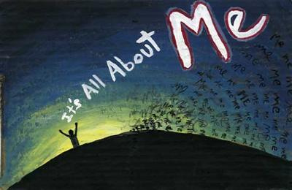
~ Church Worship ~
What I Like
What I Can Get
How Will It Make Me Feel

Slide 10
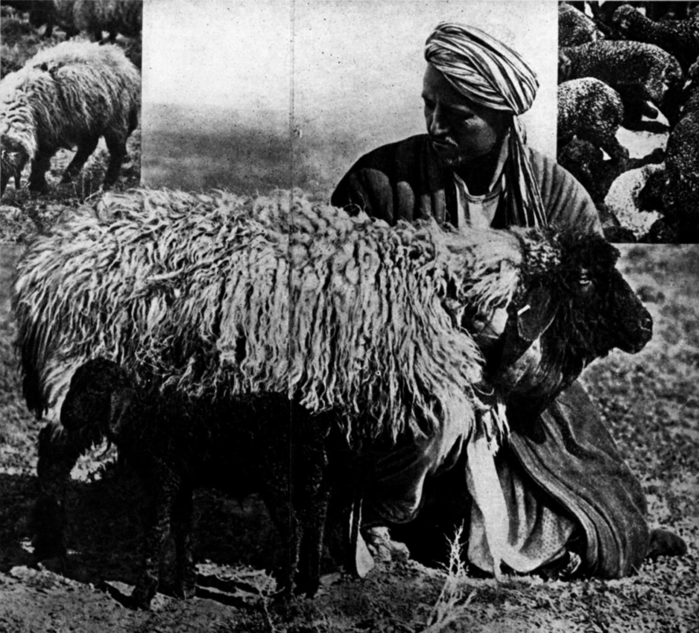
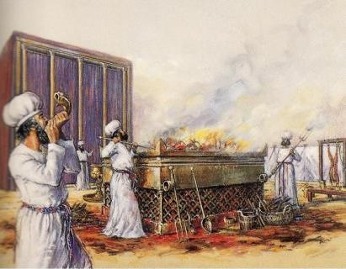
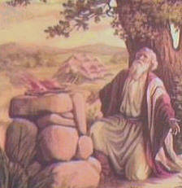
Psalms 96:7-9
Give to the LORD, O families of the peoples, give to the LORD glory and strength.
Give to the LORD the glory due His name; bring an offering, and come into His courts.
Oh, worship the LORD in the beauty of holiness! Tremble before Him, all the earth.
John 4:23-24
But the hour is coming, and now is, when the true worshipers will worship the Father in spirit and truth; for the Father is seeking such to worship Him.
God is Spirit, and those who worship Him must worship in spirit and truth.
Worship the Lord your God
(Matthew 4:10)
“I sure got a lot out of that lamb offering!”
“That burnt offering was so encouraging.”
“I really feel like I’ve been to worship after that blood offering.”
“I feel really edified after seeing all the blood sprinkled around!”

Slide 11
Worship the Lord your God
(Matthew 4:10)
Singing with grace in your hearts to the Lord (Col 3:16)
Psalm 95:6
Oh come, let us worship and bow down; let us kneel before the LORD our Maker.
Heb 12:28-29
Therefore, since we are receiving a kingdom which cannot be shaken, let us have grace, by which we may serve God acceptably with reverence and godly fear. For our God is a consuming fire.
Continued steadfastly . . . in prayers (Acts 2:42)
Continued . . . in the breaking of bread (Acts 2:42, 20:7)
Continued . . . in the apostles' doctrine (Acts 2:42, 20:7)
Continued . . . in fellowship [contribution] (Acts 2:42, Rom 15:26)

Slide 12
How did we get here?
REJECTED BIBLE AUTHORITY ~ Judges 17:6
GROWN UNENTHUSIASTIC ~ Revelation 3:15
SOWED SEEDS OF CASUALNESS ~ Hosea 8:7
SOUGHT THE WISDOM OF MEN ~ 1 Cor 3:1-4

