Slide 2
Luke 22:14-20
14 When the hour had come, He sat down, and the twelve apostles with Him. 15 Then He said to them, with fervent desire I have desired to eat this Passover with you before I suffer; 16 for I say to you, I will no longer eat of it until it is fulfilled in the kingdom of God. 17 Then He took the cup, and gave thanks, and said, take this and divide it among yourselves; 18 for I say to you, I will not drink of the fruit of the vine until the kingdom of God comes. 19 And He took bread, gave thanks and broke it, and gave it to them, saying, this is My body which is given for you; do this in remembrance of Me. 20 Likewise He also took the cup after supper, saying, this cup is the new covenant in My blood, which is shed for you.

Slide 4
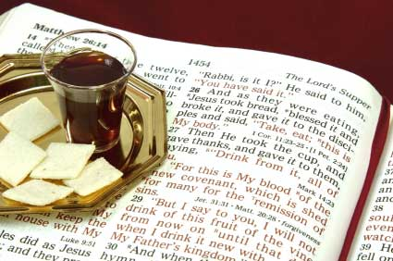
The Lord’s Supper
The Lord’s Supper

Slide 5
While we were at home, I got to go up to _______, Kentucky . . . We worshipped . . . at a new congo there . . . We were tremendously blessed by our time there on Sunday.
This congo has taken positive steps in breaking some of the bonds of traditionalism and toward revitalizing their worship in meaningful ways.
This is particularly apparent with respect to Holy Communion. The Lord’s Supper has been a topic that I’ve spent quite a bit of time on recently, reading everything I can get my hands on—both inside and outside the Stone-Campbell tradition. I’ve read John Mark Hicks’ Come to the Table and some others advocating Lord’s Supper reform among churches of Christ and have been intellectually persuaded by what they had to say.
. . . The church at _______ is the only congo among NI churches of Christ to my knowledge which has thought through and implemented changes in the practice of Communion and last night I got to be a part of that. -- anonymous
A Letter you might find interesting

Slide 6
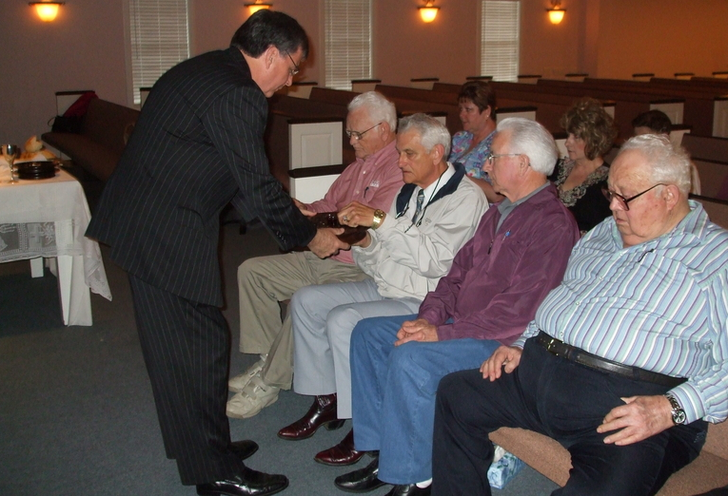
Not just a different way of observing.
A Complete Restructuring
“. . . Gone was the silent, funerary character of our typical practice of Communion—in its place was good discussion and sharing about the Lord Jesus Christ and a true meal setting in which these discussions could take place.”
-- anonymous
Stand / Sit
Break first, then pray
Method of distribution

Slide 7
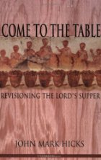
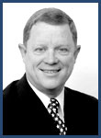
Those Advocating These Changes
J. Stephen
Sandifer
Abilene
Lectureship 2002
A Theology of Eating
Assembling to Break Bread
Pinch and Sip in Silence
Part of a Common Meal
Not Limited to Sunday
Women Leading Discussions
Children & Unbelievers Participating

Slide 8
“But isn’t it possible to work within the system to bring about any necessary changes?”
“. . . The rudimentary concerns which we will discuss . . . Simply cannot be resolved without radically restructuring the church as it presently functions. Indeed, not so much restructuring it, but actually dismantling it by means of recapturing its original definition and meaning” (pgs. 36-37).
A Divisive
Agenda

Slide 9
J. Stephen
Sandifer
Abilene
Lectureship 2002
“Our traditions are so entrenched that we face the same problems Luther, Calvin, Wesley and others did. Change is feared and resisted. A push to correct and restore overnight will result in a church split . . .
“It is important to educate your elders/leaders first. There is nothing like starting something and then finding that Sister Suzie corners an elder and objects, so he shuts the whole thing down.” (“Pinch and Sip”)
A Theology of Eating
Assembling to Break Bread
Pinch and Sip in Silence
A Divisive
Agenda

Slide 10
The Lord’s Supper is to be Observed with a Full Meal
"Do we, for example, observe the Lord's Supper in the same way as the early disciples…?" (Radical Restoration, p 13)
"Without question, on the occasion of its inaugural introduction -- there in the upper room on the night Jesus was betrayed -- the memorial was part of an actual meal being shared" (Radical Restoration, p 129)

Slide 11
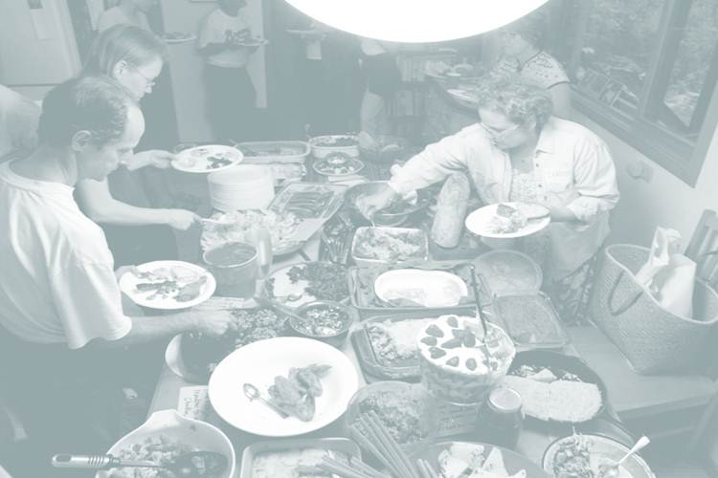
"In this regard, perhaps the most universally-overlooked feature of the Lord's Supper as practiced in the primitive church is that-from all appearances-it was observed in conjunction with a fellowship meal. That is, a normal, ordinary meal with the usual variety of food. However, unlike normal, ordinary meals, this combined table fellowship and memorial was shared among the disciples for the special purpose of strengthening, not just their physical bodies, but their common bond in the spiritual body of Christ…" (Radical Restoration, pgs. 128, 129)
“. . . for the early Christians, gathering around the Lord's table was not the token ritual with which we are familiar, but an actual food-and-drink meal. Certainly, the bread and the wine consumed on those occasions were understood to be symbolic of Christ's body and blood, but they were not just 'emblems'-not just our typical 21st-century crackers and grape juice!…" (Radical Restoration, pgs 132, 133)
“. . . the Lord’s Supper was an integral part of a real meal.“ (Radical Restoration p 129)
"Actually implementing it according to the New Testament pattern is another thing altogether, particularly if we were to go all the way and observe the Supper as an integral part of a fellowship meal in the manner of the early church. Can you imagine it? Virtually every aspect of our Lord's Day assemblies would be thrown into mass confusion! . . . You can be sure that having a first-century fellowship meal as the backdrop for our Sunday services would shatter our customary acts of worship." (Radical Restoration, pgs 141-2)

Slide 12
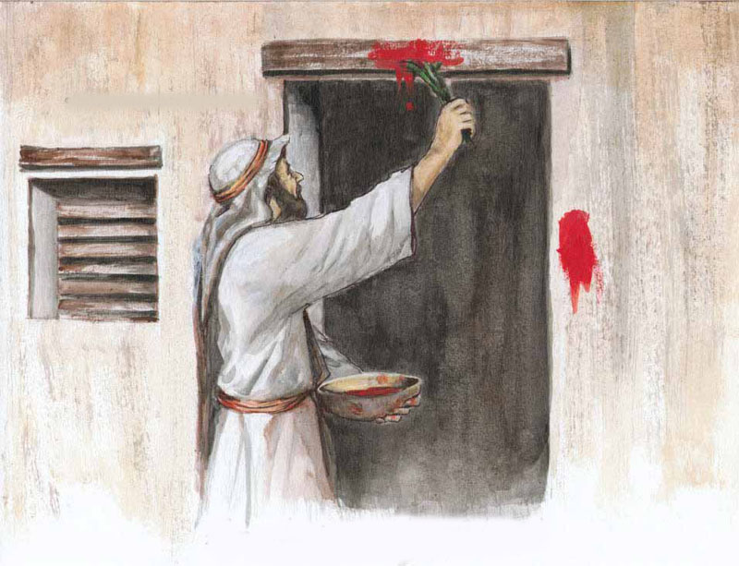
18 In the first month, on the fourteenth day of the month at evening, you shall eat unleavened bread, until the twenty-first day of the month at evening.
19 For seven days no leaven shall be found in your houses . . .
Exodus 12
24 And you shall observe this thing as an ordinance for you and your sons forever.
25 It will come to pass when you come to the land which the LORD will give you, just as He promised, that you shall keep this service.

Slide 13
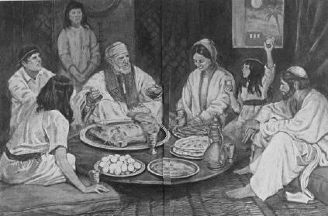
The Passover
1. Fruit of the Vine.
2. Bitter herbs to recall the bitter life in Egypt.
3. Unleavened bread.
4. Charoset (Made of chopped walnuts, grated apples, cinnamon and sweet red wine).
5. The roasted Passover lamb.

Slide 14
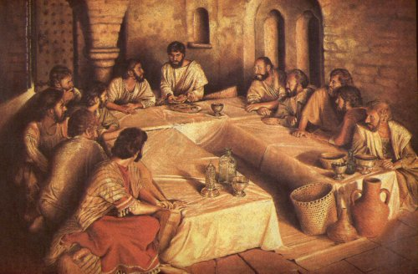
The Passover
The Lord’s Supper
Luke 1:3-4, “it seemed good to me also, having had perfect understanding of all things from the very first, to write to you an orderly account, most excellent Theophilus, that you may know the certainty . . ..”
Luke 22:20, “Likewise He also took the cup after supper . . .”

Slide 15
The Lord’s Supper
After Supper Jesus took only two items:
Unleavened Bread
Fruit of the Vine and instituted a memorial – not a common meal.
Luke 22:19, “do this in remembrance of Me.“

Slide 16
The Lord’s Supper
1 Cor 11:23-25, “For I received from the Lord that which I also delivered to
you: that the Lord Jesus on the same night in which He was betrayed took bread; and when He had given thanks, He broke it and said, take, eat; this is My body which is broken for you; do this in remembrance of Me. In the same manner He also took the cup after supper, saying, this cup is the new covenant in My blood. This do, as often as you drink it, in remembrance of Me."

Slide 17
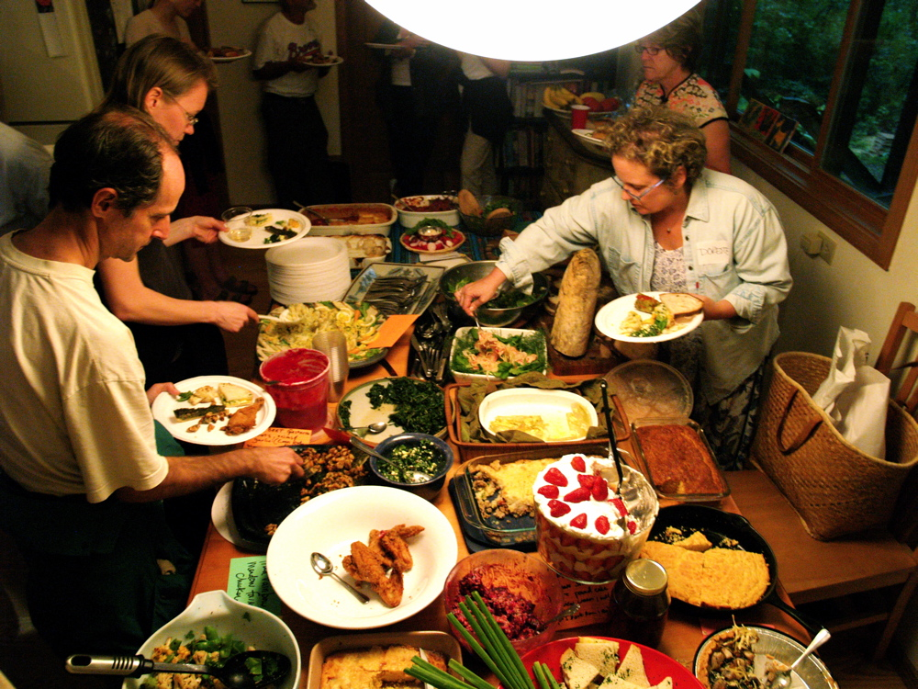
“Several things seem to characterize the early celebration . . . It was a full meal.”
J. Stephen Sandifer, “Assembling to Break Bread”
“The meal is a potluck . . . In the middle of the food sits a single loaf of bread next to a large plastic jug containing the fruit of the vine. Each believer partakes of the bread and juice while going through the serving line.” (Steve Atkerson, The Lord’s Supper, Feast or Famine)

Slide 18
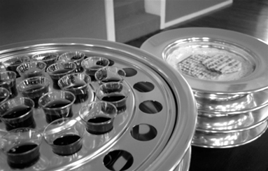
Paul’s
Warning
1 Corinthians 11:17-34
17 Now in giving these instructions I do not praise you, since you come together not for the better but for the worse.
20 Therefore when you come together in one place, it is not to eat the Lord's Supper.
21 For in eating, each one takes his own supper ahead of others; and one is hungry and another is drunk.
22 What! Do you not have houses to eat and drink in?
33 Therefore, my brethren, when you come together to eat, wait for one another.
34 But if anyone is hungry, let him eat at home, lest you come together for judgment.

Slide 19
"Here is where one must be careful not to be thrown off track by Paul's ensuing question: 'Don't you have homes to eat and drink in?' (11:22). Nor by his concluding line: 'If anyone is hungry, he should eat at home, so that when you meet together it may not result in judgment' (11:34). Far from prohibiting a fellowship meal in conjunction with the Lord's Supper, it is clear that Paul is saying (in current vernacular): If the reason you are participating in the fellowship meal is to feed your stomach, then you'd do better to stay home and pig out!" (131).
"One thing is certain: those who object on principle to having kitchens in the church building would have to reconsider that position from scratch. Knowing what we know about first-century fellowship meals, the question isn't so much whether there ought to be a kitchen in the church, but whether the church ought to be in the kitchen." (142).

Slide 20
J. Stephen
Sandifer
Abilene
Lectureship 2002
A Theology of Eating
Assembling to Break Bread
Pinch and Sip in Silence
“The Lord’s Supper was originally a fellowship meal not limited to crackers and juice . . . There is nothing in scripture to specifically limit the offering of the supper to Sunday . . .
If you have a baptism during the week, immediately after the baptism have those present stand around the new convert, pray for them, and serve communion to all who are present.” (Pinch and Sip)

Slide 21
Such irreverence
profanes the
Lord's Supper
Ezekiel 22:26
Her priests have violated My law and profaned My holy things; they have not distinguished between the holy and unholy, nor have they made known the difference between the unclean and the clean; and they have hidden their eyes from My Sabbaths, so that I am profaned among them.
1 Corinthians 11:28-30
But let a man examine himself, and so let him eat of the bread and drink of the cup. For he who eats and drinks in an unworthy manner eats and drinks judgment to himself, not discerning the Lord's body. For this reason many are weak and sick among you, and many sleep.
1 Corinthians 11:28-30
But let a man examine himself, and so let him eat of the bread and drink of the cup. For he who eats and drinks in an unworthy manner eats and drinks judgment to himself, not discerning the Lord's body. For this reason many are weak and sick among you, and many sleep.
Ezekiel 22:26
Her priests have violated My law and profaned My holy things; they have not distinguished between the holy and unholy, nor have they made known the difference between the unclean and the clean; and they have hidden their eyes from My Sabbaths, so that I am profaned among them.

Slide 22
Some assemblies are too wedded to man-tradition.
Some elders are become “Lords Over” or CEO’s.
Some Christians rush through the Lord’s Supper with an attitude of “let’s get this over with.”
With some, the songs and prayers have become mindless rote (mechanical reputation).
Some churches have become more property oriented than soul oriented.
The Appeal

Slide 23
The Solution
Loveless Ephesus
Rev 2:4-5, “Nevertheless I have this against you, that you have left your first love. Remember therefore from where you have fallen; repent and do the first works, or else . . .”
Dead Sardis
Rev 3:2-3, “Be watchful, and strengthen the things which remain, that are ready to die, for I have not found your works perfect before God. Remember therefore how you have received and heard; hold fast and repent.”
Lukewarm Laodicea
Rev 3:18-19, “I counsel you to buy from Me gold refined in the fire, that you may be rich; and white garments, that you may be clothed, that the shame of your nakedness may not be revealed; and anoint your eyes with eye salve, that you may see. As many as I love, I rebuke and chasten. Therefore be zealous and repent.”

