Slide 2
Matthew 26:47-56
⁴⁷ And while He was still speaking, behold, Judas, one of the twelve, with a great multitude with swords and clubs, came from the chief priests and elders of the people. ⁴⁸ Now His betrayer had given them a sign, saying, whomever I kiss, He is the One; seize Him. ⁴⁹ Immediately he went up to Jesus and said, greetings, Rabbi! and kissed Him. ⁵⁰ But Jesus said to him, friend, why have you come? Then they came and laid hands on Jesus and took Him. ⁵¹ And suddenly, one of those who were with Jesus stretched out his hand and drew his sword, struck the servant of the high priest, and cut off his ear. ⁵² But Jesus said to him, put your sword in its place, for all who take the sword will perish by the sword. ⁵³ Or do you think that I cannot now pray to My Father, and He will provide Me with more than twelve legions of angels? ⁵⁴ How then could the Scriptures be fulfilled, that it must happen thus? ⁵⁵ In that hour Jesus said to the multitudes, have you come out, as against a robber, with swords and clubs to take Me? I sat daily with you, teaching in the temple, and you did not seize Me. ⁵⁶ But all this was done that the Scriptures of the prophets might be fulfilled. Then all the disciples forsook Him and fled.

Slide 4
Matthew 26:47-56
⁴⁷ And while He was still speaking, behold, Judas, one of the twelve, with a great multitude with swords and clubs, came from the chief priests and elders of the people. ⁴⁸ Now His betrayer had given them a sign, saying, whomever I kiss, He is the One; seize Him. ⁴⁹ Immediately he went up to Jesus and said, greetings, Rabbi! and kissed Him. ⁵⁰ But Jesus said to him, friend, why have you come? Then they came and laid hands on Jesus and took Him. ⁵¹ And suddenly, one of those who were with Jesus stretched out his hand and drew his sword, struck the servant of the high priest, and cut off his ear. ⁵² But Jesus said to him, put your sword in its place, for all who take the sword will perish by the sword. ⁵³ Or do you think that I cannot now pray to My Father, and He will provide Me with more than twelve legions of angels? ⁵⁴ How then could the Scriptures be fulfilled, that it must happen thus? ⁵⁵ In that hour Jesus said to the multitudes, have you come out, as against a robber, with swords and clubs to take Me? I sat daily with you, teaching in the temple, and you did not seize Me. ⁵⁶ But all this was done that the Scriptures of the prophets might be fulfilled. Then all the disciples forsook Him and fled.
⁴⁷ And while He was still speaking, behold, Judas, one of the twelve, with a great multitude with swords and clubs, came from the chief priests and elders of the people. ⁴⁸ Now His betrayer had given them a sign, saying, whomever I kiss, He is the One; seize Him. ⁴⁹ Immediately he went up to Jesus and said, greetings, Rabbi! and kissed Him. ⁵⁰ But Jesus said to him, friend, why have you come? Then they came and laid hands on Jesus and took Him. ⁵¹ And suddenly, one of those who were with Jesus stretched out his hand and drew his sword, struck the servant of the high priest, and cut off his ear. ⁵² But Jesus said to him, put your sword in its place, for all who take the sword will perish by the sword. ⁵³ Or do you think that I cannot now pray to My Father, and He will provide Me with more than twelve legions of angels? ⁵⁴ How then could the Scriptures be fulfilled, that it must happen thus? ⁵⁵ In that hour Jesus said to the multitudes, have you come out, as against a robber, with swords and clubs to take Me? I sat daily with you, teaching in the temple, and you did not seize Me. ⁵⁶ But all this was done that the Scriptures of the prophets might be fulfilled. Then all the disciples forsook Him and fled.

Slide 5
“My food is to do the will of Him who sent Me, and to finish His work. “ (John 4:34)

Slide 6
He who dipped his hand with Me in the dish will betray Me. (Matt 26:23)
Then Judas, who was betraying Him, answered and said,
“Rabbi, is it I?”
(Matt 26:25)

Slide 7
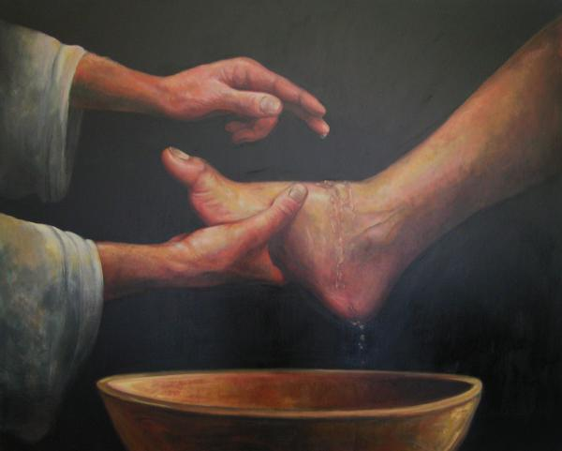
And supper being ended, the devil having already put it into the heart of Judas Iscariot, Simon’s son, to betray Him, Jesus, knowing that the Father had given all things into His hands, and that He had come from God and was going to God, rose from supper and laid aside His garments, took a towel and girded Himself. After that, He poured water into a basin and began to wash the disciples’ feet, and to wipe them with the towel with which He was girded.
(John 13:2-5)
Jesus washes the feet of His betrayer

Slide 8
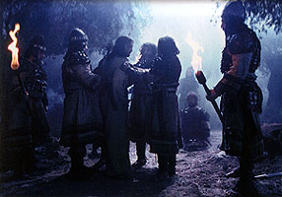
Betrayal in the Garden
And while He was still speaking, behold, Judas, one of the twelve, with a great multitude with swords and clubs, came from the chief priests and elders of the people. Now His betrayer had given them a sign, saying, whomever I kiss, He is the One; seize Him. Immediately he went up to Jesus and said, greetings, Rabbi! and kissed Him.
(Matthew 26:47-49)
But Jesus said to him, friend, why have you come? Then they came and laid hands on Jesus and took Him.
(Matthew 26:50)

Slide 9
J
UDAS
A man who betrayed the Lord

Slide 10
J
UDAS
Became a Traitor
A Disciple
And when it was day, He called His disciples to Himself; and from them He chose twelve whom He also named apostles: Simon, whom He also named Peter, and Andrew his brother; James and John; Philip and Bartholomew; Matthew and Thomas; James the son of Alphaeus, and Simon called the Zealot; Judas the son of James, and Judas Iscariot who also became a traitor. (Luke 6:13-16)
An Apostle
Work Miracles
Treasurer

Slide 11
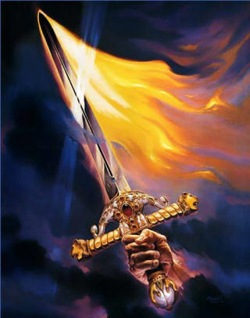
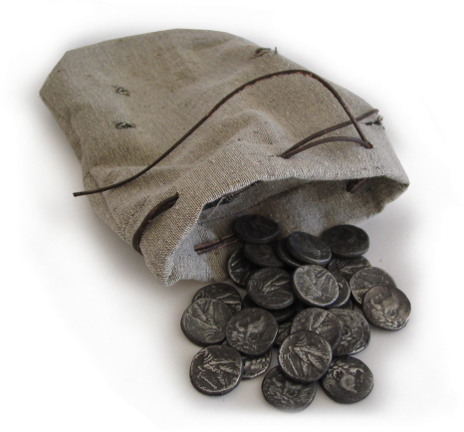
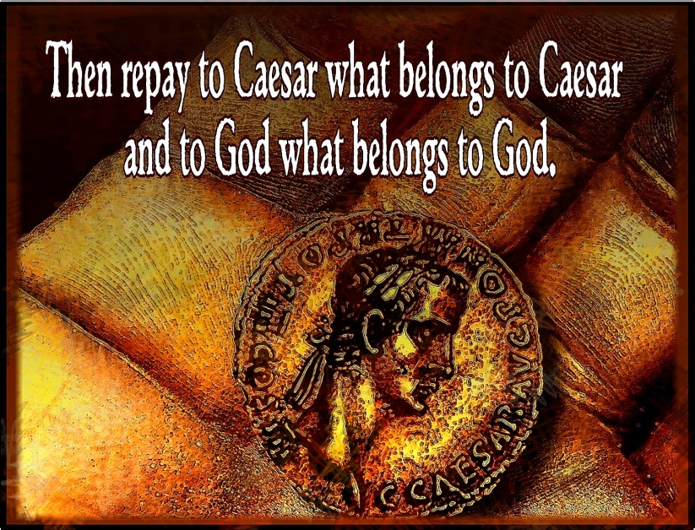
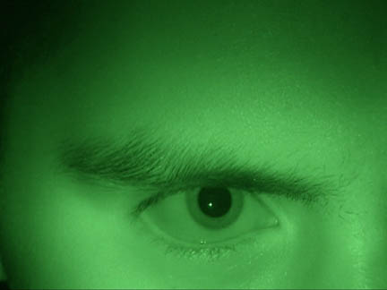
J
UDAS
Why he became a Traitor
For the Money?
Then one of the twelve, called Judas Iscariot, went to the chief priests and said, what are you willing to give me if I deliver Him to you? And they counted out to him thirty pieces of silver. So from that time he sought opportunity to betray Him. (Matthew 26:14-16)
Envy?
A Power Move?
Disappointment ?

Slide 12
J
UDAS
What Happened to Him
Then Judas, His betrayer, seeing that He had been condemned, was remorseful and brought back the thirty pieces of silver to the chief priests and elders, saying, I have sinned by betraying innocent blood. And they said, what is that to us? You see to it! Then he threw down the pieces of silver in the temple and departed, and went and hanged himself. (Matthew 27:3-5)

Slide 13
“. . . this ministry and apostleship from which Judas by transgression fell, that he might go to his own place.” (Acts 1:25)

