Slide 2
John 19:13-19
¹³ When Pilate therefore heard that saying, he brought Jesus out and sat down in the judgment seat in a place that is called The Pavement, but in Hebrew, Gabbatha. ¹⁴ Now it was the Preparation Day of the Passover, and about the sixth hour. And he said to the Jews, behold your King! ¹⁵ But they cried out, away with Him, away with Him! Crucify Him! Pilate said to them, shall I crucify your King? The chief priests answered, we have no king but Caesar! ¹⁶ Then he delivered Him to them to be crucified. So they took Jesus and led Him ¹⁷ And He, bearing His cross, went out to a place called the Place of a Skull, which is called in Hebrew, Golgotha, ¹⁸ where they crucified Him, and two others with Him, one on either side, and Jesus in the center. ¹⁹ Now Pilate wrote a title and put it on the cross. And the writing was:
JESUS OF NAZARETH, THE KING OF THE JEWS.

Slide 4
“For I determined not to know anything among you except Jesus Christ and Him crucified” (1 Corinthians 2:2).
“for the message of the cross is foolishness to those who are perishing, but to us who are being saved it is the power of God” (1 Corinthians 1:18).
“But God forbid that I should boast except in the cross of our Lord Jesus Christ . . .” (Galatians 6:14).

Slide 5
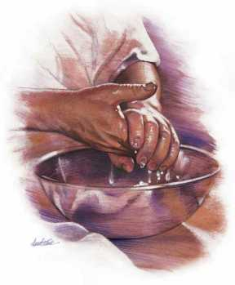
They Crucified Him
“When Pilate saw that he could not prevail at all, but rather that a tumult was rising took water and washed his hands before the multitude, saying, I am innocent of the blood of this just person. You see to it . . . And when he had scourged Jesus,
he delivered Him to be crucified”
(Matthew 27:24-26).

Slide 6
There they Crucified Him
Luke 23:33

Slide 7
My Soul Is Exceedingly Sorrowful
Matt 26:38

Slide 8
Arrest in the Garden
Matt 26:47

Slide 9
Before Caiaphas
Matt 26:57

Slide 10
The False Witnesses
Matt 26:60

Slide 11
Delivered to Pilate
Luke 23:1-4

Slide 12
Delivered to Herod
Luke 23:6-12

Slide 13
Returned to Pilate
Luke 23:13

Slide 14
What shall I do with Jesus?
Matt 27:22

Slide 15
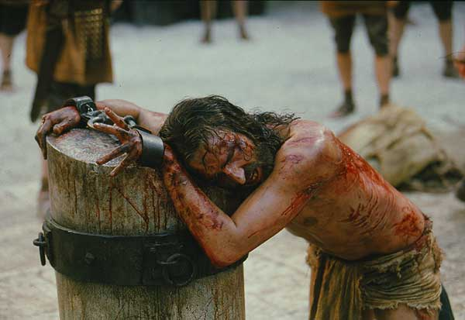
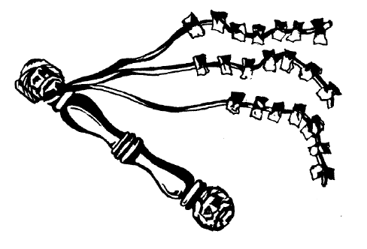
Scourging of Jesus
Matt 27:26

Slide 16
To Calvary
Matt 27:31-33

Slide 17
Then they Crucified Him
Matt 27:35

Slide 18
This is Jesus the King of the Jews
Matt 27:37

Slide 19
It is Finished
John 19:30

Slide 20
He Bore it All
1 Pet 2:24

Slide 21
Egyptians
Philistines
Babylonians
Persians
Greeks
Romans
Cross: An Instrument of Death
“for it is written, cursed is everyone who hangs on a tree” (Galatians 3:13).
Deut 21:23

Slide 22
John 1:51
John 3:14-15
Matthew 9:15
Matthew 12:40
Isaiah 50:6
Isaiah 53:4-8
Psalm 22:1-2
Daniel 9:26

Slide 23
Jesus prepares His disciples
Matthew 16:13-21
Matthew 20:18-19, 28
Matthew 26:12
Luke 17:25
John 2:19-22
John 7:33-34
John 10:11, 17-18
John 12:27

Slide 24
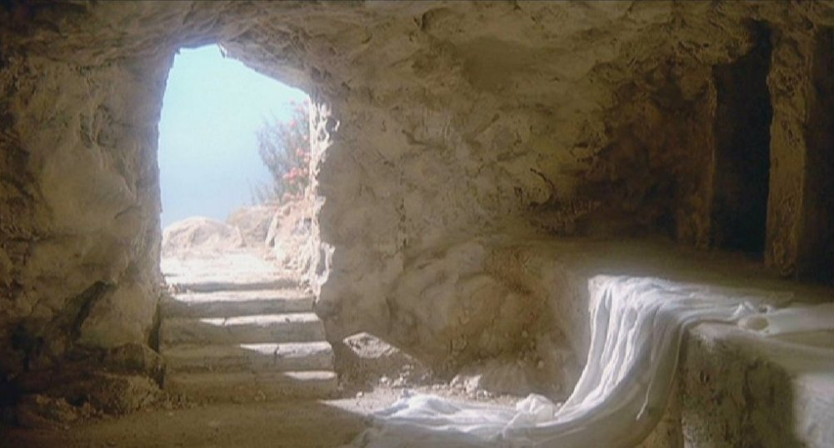
That I might live
He Bore it All
“knowing that you were not redeemed with corruptible things, like silver or gold, from your aimless conduct received from your fathers, but with the precious blood of Christ, as of a lamb without blemish and without spot. He indeed was foreordained before the foundation of the world, but was manifest in these last times for you who through Him believe in God who raised Him from the dead and gave Him glory, so that your faith and hope are in God” (1 Pet 1:18-21).
“knowing that you were not redeemed with corruptible things, like silver or gold, from your aimless conduct received from your fathers, but with the precious blood of Christ, as of a lamb without blemish and without spot. He indeed was foreordained before the foundation of the world, but was manifest in these last times for you who through Him believe in God who raised Him from the dead and gave Him glory, so that your faith and hope are in God” (1 Pet 1:18-21).
“Or do you not know that as many of us as were baptized into Christ Jesus were baptized into his death? Therefore we were buried with him through baptism into death, that just as Christ was raised from the dead by the glory of the Father, even so we should also walk in newness of life”
(Romans 6:3-4).

