Slide 2
Two are better than one, because they have a good reward for their labor. For if they fall, one will lift up his companion. But woe to him who is alone when he falls, for he has no one to help him up. Again, if two lie down together, they will keep warm; But how can one be warm alone? Though one may be overpowered by another, two can withstand him. And a threefold cord is not quickly broken.

Slide 3
Why does the sun go on shining? Why does the sea rush to shore? Don't they know it's the end of the world? 'Cause you don't love me any more…
All the lonely people (Ah, look at all the lonely people); Where do they all come from? All the lonely people…
Lonely, I'm Mr. Lonely I have nobody for my own now I am so lonely…
I’m so lonesome, I could cry…
Only the Lonely…
All by myself…

Slide 4
Two are better than one, because they have a good reward for their labor. For if they fall, one will lift up his companion. But woe to him who is alone when he falls,
For he has no one to help him up. Again, if two lie down together, they will keep warm;
But how can one be warm alone? Though one may be overpowered by another, two can withstand him. And a threefold cord is not quickly broken.

Slide 5
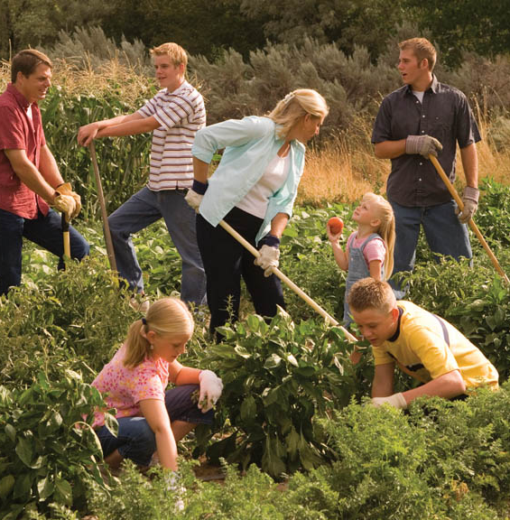
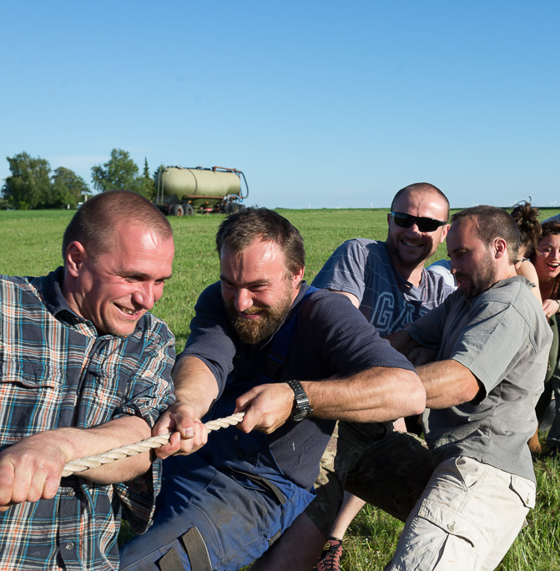
There is a certain power when old and young come together - we can do more together than we can on our own.
No one can do everything, but everyone can do something, and together we can change the world.
Now all who believed were together, and had all things in common,
Acts 2:44
By ourselves we suffer serious limitations. Together we can be something wonderful.
I can do things you cannot, you can do things I cannot; together we can do great things.

Slide 6
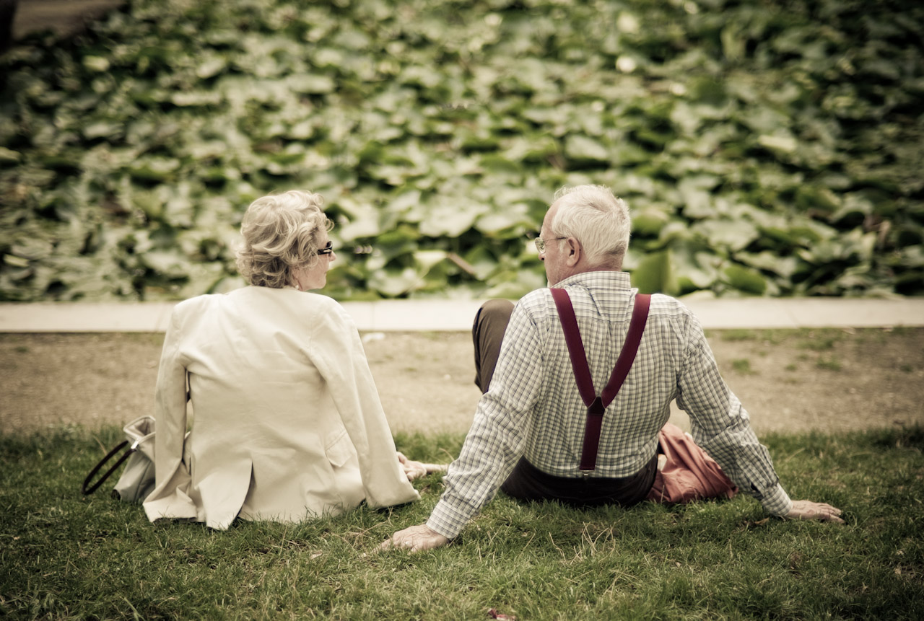
The Value of
Togetherness
And the Lord God said, it is not good that man should be alone; I will make him a helper comparable to him...Then the rib which the Lord God had taken from man He made into a woman, and He brought her to the man…Therefore a man shall leave his father and mother and be joined to his wife, and they shall become one flesh.
Genesis 2:18-24

Slide 7
Togetherness is Two
Looking at the Same Thing
RELATIONSHIP: (Goals, hopes, pleasures, fears)
CHILDREN: (Discipline, what is allowed, and what isn’t)
TRIALS: (Draws closer— not damages the marriage)
LORD: (Pray, read Scripture, worship together)

Slide 8
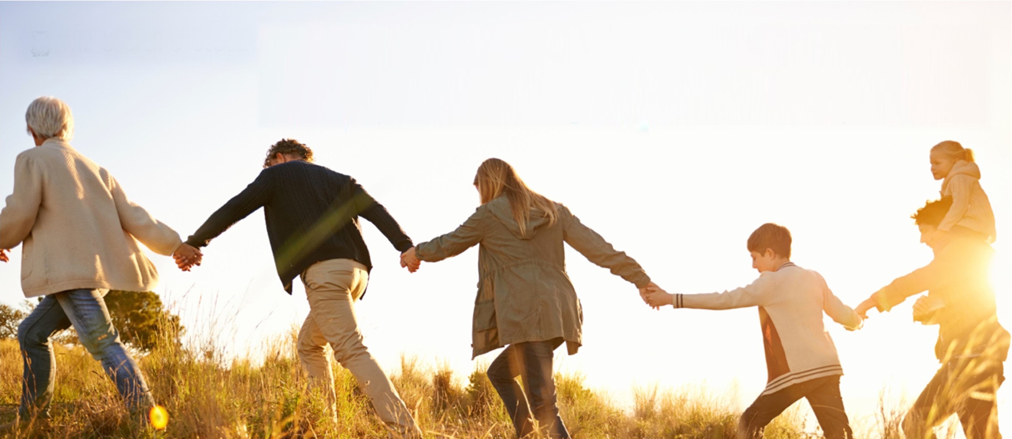
For this reason a man shall leave his father and mother and be joined to his wife, and the two shall become one flesh. This is a great mystery, but I speak concerning Christ and the church. (Eph 5:31-32).
But he who is joined to the Lord is one spirit with Him. (1 Cor 6:17).

Slide 9
Members of One Another ~ Romans 12:5
Family of Brothers & Sisters ~ Romans 12:10

Slide 10
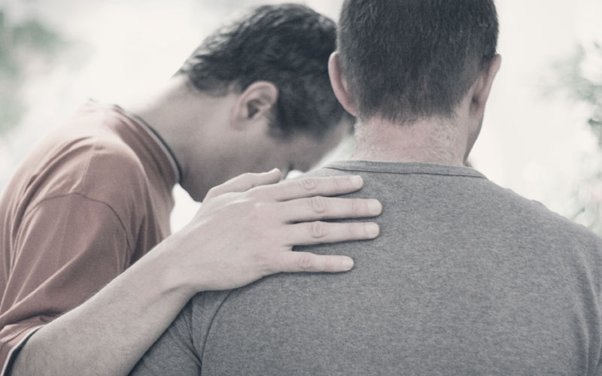
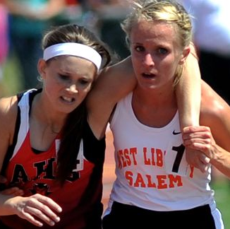
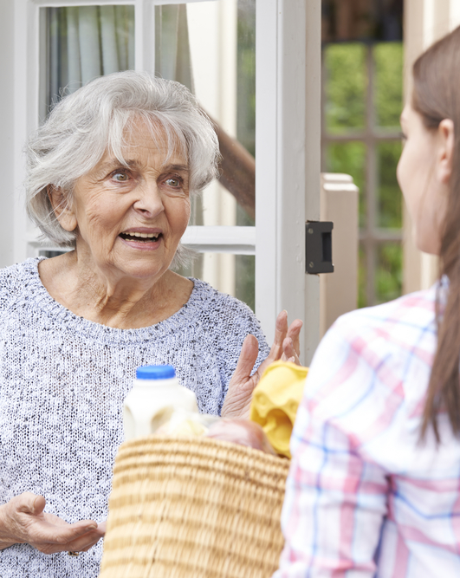
Bear one another’s burdens (Gal 6:2)
Serve one another (Gal 5:13)
Encourage one another (1 Thess 5:11)
Pray for one another (Jas 5:16)

Slide 11
…keep yourselves in the love of God, looking for the mercy of our Lord Jesus Christ unto eternal life. And on some have compassion, making a distinction; but others save with fear, pulling them out of the fire, hating even the garment defiled by the flesh, (Jude 1:21-23).
Can turn our world upside down,
Can strengthen the church,
Can help those that are struggling,
Can comfort those that are hurting,

