Slide 1
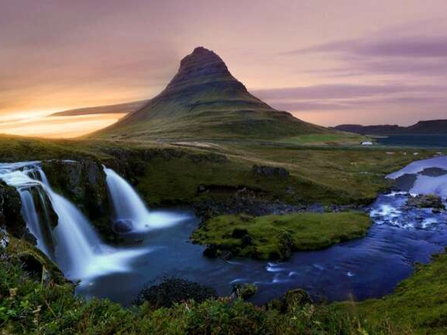
Our God is Awesome

Slide 2
He is Creator of the Universe
He created light before the sun, moon, and stars were created.
The reason He created light is why we still use the light today.
There are currently 10,824 species of birds and 33,000 species of fish. God created them all in one day with His voice.
Everything He created produces after its own kind.

Slide 3
He is Creator of the Universe
If 1 inch = 640.67 km (398 miles):
Depth of the Grand Canyon: 0.00156 inches
Height of Mount Everest: 0.0137 inches
Deepest depth of the Pacific Ocean: 0.0172 inches
Distance between San Francisco and New York: 6.4 inches
Diameter of the Earth: 19.91 inches
Diameter of Jupiter: 222.96 inches (18.4 feet)
Distance between Earth and the moon: 600 inches (50 feet)

Slide 4
He is Creator of the Universe
If 1 inch = 640.67 km (398 miles):
Diameter of the Sun: 2,185.21 inches (181.85 feet)
Distance between Earth and the Sun: 237,251.63 inches (19,771 feet = 3.74 miles)
Distance to the nearest star: 59,312,906,800.7 inches (4,942,742,233.39 feet = 936,125.4 miles)
Size of the Milky Way Galaxy: 1,560,865,968,439.29 inches (130,072,164,036.61 feet = 24,634,879.6 miles)

Slide 5
But He Also Cares For Us
Jeremiah 1:5; Psalm 139:13-14 – He uniquely created us.
Luke 12:7 - He knows us.
1 Corinthians 10:13 - He wants us to be holy.
John 3:16 - He sent His Son to die for us.
Philippians 4:6; James 5:16 - He listens to us.
He wants to live with us for all eternity.

Slide 6
Our God is Awesome
Do you not know? Have you not heard?
The Everlasting God, the Lord, the Creator of the ends of the earth
Does not become weary or tired.
His understanding is inscrutable.
29 He gives strength to the weary,
And to him who lacks might He increases power.
30 Though youths grow weary and tired,
And vigorous young men stumble badly,
31 Yet those who wait for the Lord
Will gain new strength;
They will mount up with wings like eagles,
They will run and not get tired,
They will walk and not become weary.
Isaiah 40:28-31

