Slide 1
……….

Slide 2
Egyptian gods

Slide 3
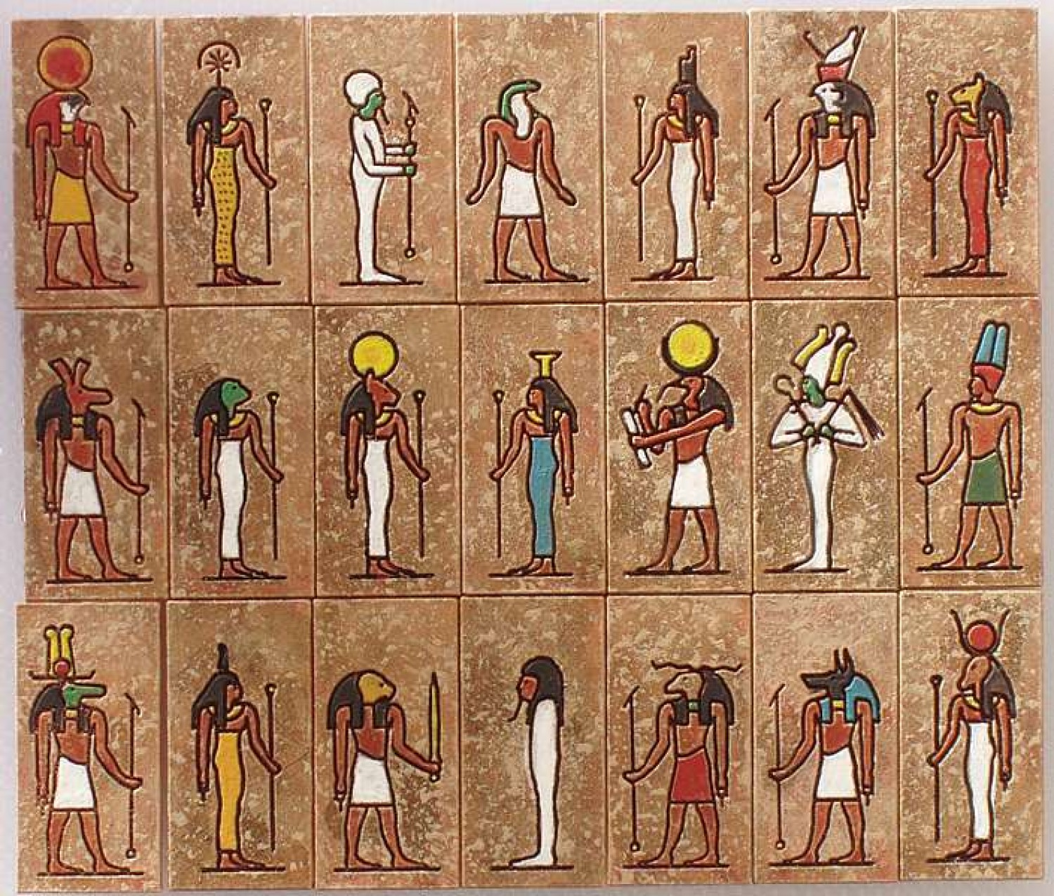
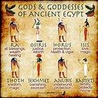

Slide 5
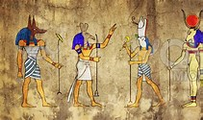

Slide 6
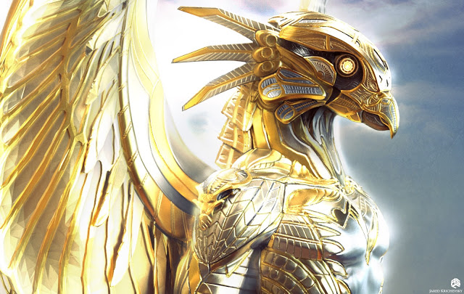

Slide 7
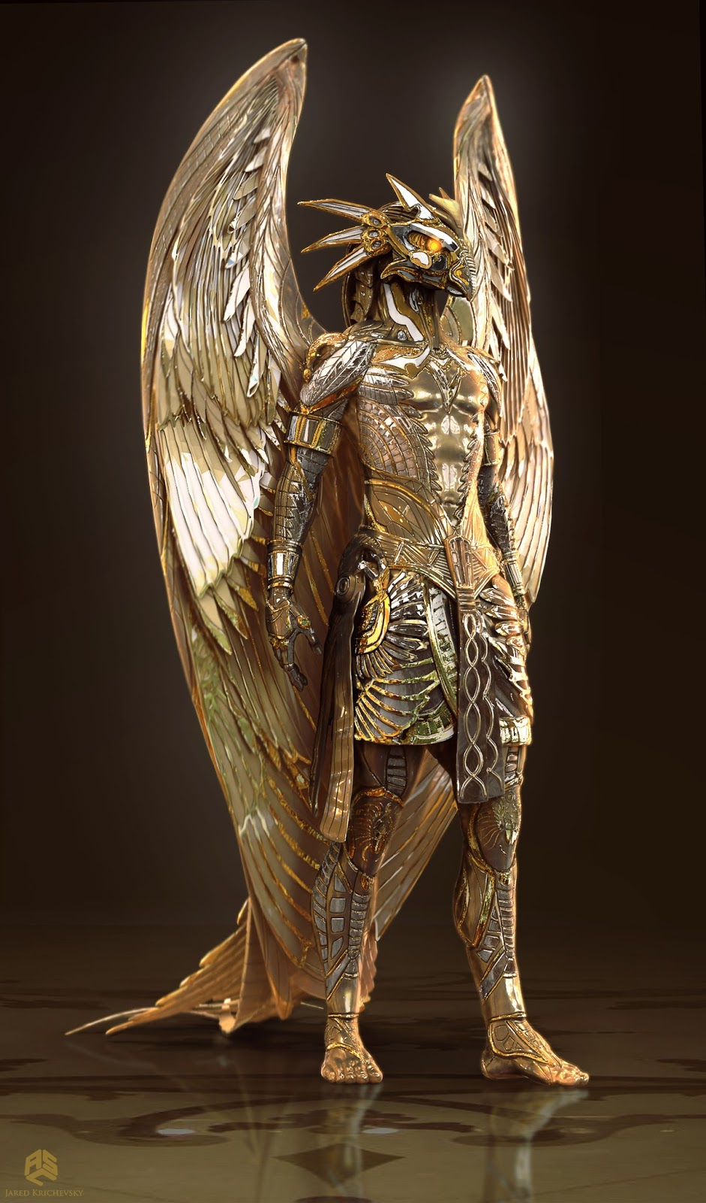

Slide 8
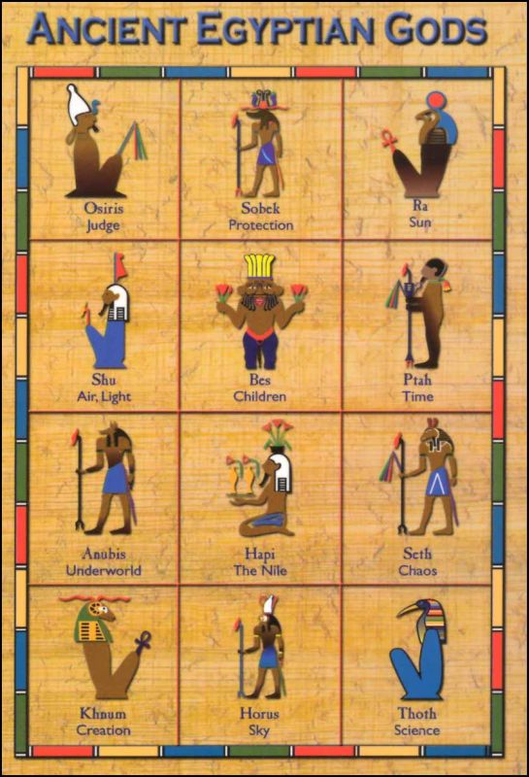
JUDGE
PROTECTION
SUN
AIR, LIGHT
CHILDREN
TIME
UNDERWORLD
THE NILE
CHAOS
CREATION
SKY
SCIENCE

Slide 9
ISAIAH 44:6-23
“This is what the Lord says—Israel’s King and Redeemer, the Lord Almighty: I am the first and I am the last; apart from me there is no God. 7 Who then is like me? Let him proclaim it. Let him declare and lay out before me what has happened since I established my ancient people, and what is yet to come—yes, let them foretell what will come. 8 Do not tremble, do not be afraid. Did I not proclaim this and foretell it long ago? You are my witnesses. Is there any God besides me? No, there is no other Rock; I know not one.” 9 All who make idols are nothing, and the things they treasure are worthless

Slide 10
Those who would speak up for them are blind; they are ignorant, to their own shame. 10 Who shapes a god and casts an idol, which can profit nothing? 11 People who do that will be put to shame; such craftsmen are only human beings. Let them all come together and take their stand; they will be brought down to terror and shame. 12 The blacksmith takes a tool and works with it in the coals; he shapes an idol with hammers, he forges it with the might of his arm. He gets hungry and loses his strength; he drinks no water and grows faint. 13 The carpenter measures with a line and makes an out-line with a marker; he roughs it out with chisels and marks it with compasses. He shapes it in human form, human form in

Slide 11
all its glory, that it may dwell in a shrine. 14 He cut down cedars, or perhaps took a cypress or oak. He let it grow among the trees of the forest, or planted a pine, and the rain made it grow. 15 It is used as fuel for burning; some of it he takes and warms himself, he kindles a fire and bakes bread. But he also fashions a god and worships it; he makes an idol and bows down to it. 16 Half of the wood he burns in the fire; over it he prepares his meal, he roasts his meat and eats his fill. He also warms himself and says, “Ah! I am warm; I see the fire.” 17 From the rest he makes a god, his idol; he bows down to it and worships. He prays to it and says, “Save me! You are my

Slide 12
god!” 18 They know nothing, they understand nothing; their eyes are plastered over so they cannot see, and their minds closed so they cannot understand. 19 No one stops to think, no one has the knowledge or understanding to say, “Half of it I used for fuel; I even baked bread over its coals, I roasted meat and I ate. Shall I make a detestable thing from what is left? Shall I bow down to a block of wood?” 20 He feeds on ashes; A deceived heart has turned him aside; And he cannot deliver his soul, Nor say, “Is there not a lie in my right hand?” 21 “Remember these things, Jacob, for you, Israel, are my servant. I have made you, you are my servant; Israel, I will not forget you

Slide 13
22 I have swept away your offenses like a cloud, your sins like the morning mist. Return to me, for I have redeemed you.”

Slide 14
PSALM 115:1-8
Not to us, Lord, not to us but to your name be the glory, because of your love and faithfulness. 2 Why do the nations say, “Where is their God?” 3 Our God is in heaven; he does whatever pleases him. 4 But their idols are silver and gold, made by human hands. 5 They have mouths, but cannot speak, eyes, but cannot see. 6 They have ears, but cannot hear, noses, but cannot smell. 7 They have hands, but cannot feel, feet, but cannot walk, nor can they utter a sound with their throats. 8 Those who make them will be like them, and so will all who trust in them.

