Slide 3
distress
my
iniquity
sorrow
grief
sighing
31:5
DAVID
adversaries
31:14-16
forgotten

Slide 4
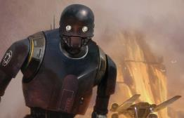
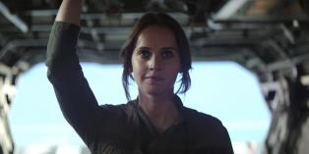
K-2SO
Congratulations! You are being rescued.
Please do not resist.”
Exodus 14:11-13
Jyn

Slide 5
false confidence
in religion
not
in
time
in the world
in goodness

Slide 6
confidence
in Jesus
2 Corinthians 5:15
“And He died for all, that they who live should no longer live for themselves, but for Him who died and rose again on their behalf.”

Slide 7
God reconciled us (5:18) Be reconciled to God! (5:20)
confidence
in Jesus
… sin on our behalf
(5:21)
… might become the righteousness of God in Him
2 Corinthians 5:17
“Therefore, if any man is in Christ, he is a new creature; the old things have passed away, new things have come.”

Slide 8
confidence
in Jesus
1 Corinthians 6:17
“But the one who joins himself to the Lord is one spirit with Him.”

