Slide 4
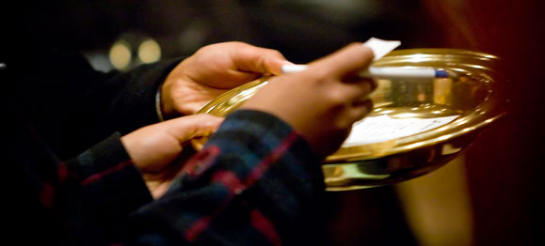
Now concerning the collection for the saints, as I have given orders to the churches of Galatia, so you must do also: On the first day of the week let each one of you lay something aside, storing up as he may prosper, that there be no collections when I come, (1 Cor 16:1-2).
COMMAND: A command given to the church at Corinth as well as the churches of Galatia.
A uniform practice (1 Cor 4:17).
Including the Danville church!

Slide 5
SUNDAY: This phrase (kata mian sabbatou) means EVERY 1st day of the week (NIV, “On the first day of every week . . .”).
[Lk 18:12].
Now concerning the collection for the saints, as I have given orders to the churches of Galatia, so you must do also: On the first day of the week let each one of you lay something aside, storing up as he may prosper, that there be no collections when I come, (1 Cor 16:1-2).

Slide 6
PERSONAL: This means every member of this (or any) local church!
If you are a Christian—if you have earned anything (prospered) then YOU are to contribute!
Now concerning the collection for the saints, as I have given orders to the churches of Galatia, so you must do also: On the first day of the week let each one of you lay something aside, storing up as he may prosper, that there be no collections when I come, (1 Cor 16:1-2).

Slide 7
THIS IS NOT A STORING UP AT HOME: This “storing up” is the same as the “collection.”
This is a collection of the local family of believers (church treasury)!
Now concerning the collection for the saints, as I have given orders to the churches of Galatia, so you must do also: On the first day of the week let each one of you lay something aside, storing up as he may prosper, that there be no collections when I come, (1 Cor 16:1-2).

Slide 8
NOT A SET AMOUNT (10%): But the gift (giving) should be in proportion to how much you have been prospered (financially increased).
But it is to be generous—2 Cor 9:6-7.
Now concerning the collection for the saints, as I have given orders to the churches of Galatia, so you must do also: On the first day of the week let each one of you lay something aside, storing up as he may prosper, that there be no collections when I come, (1 Cor 16:1-2).

Slide 10
Server
Gratuity
An article un USA Today suggests that 20 percent is standard, although some patrons are willing to pay 25 percent or even more for exceptional service, and knock gratuity down to 15 percent for sub-par attendance.
Nowadays, 15 percent isn’t an average tip – it’s a way of registering displeasure with the service.

Slide 11
No one can serve two masters; for either he will hate the one and love the other, or else he will be loyal to the one and despise the other. You cannot serve God and mammon,
Matthew 6:24
Some are simply covetous (1 Tim 6:10; Lk 12:15; Eph 5:5; 1 Cor 5:9-11).
Some do not understand that giving is an expression of worship (2 Cor 8:7).
Some believe giving is optional: “You don’t have to give unless you want to.”
Many do not know how often the Bible discusses giving.

Slide 12
There are at last 350 Scriptures in the Bible referring to money; “A good name is more desirable than great riches; to be esteemed is better than silver or gold” (Prov 22:1).
Jesus talked about money 15% of the time during His 3 years of preaching; “Now these are the ones sown among thorns; they are the ones who hear the word, and the cares of this world, the deceitfulness of riches, and the desires for other things entering in choke the word, and it becomes unfruitful. ” (Mk 4:18-19).
In the book of Matthew—giving is mentioned 33 times.
In Mark—it is mentioned 20 times.
In Luke—giving is discussed 53 times.
In John—17 times.
Giving is mentioned in EVERY book in the New Testament.
Giving is discussed more than faith, repentance, confession, baptism and church organization COMBINED!

Slide 14
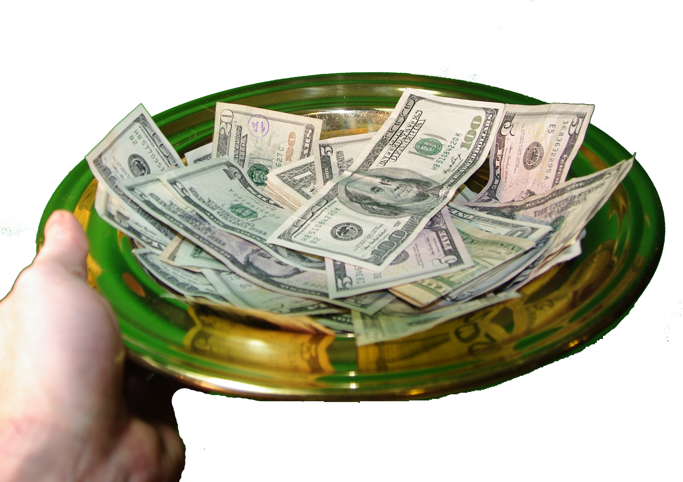
So the church can pay it’s bills (electric, water, etc.).
To buy communion bread/juice; class material.
To pay a preacher (in the estimates of some)—makes too much.
To help members who get themselves in financial binds.
Save up a “rainy-day” fund—in case the air conditioner goes out.
Give a little sustenance to preachers in the “field.”
First Day of the Week Contribution

Slide 16
Then Melchizedek king of Salem brought out bread and wine; he was the priest of God Most High. And he blessed him and said: Blessed be Abram of God Most High, possessor of heaven and earth; And blessed be God Most High, who has delivered your enemies into your hand. And he gave him a tithe of all.
Genesis 14:18-20
And when they had come into the house, they saw the young Child with Mary His mother, and fell down and worshiped Him. And when they had opened their treasures, they presented gifts to Him: gold, frankincense, and myrrh.
Matthew 2:11

Slide 17
SINGING: Christians join their voices in a common song. Jesus joining together with us as the one body offering praise to the name of God.
PRAYER: Christians join as one body in singular prayer to God offered through Jesus as head of that body.
LORD’S SUPPER: Christians join in communion as a reminder and symbol of our fellowship with one another, and w/Christ and His sufferings.
TEACHING: When Christians join their minds and hearts in study and meditation upon God's word, we grow together in understanding, and as one body move closer to perfection and unity.
GIVING: The freewill offering of Christians is a collective sacrificial expression of praise for the grace extended to us through Jesus Christ.

Slide 18
It’s never been about “giving” being commanded!
It has never been about whether “giving” is worship!
More often than not—it is about greed (Matt 13:22).

Slide 19
For where your treasure is, there your heart will be also (Matt 6:21).
It enslaved Judas—“. . . he was a thief, and had the money box; and he used to take what was put in it” (Jn 12:6); betrayed Christ for money, (Matt 26:14-16).
It captured Ananias & Saphira—Acts 5:1-4.
Money ruled the wealthy farmer—Lk 12:15.
Money conquered the young Ruler—Matt 19:22.
Greed is idolatry—Col 3:5.
Love of money is a root of all kinds of Evil—1 Tim 6:10 (it is the doorway through which all manner of sin enters, including NOT giving as one is prospered)!

Slide 20
Society views covetousness as a virtue: (Movies: “Jerry Maguire,” “An American Psycho,” “Boiler Room,” “Wall Street.”
Or, an amusing flaw: (Maybe money can’t buy happiness, but I’d rather be unhappy in a mansion than in a shack.
I’m not greedy: Instead I’m frugal, thrifty, penny-wise—after all “A fool and his money are soon parted.”
Ask yourself: When is the last time you heard of a church disciplining a covetous member, or of someone confessing the sin of covetousness?

Slide 21
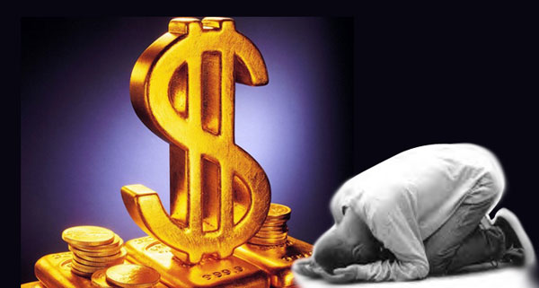
Understand that all that we think is ours belongs to God (Psa 24:1; Psa 50:10).
By being content with what God has granted to us (Heb 13:5).
Know we are mere “stewards” of what God has granted us to use (Lk 16:1-13).
Remember we will be held accountable to God for the way we use wealth (Rom 14:12; 1 Tim 6:17-19); (“Give an account of your stewardship . . .,” Lk 16:1).
Learn God’s principle for earning: “. . . let him labor, working with his hands what is good, that he may have something to give him who has need” (Eph 4:28).
Remember to abound in 1st Day of the Week giving (2 Cor 8:7; 2 Cor 9:6-8).

Slide 22
Worksheet Questions:
(1 Cor 16) 1 Now concerning the collection for the saints, as I have given orders to the churches of Galatia, so you must do also: 2 On the first day of the week let each one of you lay something aside, storing up as he may prosper, that there be no collections when I come.
These verses tell us a lot about our giving. How do these verses instruct us in the following:
That giving is commanded?___________________________________
That giving is systematic?____________________________________
That giving is limited?_______________________________________
That giving is proportionate?__________________________________
“given orders” “must do also”
“first day of the week”
to “each one of you” & “for the saints”
“as he may prosper”

Slide 23
Worksheet Questions:
The sacrifices made to God in the O.T. (e.g., Num 18:11; Heb 5:1) were called what?
Num 18:11, “This also is yours: the heave (wave) offering of their gift, with all the wave offerings of the children of Israel; I have given them to you, and your sons and daughters with you, as an ordinance forever. Everyone who is clean in your house may eat it.”
Heb 5:1, “Every high priest is selected from among the people and is appointed to represent the people in matters related to God, to offer gifts and sacrifices for sins.”

Slide 24
Worksheet Questions:
When using our money to help others (sharing), what is it called (Heb 13:16)?
Heb 13:16, “And do not forget to do good and to share with others, for with such sacrifices God is pleased.”

Slide 25
Worksheet Questions:
When the Philippian church sent money (support) to Paul, what was it called (Phil 4:18)?
Phil 4:18, “I have received full payment and have more than enough. I am amply supplied, now that I have received from Epaphroditus the gifts you sent. They are a fragrant offering, an acceptable sacrifice, pleasing to God.”

Slide 26
Worksheet Questions:
“And they continued steadfastly in the apostles’ doctrine and fellowship, in the breaking of bread, and in prayers” (Acts 2:42). It is rightly concluded that this verse reveals the worship being offered by the Jerusalem church. Included is “fellowship.” This translates the Greek word koinōnia, a word meaning “(lit: partnership) (a) contributory help, participation, (b) sharing in, communion, (c) spiritual fellowship,” (Thayer’s Lexicon).
The same word is used in Rom 15:26 & 2 Cor 9:13. Consider these verses and tell what each is discussing?
Therefore, when koinōnia is used in the context of expressions of worship (breaking of bread, prayers, etc.) THINK what is the obvious conclusion one should reach about it?
Rom 15:26 (koinōnia) contribution / 2 Cor 9:13 ~ sharing/contribution
That koinōnia is also an expression of worship—as much as the others . . .

Slide 27
Worksheet Questions:
It is evident that the first century church was extremely generous in giving (2 Cor 8:3; Acts 2:44-45). THINK, why do you suppose the early church was so generous in their giving? And is this generous spirit something we (the 21st century church) have captured?
Consider these 6 – reasons for the early church’s generosity!

Slide 28
For some it was their Jewish background
All Christians were zealous new converts
The church had a clear vision of its mission
They sincerely believed the words of Jesus
They lived in the “shadow” of the cross
They first gave themselves to the Lord

Slide 29
I gave My life for thee, My precious blood I shed, that thou might ransomed be, and raised up from the dead, I gave, I gave My life for thee, what hast thou given for Me?
And is this generous spirit something we (the 21st century church) have captured?
A belief in the words of Jesus (Acts 20:35)?
A sacrificial passion for the Lord (Rev 3:19)?
A heartfelt devotion to our mission (Lk 19:10)?
An unwavering trust in the Lord (Prov 3:5)?
I have been changed by the Cross (Gal 2:20)?
I’ve first given myself to Christ (2 Cor 8:5)?

