Slide 2
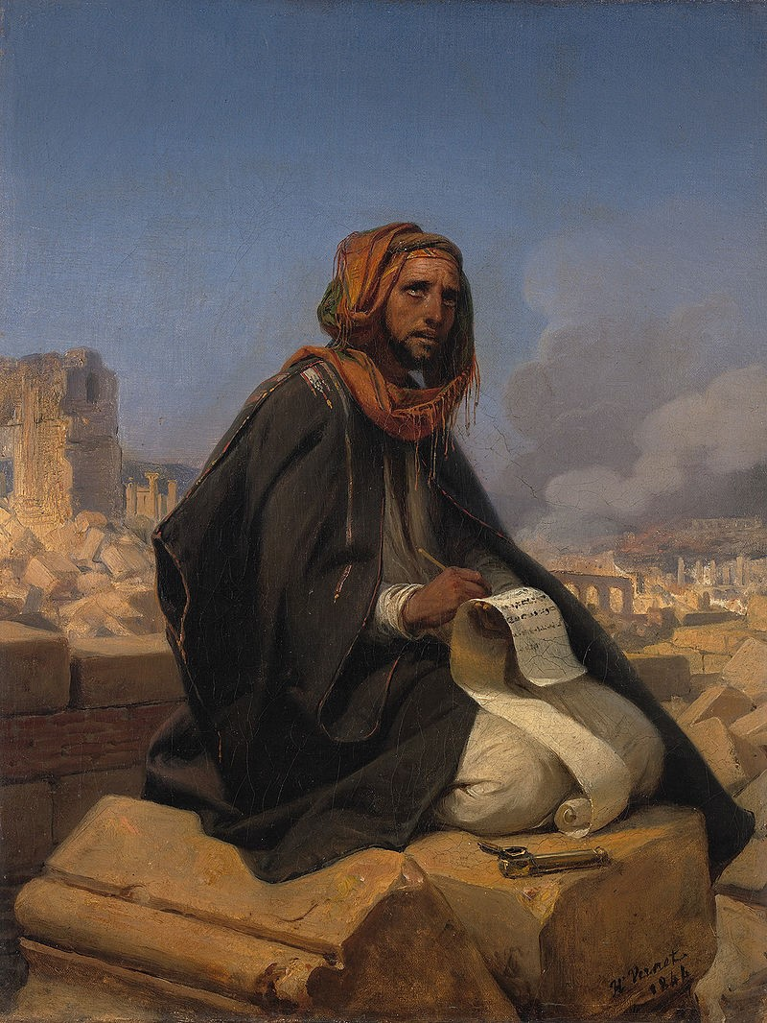
Jeremiah
G R A C E I N T H E E N D
Week 13 (9.24 – 9.27)
Conclusion: Fall of Jerusalem (52:1-34)
Jerusalem’s Fall & Zedekiah’s Blinding (vv.1-11)
The Destruction of the Temple (vv.12-23)
The Exile of the People (vv.24-30)
The Continuation of the Davidic Lineage (vv.31-34)

Slide 3
Week 13 (9.24 – 9.27)
Conclusion: Fall of Jerusalem (52:1-34)
JERUSALEM’S FALL & ZEDEKIAH’S BLINDING (VV.1-11)
Zedekiah’s failure (vv.1-3)
Nebuchadnezzar’s victory (vv.4-6)
The fleeing of the faithless (vv.7-8)
The punishment of the faithless (vv.9-11)

Slide 4
Week 13 (9.24 – 9.27)
Conclusion: Fall of Jerusalem (52:1-34)
JERUSALEM’S FALL & ZEDEKIAH’S BLINDING (VV.1-11)
THE DESTRUCTION OF THE TEMPLE (VV.12-23)
Jerusalem burned & elite exiled (vv.12-16)
Temple pillaged & defiled (vv.17-23)

Slide 5
Week 13 (9.24 – 9.27)
Conclusion: Fall of Jerusalem (52:1-34)
JERUSALEM’S FALL & ZEDEKIAH’S BLINDING (VV.1-11)
THE DESTRUCTION OF THE TEMPLE (VV.12-23)
THE EXILE OF THE PEOPLE (VV.24-30)
Nation’s leaders slaughtered (vv.24-27)
3 stages of exile (vv.28-30)

Slide 6
Week 13 (9.24 – 9.27)
Conclusion: Fall of Jerusalem (52:1-34)
JERUSALEM’S FALL & ZEDEKIAH’S BLINDING (VV.1-11)
THE DESTRUCTION OF THE TEMPLE (VV.12-23)
THE EXILE OF THE PEOPLE (VV.24-30)
THE CONTINUATION OF THE DAVIDIC LINEAGE (VV.31-34)

Slide 8
Jeremiah
G R A C E I N T H E E N D
Week 13 (9.24 – 9.27)
Applying the Book of Jeremiah

Slide 9
Week 13 (9.24 – 9.27)
Applying the Book of Jeremiah
THE PROPHET’S CALL & OUR CALL (1:4-10)
FIRST LOVE ABANDONED (2:1-3)
THE COST OF REPENTANCE (3:1-5)
LIMITLESS FORGIVENESS (3:6-4:4)
WARNINGS OF JUDGMENT (4:5-6:30)
FALSE SECURITY (7:1-8:3)
HYPOCRITICAL RELIGION (8:8-9)
ANGER & PAIN OF GOD (8:16-9:1)
GOD’S NAME, GOD’S PRAISE, & GOD’S GLORY (13:1-11)
LIMITS OF PATIENCE (15:1-9)

Slide 10
Week 13 (9.24 – 9.27)
Applying the Book of Jeremiah
GENTILES WOULD BELIEVE (16:19-21)
CLAY IN THE POTTER’S HAND (18:1-12)
IS GOD FOR US OR AGAINST US? (21:4-5)
KNOWING THE LORD (22:15-16)
FALSE PROPHETS (23:9-40)
GRACE & FAITH (25:7)
FATE OF THE FAITHFUL (26:18-23)
LIVING IN THIS WORLD (29:5-7)
HOLY SCRIPTURES (36)
TOO LITTLE TOO LATE (37:17-21; 38:14-23)
BABYLON (50-51)

