Slide 1
Scripture Reading:
John 19:38-42

Slide 3
EVANGELISM
Jesus & Nicodemus—Gospel Rebirth

Slide 4
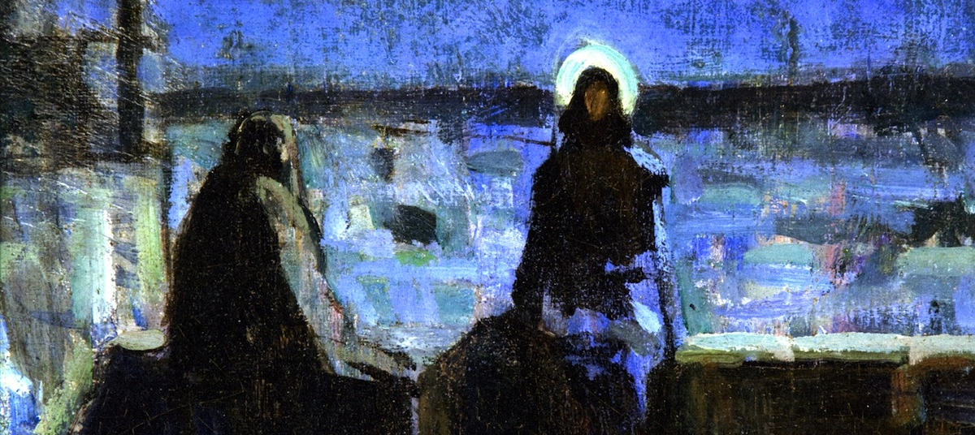
EVANGELISM: Jesus & Nicodemus—Gospel Rebirth
Nicodemus was very religious (vv.1-2)
Open confession of Jesus as Lord,
not religion, saves

Slide 5
that if you confess with your mouth Jesus as Lord, and believe in your heart that God raised Him from the dead, you will be saved; for with the heart a person believes, resulting in righteousness, and with the mouth he confesses, resulting in salvation.
(Romans 10:9-10)

Slide 6
EVANGELISM: Jesus & Nicodemus—Gospel Rebirth
Nicodemus had to start over (v.3)
Status & achievements do not save; rather, sinners require rebirth

Slide 7
EVANGELISM: Jesus & Nicodemus—Gospel Rebirth
Nicodemus underestimated God’s power (vv.4-8)

Slide 8
Then I will sprinkle clean water on you, and you will be clean; I will cleanse you from all your filthiness and from all your idols. Moreover, I will give you a new heart and put a new spirit within you; and I will remove the heart of stone from your flesh and give you a heart of flesh. I will put My Spirit within you and cause you to walk in My statutes, and you will be careful to observe My ordinances.
(Ezekiel 36:25-27)

Slide 9
But before very long there rushed down from the land a violent wind, called Euraquilo; and when the ship was caught in it and could not face the wind, we gave way to it and let ourselves be driven along.
(Acts 27:14-15)

Slide 10
EVANGELISM: Jesus & Nicodemus—Gospel Rebirth
Nicodemus underestimated God’s power (vv.4-8)
Knowledge of Scripture does not save; but rather the transformative work
of God’s Spirit through
baptism

Slide 11
EVANGELISM: Jesus & Nicodemus—Gospel Rebirth
Nicodemus should have known better (vv.9-11)
Academic study of Scripture
does not guarantee a proper understanding of
Scripture

Slide 12
EVANGELISM: Jesus & Nicodemus—Gospel Rebirth
Nicodemus should have known better (vv.9-11)
Academic study of Scripture
does not necessarily result
in saving faith

Slide 13
EVANGELISM: Jesus & Nicodemus—Gospel Rebirth
Nicodemus did not have faith
(vv.12-13)
If one cannot grasp the fundamentals
of faith all further study is futile

Slide 14
“Blessed are the poor in spirit, for theirs is the kingdom of heaven.”
(Matthew 5:3)

Slide 15
EVANGELISM: Jesus & Nicodemus—Gospel Rebirth
Nicodemus had to witness the cross
(vv.14-15)

Slide 16
Behold, My servant will prosper,
He will be high and lifted up and greatly exalted.
(Isaiah 52:13)

Slide 17
Now, Father, glorify Me together with Yourself, with the glory which I had with You before the world was.
(John 17:5)

Slide 18
So Jesus said, “When you lift up the Son of Man, then you will know that I am He, and I do nothing on My own initiative, but I speak these things as the Father taught Me.
And I, if I am lifted up from the earth, will draw all men to Myself.”
(John 8:28; 12:32)

Slide 19
EVANGELISM: Jesus & Nicodemus—Gospel Rebirth
Nicodemus had to witness the cross
(vv.14-15)
We all must turn to Jesus & see
Him “lifted up” on cross to
inherit “eternal life”

Slide 20
EVANGELISM: Jesus & Nicodemus—Gospel Rebirth
Nicodemus could find eternal life in Jesus
(v.15)
Faith takes time to grow

