Slide 1
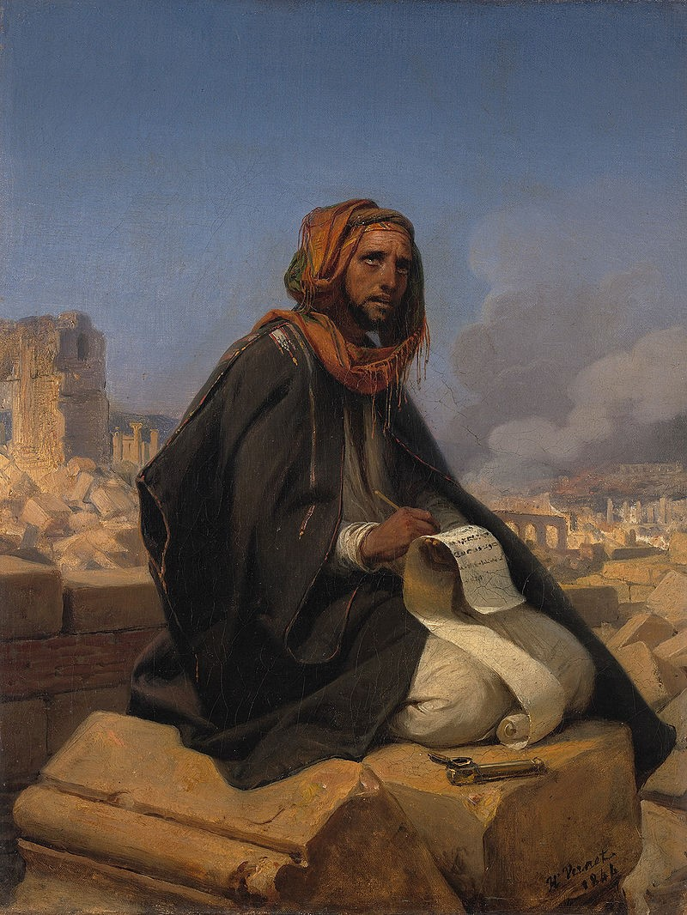
Jeremiah
G R A C E I N T H E E N D
Week 1 (7.2 - 7.5)
Introduction
Jeremiah & the times he spoke into
Jeremiah & the book he speaks through
Jeremiah & the God he spoke for

Slide 2
Jeremiah
Jeremiah & the times he spoke into
THE ERA BEFORE HIS CALL
Jotham (750-735) | Ahaz (735-715) | Hezekiah (715-687) | Manasseh (687-642) | Amon (642-640) | Josiah (640-609)
735 BC
Assyria Defeats
Syria/Israel Rebellion
Judah Serves Assyria
715 BC
Hezekiah Reforms Judah Politically & Spiritually
687 BC
Manasseh Brings Political & Spiritual Ruin to Judah
640 BC
Josiah Reforms Judah Politically & Spiritually
626 BC
Babylon Conquers Assyria
Jeremiah’s
call (1:2)
745 BC
Tiglath Pileser III
King of Assyria
722 BC
Samaria Destroyed by Assyria
705 BC
Sennacherib King of Assyria; Judah Distressed & Delivered
642 BC
Amon Brings Further Destruction
627 BC
Ashurbanipal King of Assyria; Assyria Begins to Weaken
622 BC
The Book of the Law was Discovered in the Temple
Assyrian Domination | Babylonian Domination

Slide 3
Jeremiah
Jeremiah & the times he spoke into
THE ERA BEFORE HIS CALL
THE YEARS DURING HIS MINISTRY
Jehoiakim (609-598) | Jehoiachin (3 months) | Zedekiah (597-586)
609 BC
Judah Defeated by Egypt; Jehoiakim Installed as King
597 BC
Jehoiakim Dies; Jehoiachin Surrenders; 1st Deportation
587-586 BC
Jerusalem Destroyed; 2nd Deportation; Gedaliah Governor
605 BC
Nebuchadnezzar Conquers Egypt
589 BC
Zedekiah Rebels; Nebuchadnezzar Invades Judah
Babylonian Domination

Slide 4
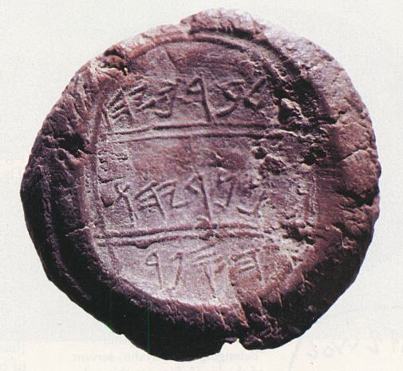
Jeremiah
Jeremiah & the times he spoke into
Jeremiah & the book he speaks through
THE SCROLLS

Slide 5
Jeremiah
Jeremiah & the times he spoke into
Jeremiah & the book he speaks through
THE SCROLLS
THE STRUCTURE
Jeremiah 1:9-10
Then the LORD stretched out His hand and touched my mouth, and the LORD said to me,
“Behold, I have put My words in your mouth.
“See, I have appointed you this day over the nations and over the kingdoms,
To pluck up and break down,
To destroy and to overthrow,
To build and to plant.”
BALANCE
ORDER

Slide 6
Jeremiah
Jeremiah & the times he spoke into
Jeremiah & the book he speaks through
THE SCROLLS
THE STRUCTURE
Calling (1)
Accusation & Warning for Israel (1-24)
Adopted worship of Canaanite gods
Accusation of Israel’s leaders
Rampant social injustice
Jeremiah’s temple sermon (7)
Transition (25)
Looks back to previous prophecy (vv.1-7)
Looks ahead to Judah’s judgment at the hands of Babylon (vv.8-11)
Looks ahead to God’s promised judgment on Babylon & all nations (vv.12-38)
Judgment & Hope for Israel (26-45)
Jeremiah rejected by Israel’s leaders (26-29)
Siege & Destruction of Jerusalem (34-45)
Judgment & Hope for the Nations (46-51)
God will use Babylon to judge the nations around Israel (46-49)
God’s coming judgment on Babylon itself (50-51)
HOPE FOR ISRAEL’S FUTURE (30-33)
Destruction & Exile (52)
Fulfillment of Jeremiah’s warnings of judgment
Promise of future hope

Slide 7
Jeremiah
Jeremiah & the times he spoke into
Jeremiah & the book he speaks through
Jeremiah & the God he spoke for
THE PASSION OF GOD
THE WORD OF GOD
THE SOVEREIGNTY OF GOD
THE MISSION OF GOD

Slide 8
Jeremiah
Summary
Calling (1)
Accusation & Warning for Israel (1-24)
Adopted worship of Canaanite gods
Accusation of Israel’s leaders
Rampant social injustice
Jeremiah’s temple sermon (7)
Transition (25)
Looks back to previous prophecy (vv.1-7)
Looks ahead to Judah’s judgment at the hands of Babylon (vv.8-11)
Looks ahead to God’s promised judgment on Babylon & all nations (vv.12-38)
Judgment & Hope for Israel (26-45)
Jeremiah rejected by Israel’s leaders (26-29)
Siege & Destruction of Jerusalem (34-45)
Judgment & Hope for the Nations (46-51)
God will use Babylon to judge the nations around Israel (46-49)
God’s coming judgment on Babylon itself (50-51)
HOPE FOR ISRAEL’S FUTURE (30-33)
Destruction & Exile (52)
Fulfillment of Jeremiah’s warnings of judgment
Promise of future hope

Slide 9
Jeremiah
G R A C E I N T H E E N D
Week 1 (7.2 - 7.5)
Introduction (1:1-19)
Jeremiah’s historical setting (1:1-3)
Jeremiah’s call & message (1:4-16)
God’s promised protection of Jeremiah (1:17-19)

