Slide 3
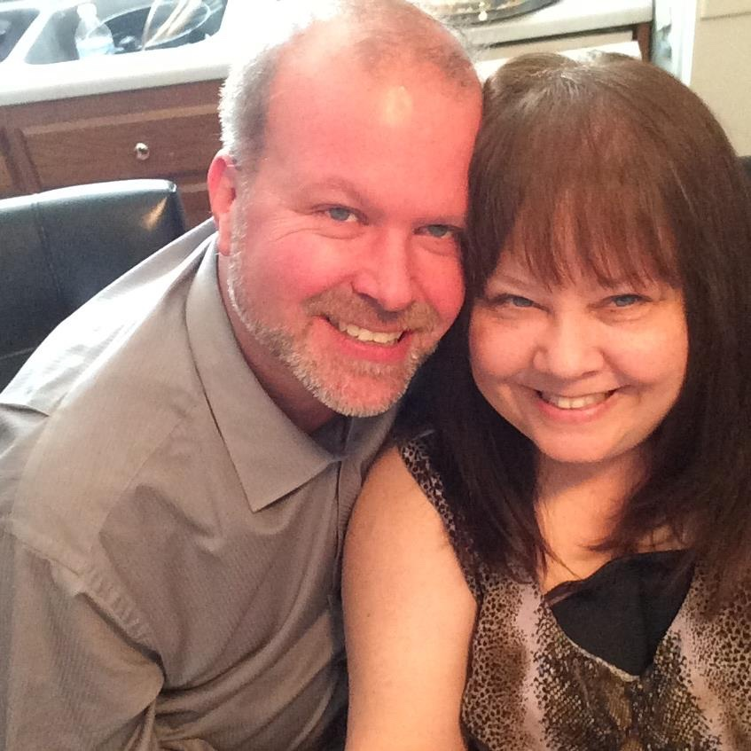
John Watson

Slide 5
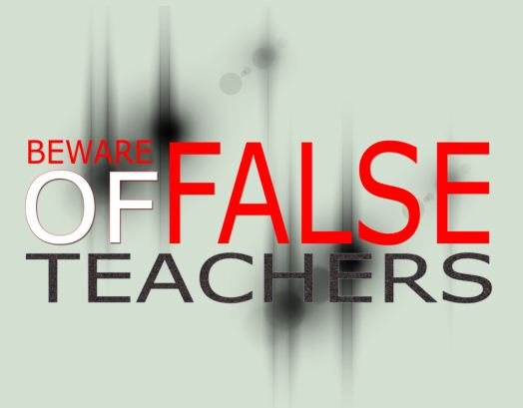
And have no fellowship with the unfruitful works of darkness, but rather expose them, (Eph 5:11).
John Watson,
Westside church of Christ
John, I hear you all are itching for a debate, believe me we are willing to scratch it. I told you when we met I was swamped with meetings through the spring. We have arranged for Harry Osborn to debate anyone of your choosing. I am in West Virginia until Monday. Who do you wish to endorse to debate brother Osborn? Upon my return let's meet to discuss scheduling the debate. As we discussed when we met, it will be a four night debate with you in the affirmative two nights and we in the affirmative two nights. Do not assume for a second that just because I have been busy that a debate will not be held.

Slide 7
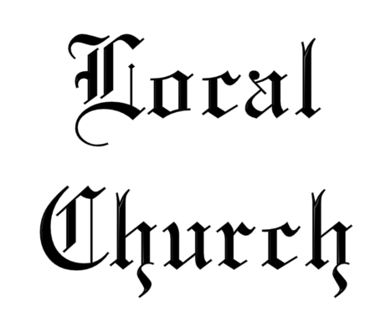
A “team” functioning together (Acts 9:26)
Having a common treasury (1 Cor 16:1-2)
Worshiping together (Acts 2:42; 1 Cor 11:20-21)
Working together (Eph 4:12)
Teaching the lost (Acts 14:27)
Structured with organization (Acts 14:23; Phil 1:1)

Slide 8
Local
Church
Paul and Timothy, bondservants of Jesus Christ, to all the saints in Christ Jesus who are in Philippi, with the bishops and deacons:
Philippians 1:1

Slide 9
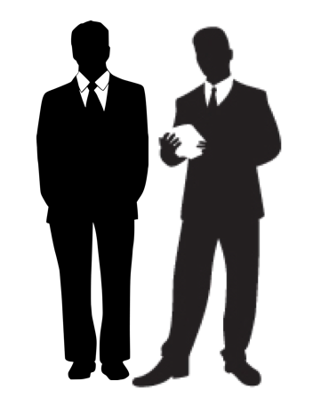
Local
Church
Elders
Saints / Christians
Deacons

Slide 10
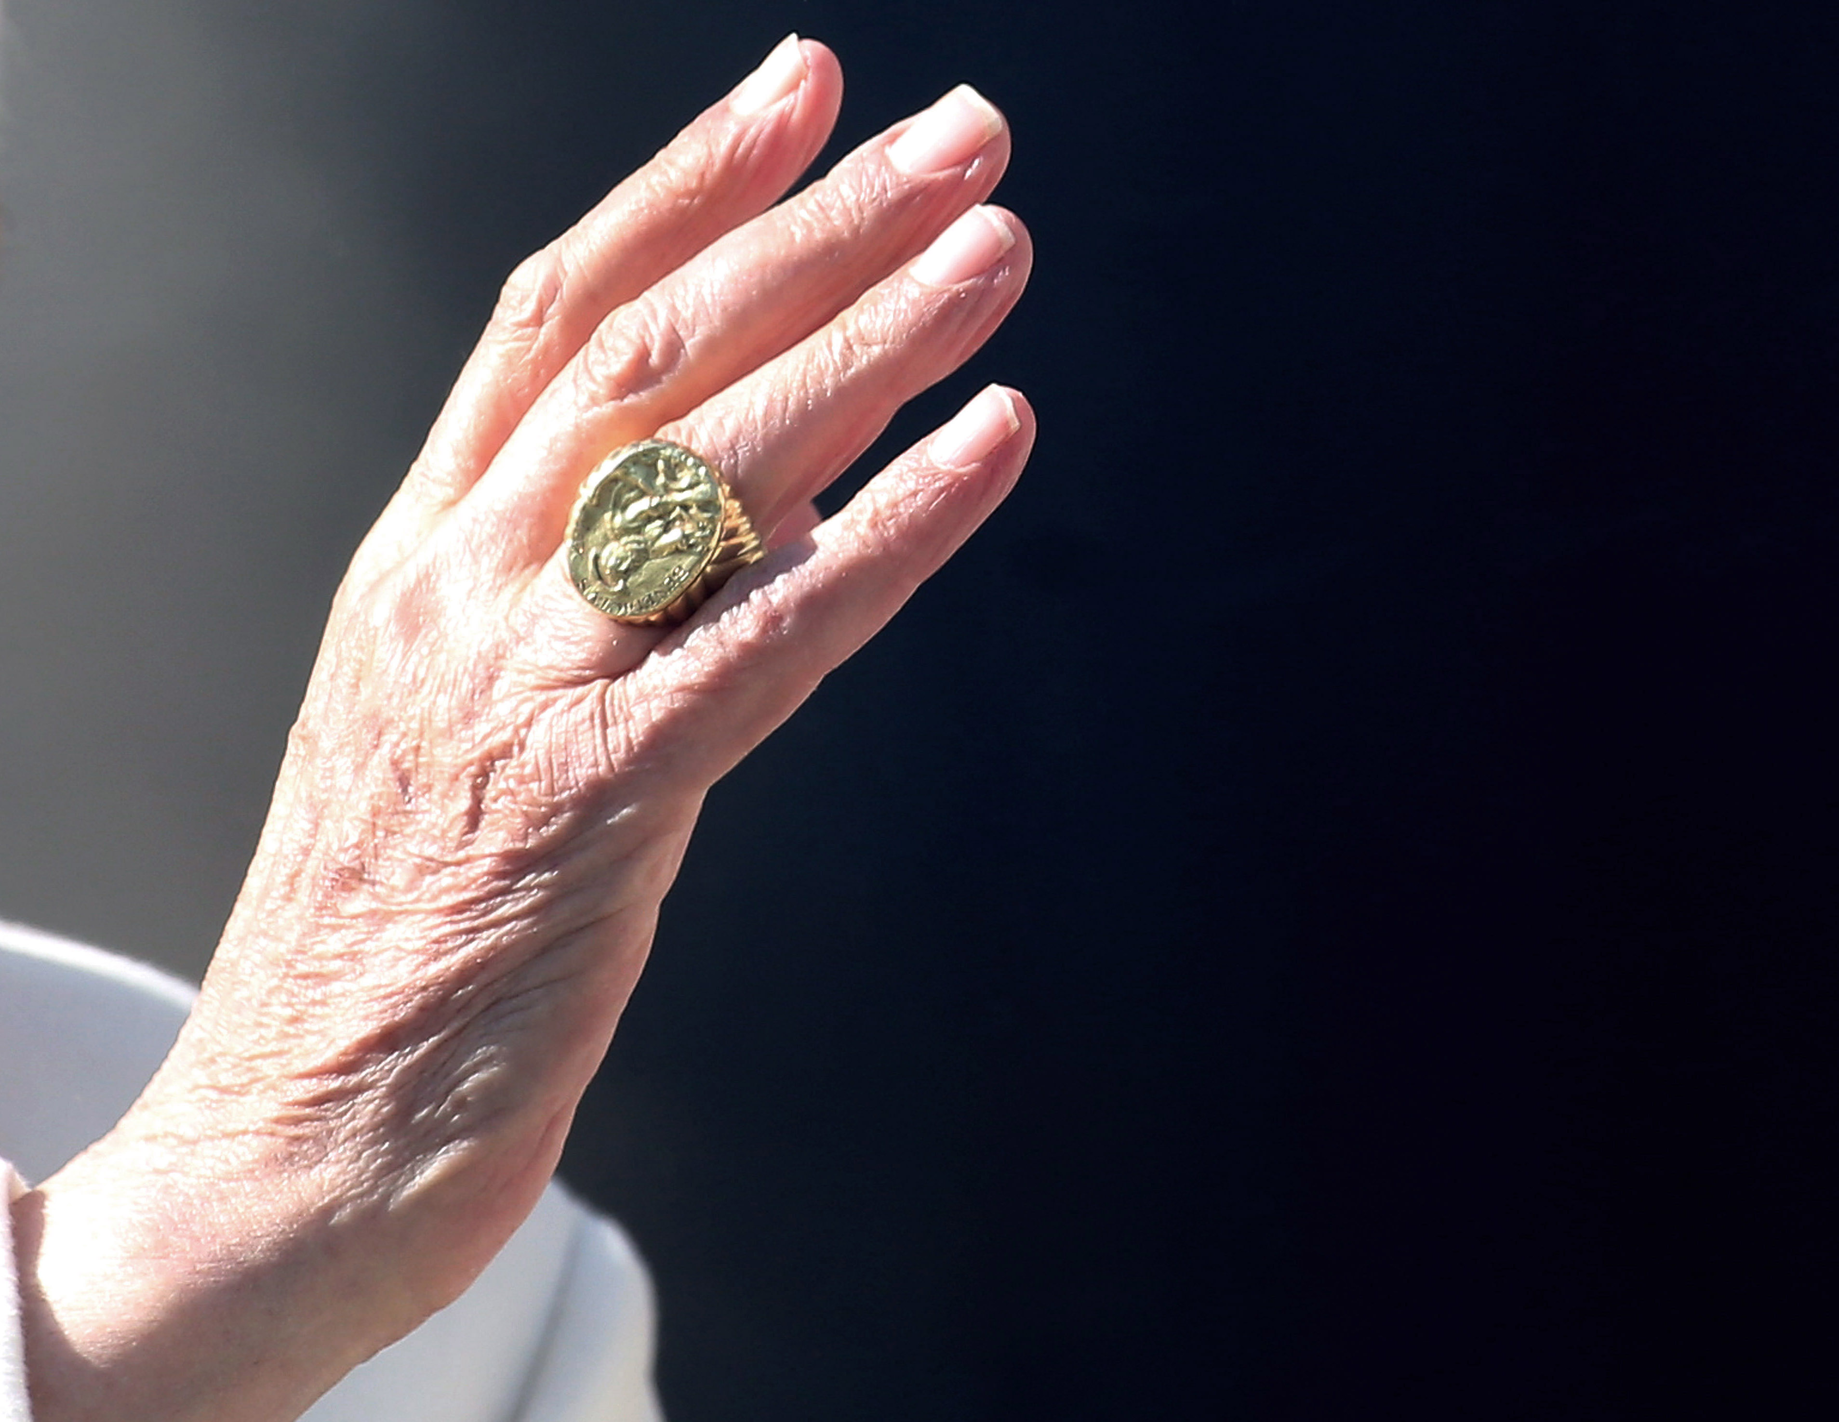
Even before the death of the apostles men were pushing for changes in the divine pattern for church organization. “For the mystery of lawlessness is already at work” (2 Thess 2:7). It began in, and involved the eldership (Acts 20:29-30). This led to apostasy!
Holman Bible Dictionary: “During the second century A.D. churches came to have a single bishop, and then that bishop came to exercise oversight over nearby rural churches as well as the city church so that his ecclesiastical territory became known as a ‘diocese’ or ‘see . . .’ By 400 A.D. in the West, the bishop of Rome began to assume extraordinary authority above other bishops.”
A. T. Robinson's Word Pictures: "Ignatius shows that in the early second century the office of bishop over the elders had developed, but Lightfoot has shown that it was not so in the first century."

Slide 12
Most Denominations are structured
like the Roman Catholic Church
Many denominations have simply adopted these same changes in church organization. Some seek to emulate an organization similar to Roman Catholicism. Others have a three tier system of bishop (pastor), elders and deacons within a congregation; or where a bishop or group of bishops (presbyters) oversee a number of churches.
Some so-called churches of Christ have adopted changes that are not much different from what occurred in the past. For example, the sponsoring-church concept adopted by many churches of Christ has the same effect as changes which occurred in the second century (elders in one area overseeing other churches or areas).
Additionally some churches of Christ have adopted a hierarchical structure within the local church that is unknown in scripture and thus unscriptural.

Slide 15
Denominational
Organization

Slide 17
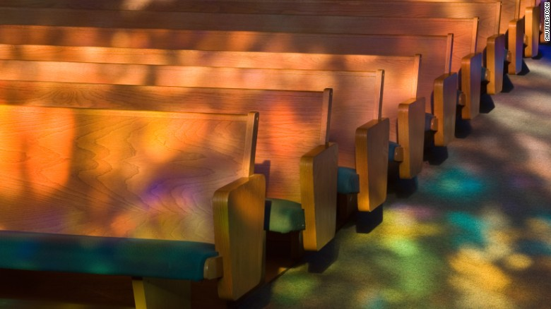
How do you go from this . . .
. . . to this?

Slide 18
The Bible teaches us today in one or more of these three ways!
By disrespecting the constraining authority of God’s Word.
Commands to Follow (“This do” 1 Cor 11:25)
Prohibitions to Avoid (“Abstain from fleshly lusts” 1 Pet 2:11)
Affirmatives to Respect (“He who believes and is baptized will be saved”
Mk 16:16)
Divinely Approved Examples
(“Brethren, join in following my example, and note those who so walk, as you have us for a pattern” Phil 3:17)
Necessary Inferences
(“For the priesthood being changed, of necessity there is also a change of the law . . . For it is evident that our Lord arose from Judah . . .” Heb 7:12-14)
Direct Statements
Given Examples
Forced Conclusions

Slide 19
I could not go beyond the word of the LORD my God, to do less or more (Num 22:18)
You shall not add to the word which I command you, nor take anything from it (Deut 4:2)
Every word of God is pure; he is a shield to those who put their trust in Him. Do not add to His words, lest He rebuke you, and you be found a liar (Prov 30:5-6)
Whoever transgresses and does not abide in the doctrine of Christ does not have God. He who abides in the doctrine of Christ has both the Father and the Son (2 John 9)
For I testify to everyone who hears the words of the prophecy of this book: If anyone adds to these things, God will add to him the plagues that are written in this book; and if anyone takes away from the words of the book of this prophecy, God shall take away his part from the Book of Life . . . (Rev 22:18-19)
Respecting the Silence of God

Slide 21
Worksheet Questions
SAINTS
According to Catholicism a “Saint” is a perfect or near perfect person who, after death, is canonized and elevated to the position of sainthood. This is unscriptural; a saint is a Christian (1 Cor 1:2). What do the following verses say about saints?
Acts 26:10__________________________________________________________
Romans 1:7________________________________________________________
1 Cor 16:1__________________________________________________________
Eph 2:19___________________________________________________________
Among the saints there are various jobs or responsibilities. Eph 4:11 mentions teachers and evangelists. What do you THINK is the work these are to do?
Saul arrested and imprisoned them—Acts 8:1 (the church)
They were the Christians comprising the church in Rome
The church collection was to be used for needy saints/Christians
Saints are members of God’s household—the church
TEACHERS: Mk 12:14, teach the way of God in truth
EVANGELISTS: 1 Tim 4:13, give attention to reading, to exhortation, to doctrine

Slide 22
Worksheet Questions
DEACONS
Deacons are men who are special servants who assist the elders in the work of the local church. Deacons do not have any oversight.
Upon what needs of the local church do deacons focus (Acts 6:2-3)?
Why do you THINK these men are required to meet certain qualifications (1 Tim 3:8-12)?
How does God view those who serve well as deacons (1 Tim 3:13)?
“Serve tables” seeing to the material or physical needs of the congregation
To prove they have servant’s hearts (“have served well,” vs 13)
“Obtain good standing . . . in the faith” (good reputation in the church & before God)

Slide 23
Worksheet Questions
ELDERS
The men who serve a congregation as elders are also called bishops, pastors and overseers (Acts 20:17, 28).
Not everyone can serve as an elder, there are certain qualifications that must be met. Make a list of the qualifications required of those who are to be appointed (1 Tim 3:1-7; Titus 1:5-9)?
Why do you THINK God required these qualifications of those who serve as elders?
Elders (vs 17), [presbuterous]—older / Overseers (vs 28) [episkopous]—Bishop / Shepherd (vs 28) [poimainein]—Pastor
How many “qualifications” does the Bible list?

Slide 24
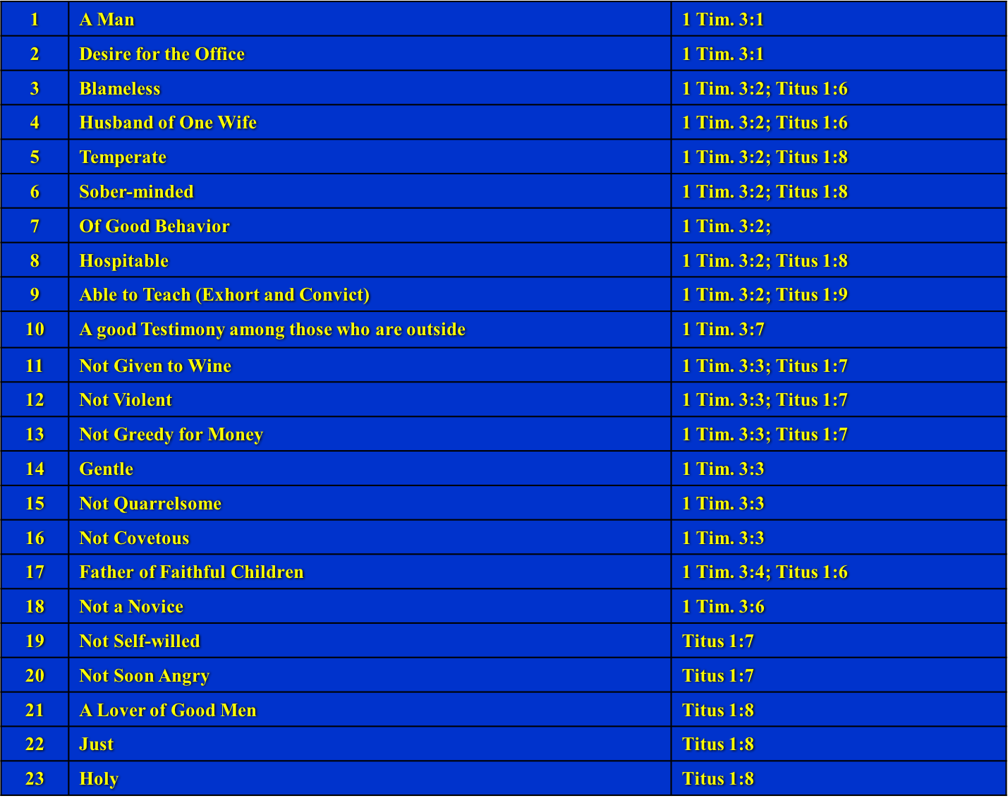
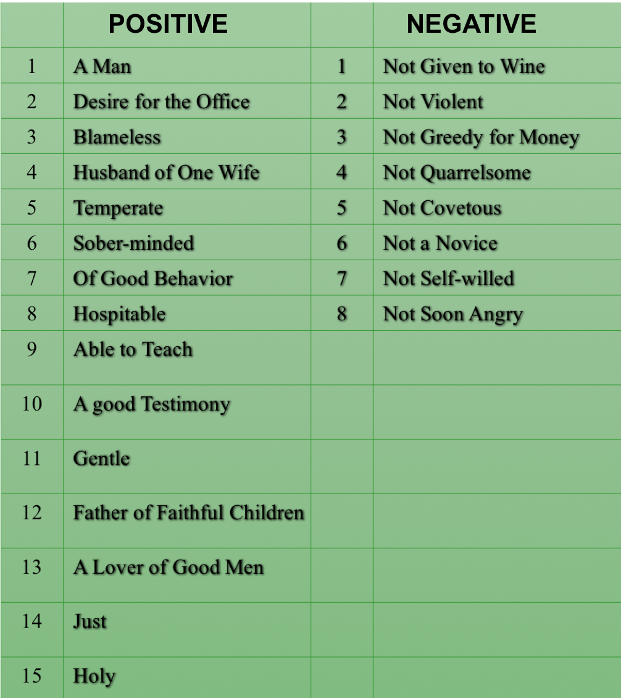

Slide 25
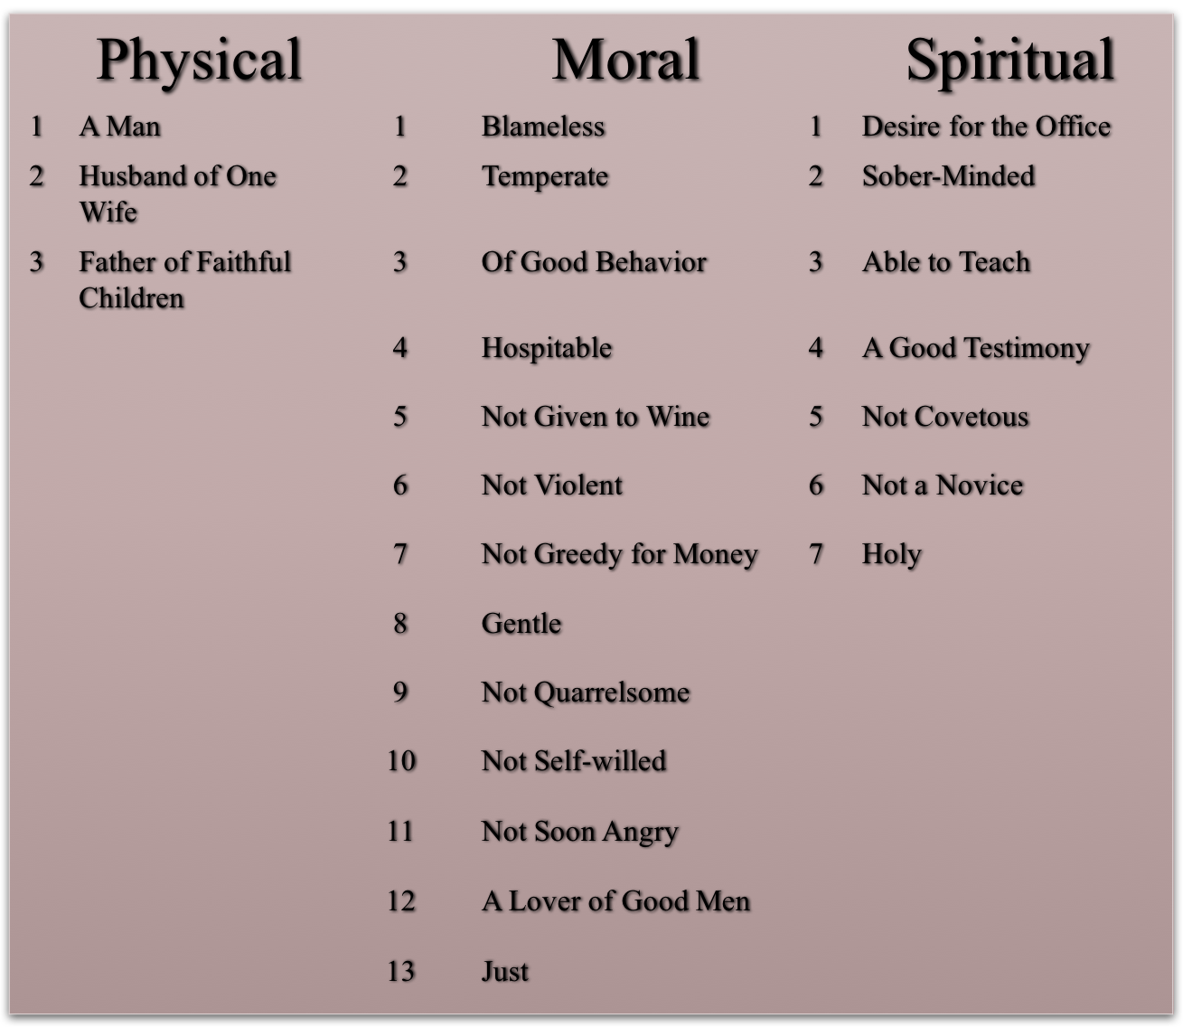
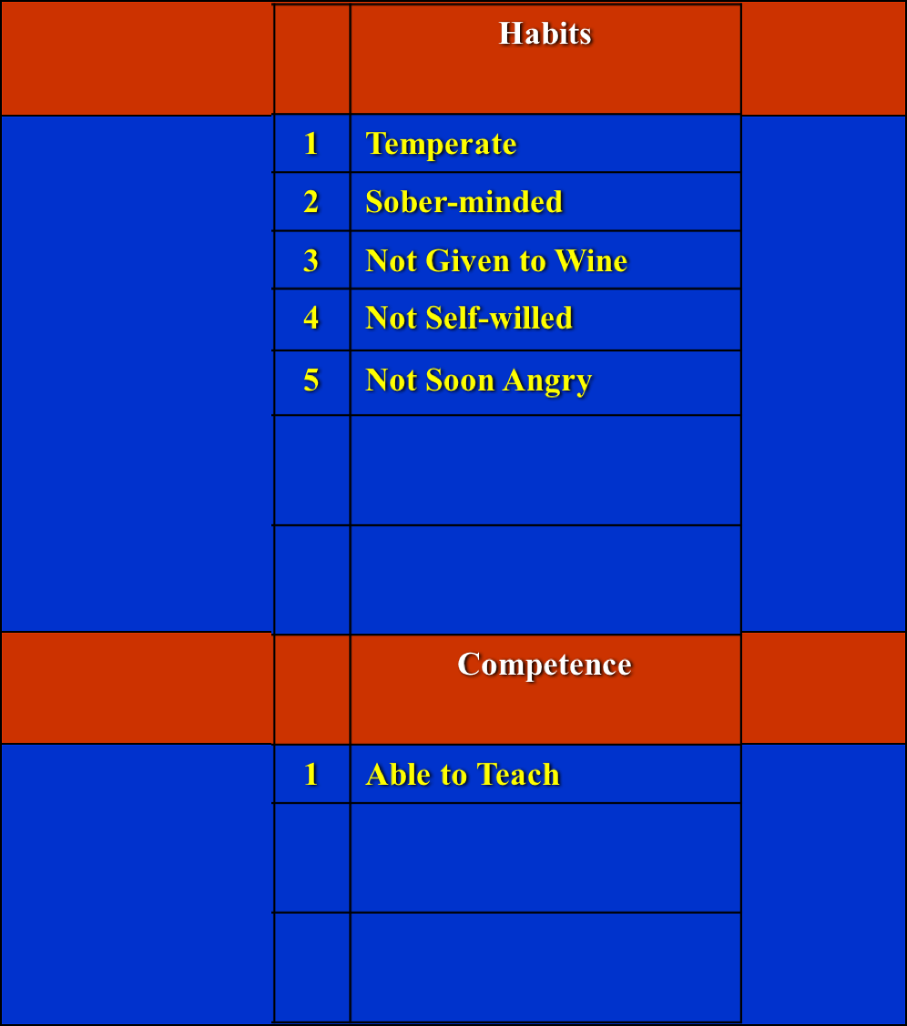
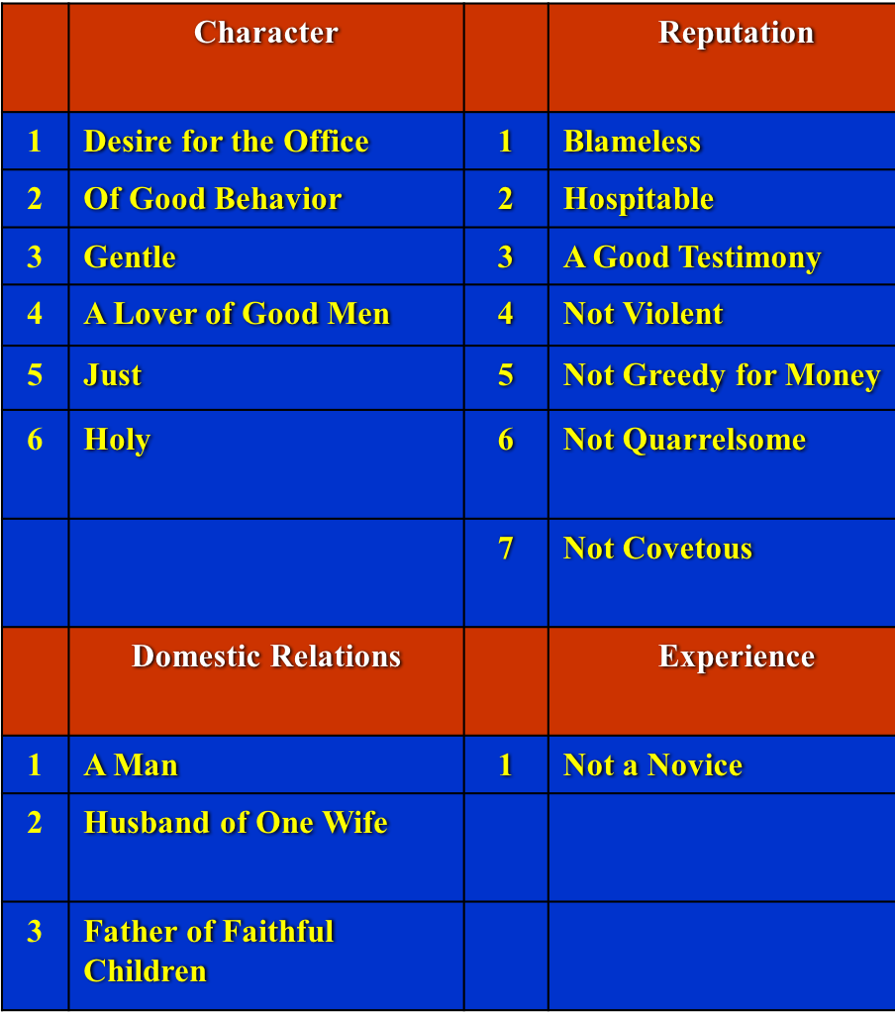

Slide 26
Worksheet Questions
ELDERS
The men who serve a congregation as elders are also called bishops, pastors and overseers (Acts 20:17, 28).
Not everyone can serve as an elder, there are certain qualifications that must be met. Make a list of the qualifications required of those who are to be appointed (1 Tim 3:1-7; Titus 1:5-9)?
Why do you THINK God required these qualifications of those who serve as elders?
Elders (vs 17), [presbuterous]—older / Overseers (vs 28) [episkopous]—Bishop / Shepherd (vs 28) [poimainein]—Pastor
23 in all
In order to do the work: “take heed to yourselves and to all the flock” (Ac 20:28)

Slide 27
Worksheet Questions
ELDERS
This work of elders would involve what according to Hebrews 13:17?
God has not permitted a church to be overseen by only one elder, He demands a plurality? Tell why you THINK God’s decision on this is so wise?
Over how many churches may an eldership rule (1 Pet 5:2)?
Elders are NOT permitted to make laws. Their rule is limited to what according to Acts 20:32?
This congregation is overseen by three elders. How much authority do you THINK is entrusted in any one man of this eldership?
“rule over” (keep watch), thus the congregations is to submit to their authority.
Prevents “one man rule”
Only the congregation “among” them
The scriptures—the word of God
None

