Slide 2
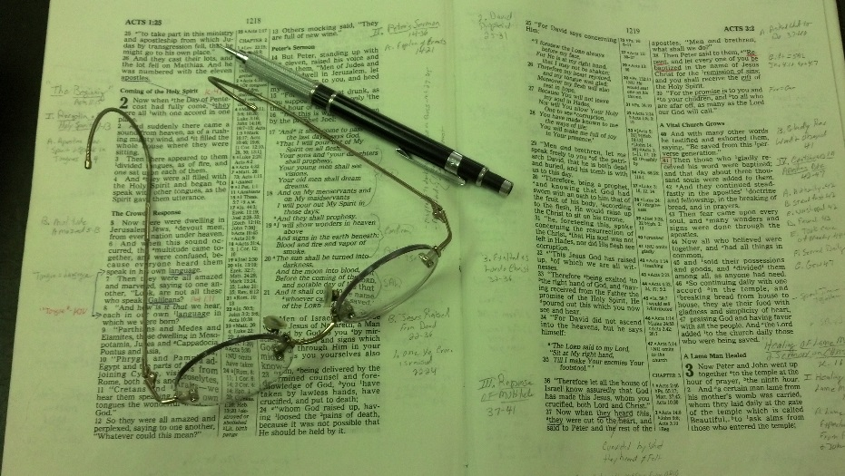
Topics
Wednesday: Training Our Children
Thursday: The Wayward Son Comes Home
Friday: Are You Serious about Heaven?

Slide 3
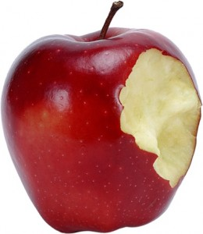
Gen. 3:5-6 – Better if you do eat of forbidden
Prov. 1:13-14 – Appeal that sin is good – you will benefit
Rom. 3:5-8 – Our sin is an occasion for God to demonstrate his righteousness, so….
Satan Has Deceived the World – Saying There is Value / Benefit to Sin

Slide 4
If don’t engage – are denied fun, enjoyment
Drinking alcohol is good for health
Open marriage – better & trusting relationship
Lying is necessary to spare feelings
The World Sees Value in Sin

Slide 5
End justifies the means (if do wrong and good comes from it – ok)
Leave the impression little consequence to sin
Talk about our past to point cause people to think if I do same – I’ll end up OK too!
Message (unintended): “Oh, sure, if you toy with sin… you will be survive too!”
Christians, at times, act as if There is Value in Having a Record of Sin

Slide 6
End justifies the means (if do wrong and good comes from it – ok)
Leave the impression little consequence to sin
Can relate to people in sin (world/ erring) better
Better equipped because of the depth of sin
Better understand
Emphasis on having been in sin / done – not change
Christians, at times, act as if There is Value in Having a Record of Sin

Slide 7
The Value of Sin
Plea For A Balanced Study
Shall we do evil that good may come?
(Rom. 3:8)

Slide 8
The Value of Sin
The Danger of Sin

Slide 9
The Danger of Sin
Separates from God
Isa. 59:1-2
Rom. 5:12
Jas. 1:15

Slide 10
The Danger of Sin
Separates from God
Renders our Prayers & Worship Vain
1 Pet. 3:7, 12
Prov. 28:9

Slide 11
The Danger of Sin
Separates from God
Renders our Prayers & Worship Vain
Causes Shame, Wounds & Dishonor
Prov. 6:27-33
Psa. 51:3 – sin ever before me
Exo. 20:5 – visit sin unto 3rd & 4th generation

Slide 12
The Danger of Sin
Separates from God
Renders our Prayers & Worship Vain
Causes Shame, Wounds & Dishonor
Enslaves
2 Pet. 2:19
To yield is to become a servant (Rom. 6)

Slide 13
The Danger of Sin
Separates from God
Renders our Prayers & Worship Vain
Causes Shame, Wounds & Dishonor
Enslaves
Cost You Your Soul
John 8:21
Rom. 6:23
Gal. 5:19-21

Slide 14
The Danger of Sin
Separates from God
Renders our Prayers & Worship Vain
Causes Shame, Wounds & Dishonor
Enslaves
Cost You Your Soul
Destroys Your Influence
Prov. 13:15 (ASV)
Matt. 6:13-15

Slide 15
The Danger of Sin
Separates from God
Renders our Prayers & Worship Vain
Causes Shame, Wounds & Dishonor
Enslaves
Cost You Your Soul
Destroys Your Influence
May Cost You Your Family
Matt. 19:9
Ezra 10:10-11, 44

Slide 16
The Value of Sin
The Danger of Sin
The Knowledge of Sin

Slide 17
The Knowledge of Sin
Know about Sin from Revelation – not Experience
God told Eve what was right & wrong (Gen. 2:17)
Satan lied: You don’t know until you eat of fruit (Gen. 3:5)
Already had been told good and evil!

Slide 18
The Knowledge of Sin
Know about Sin from Revelation – not Experience
The Lord Calls Us to Faith Based Upon Revealed Evidence – Not Personal Experience
John 20:29
1 Pet. 1:8-9

Slide 19
The Knowledge of Sin
Know about Sin from Revelation – not Experience
The Lord Calls Us to Faith Based Upon Revealed Evidence – Not Personal Experience
Example: We Can Know About Fornication
Know it is a sin (1 Cor. 6:18)
Know how it happens (Prov. 2:17; 6:25)
Know how to avoid it (Prov. 5:8; Gen. 39)
Know consequences (Prov. 6:33)
Don’t have to experience it!

Slide 20
The Value of Sin
The Danger of Sin
The Knowledge of Sin
The Victory over Sin

Slide 21
The Victory over Sin
Can Overcome
Can be forgiven (1 John 1:7)
Sin remembered no more (Heb. 8:12)
Can overcome grievous sins (1 Cor. 6:9-11)

Slide 22
The Victory over Sin
Can Overcome
Victory Removes Quilt – Not Consequence
Not held as guilty
Forgiven = release
Remission = removed
Blotted out = gone
Still consequences (Prov. 13:15, ASV)

Slide 23
The Victory over Sin
Can Overcome
Victory Removes Quilt – Not Consequence
Help & Encouragement from Others

Slide 24
Help & Encouragement from Others
Those who have experienced sin have a role – have value to offer
Tell others what not to do (“Don’t do what I did”)
Show others can change – can quit sin – can overcome
Peter would be of use when he returned (Luke 22:31-32
Have a role, have a place – unique function
Big leap & unfounded conclusion: far better equipped to help others!

Slide 25
Help & Encouragement from Others
Those who have experienced sin have a role – have value to offer
False idea: Those who experience sin are far better equipped to help others
Makes Jesus the worst help of all (Heb. 4:15-16)
Very poor High Priest!
Understands because was tempted –not yielded
Leaves the impression sin is not that bad – “If I play with sin, I will be okay in the end too.”
Logical extension – ought to plunge into sin for a while – make us better servants!
Danger: our teaching become more testimonial than textual!
Stories of prodigal (Lk 15), Saul (Acts 8-9), and David (2 Sam. 11) suggests they would have been happier had they not gone to the depths of sin!

Slide 26
Help & Encouragement from Others
Those who have experienced sin have a role – have value to offer
False idea: Those who experience sin are far better equipped to help others
Case to be made for the faithful Christians (endure & resist) to help others
Example: Would you get financial advice from one who has failed, or avoided failure?
It is not the depth of sin, but depth of faith that qualifies one to help (Gal. 6:1-2)

Slide 27
The Value of Sin
The Danger of Sin
The Knowledge of Sin
The Victory over Sin
The Prevention of Sin

Slide 28
The Prevention of Sin
Written Word Can Prevent Sin
1 John 2:1
Psa. 119:11
Matt. 4:1-ff

Slide 29
The Prevention of Sin
Written Word Can Prevent Sin
Familiarity With Sin Does Not Help Prevention
Psa. 1:1-3
Prov. 5:8; 7:25
Josh. 23:7-13

Slide 30
The Prevention of Sin
Written Word Can Prevent Sin
Familiarity With Sin Does Not Help Prevention
Look to Examples- Those Have Done Well
1 Pet. 1:21
1 Cor. 11:1
1 Tim. 4:12
Matt. 5:13-16

Slide 31
The Value of Sin
The Danger of Sin
The Knowledge of Sin
The Victory over Sin
The Prevention of Sin

