Slide 2
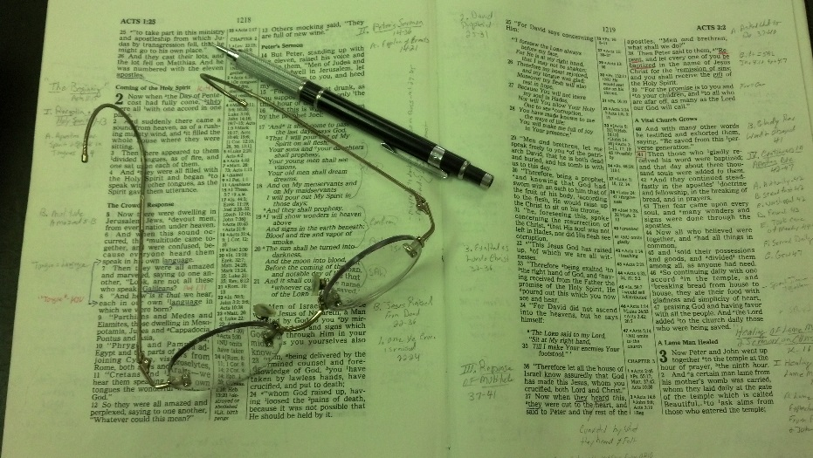
Topics
Monday: Doctrine, Faith & Consequences
Tuesday: The Value of Sin
Wednesday: The Wayward Son Comes Home
Thursday: Training Our Children
Friday: Are You Serious about Heaven?

Slide 3
Genesis 3:1-13
Adam and Eve sin (vv. 1-6)
God asked them about their wrong (vv. 7-11)
Claimed to be victims – played the blame game (vv. 12-13)

Slide 4
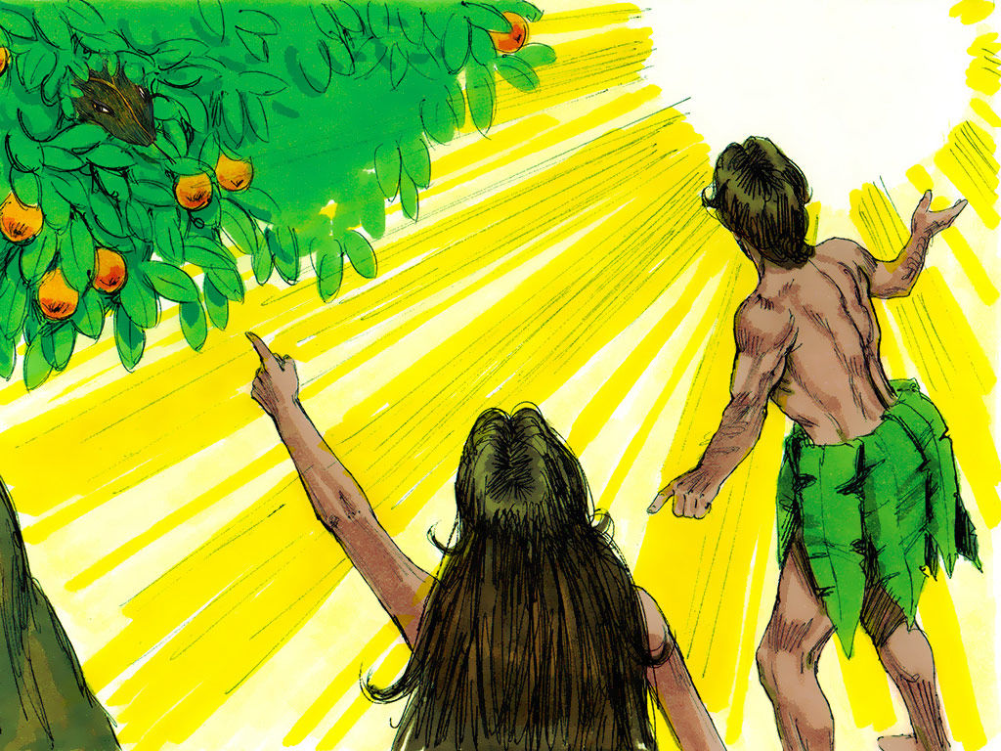
Genesis 3:12–13
¹² Then the man said, “The woman whom You gave to be with me, she gave me of the tree, and I ate.”
¹³ And the Lord God said to the woman, “What is this you have done?” The woman said, “The serpent deceived me, and I ate.”
Claimed: Victims
Not Responsible

Slide 5
The Blame Game is Very Popular
Is alive and played today as it was in Eden
Played in World
Played in Business
Played in Politics
Played in School
Played in Church

Slide 6
The
Blame
Game

Slide 7
The First Players
The Blame Game

Slide 8
The First Players
Adam & Eve (Gen. 3:12-13)
Claimed to be victims of the faults of others
Would not admit – “I sinned” or “we sinned”
Adam: “A cold expression, manifesting neither any grief nor shame at so foul an act, but rather a desire to cover his sin” (White)” (Pulpit)
Eve: didn’t mention her sin of tempting her husband
Beguiled: caused me to forget
“A forced confession, but no appearance of contrition. ‘It’s true I did eat, but it was not my fault’ (Hughes)” (Pulpit)

Slide 9
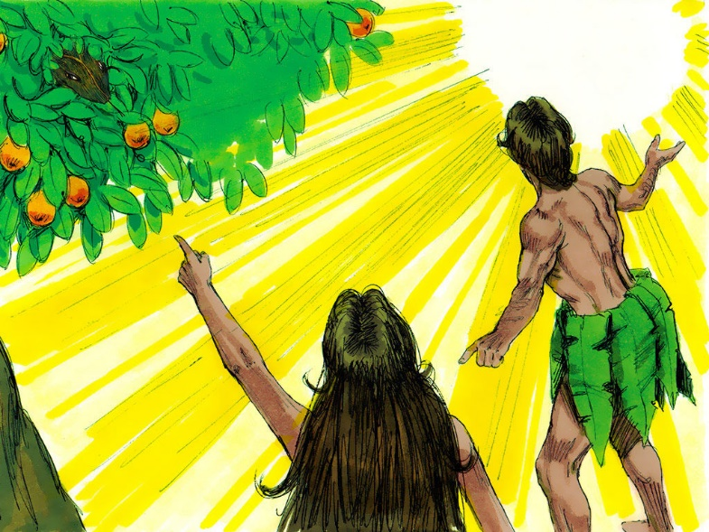
The First Players
Adam & Eve (Gen. 3:12-13)
Claimed to be victims of the faults of others
Would not admit – “I sinned” or “we sinned”
Blame was shifted
Verse 12 – Adam blamed the woman & God
Verse 13 – Woman blamed serpent
Anywhere but personal responsibility

Slide 10
The First Players
Adam & Eve (Gen. 3:12-13)
Claimed to be victims of the faults of others
Regardless of Others:
They both knew the rules (Gen. 2:16-17)
They both knew the consequences (Gen. 2:16-17)
They both had a choice (Gen. 3:6)
They both were wrong!

Slide 11
The First Players
A Lot of Players Through History
The Blame Game

Slide 12
A Lot of Players Through History
Aaron blamed the people & Moses (Exo. 32:1-8; 19-24)
Ahab blamed Elijah (1 Kings 18:16-46)
Saul blamed the people (1 Sam. 15:1-ff)
Elder son blamed his father (Luke 15:28-32)
Peter was worried about what was expected of John (John 21:20-22)

Slide 13
The First Players
A Lot of Players Through History
Players Today
The Blame Game

Slide 14
Players Today
Blame parents & raising
They are to blame – (no religion or pushed it too much)
They made me what I am
Blame world / society
World is out to get me – everyone is working against me
I am helpless in a sea of terrible society – can’t get ahead
Blame church / brethren
Discouraged
Been ignored (cf. Acts 6)
Not included / treated unfriendly
People who are hypocrites
The charges may be true
Adam was right – Eve did tempt him & God gave her
Eve was right – Serpent did beguile her

Slide 15
The First Players
A Lot of Players Through History
Players Today
Rules of the Game
The Blame Game

Slide 16
Rules of the Game
Refuse to take responsibility for own action
Focus on self & how you’ve been wronged
Make the wrong done to you GREATER than own wrong
Feel powerless to overcome – act like you are stuck
Use the power of the game: Always act as if you are morally right, but not responsible or accountable & forever entitled to sympathy!
Blow your problem up bigger than it really is (cf. Prov. 18:13-17)

Slide 17
The First Players
A Lot of Players Through History
Players Today
Rules of the Game
Breaking Out of Children’s Games
The Blame Game

Slide 18
Breaking Out of Children’s Games
Wrong is wrong – no matter how you got there!
Violation of law still in (1 Jno. 3:4)
Sin still separates from God (Jas. 1:15)

Slide 19
Breaking Out of Children’s Games
Wrong is wrong – no matter how you got there!
Take responsibility for your own sin
Ezek. 18 – not bear the sins of others
Must given an account of self (Rom. 14:12)
We drawn away of own lust (Jas. 1:13-15)

Slide 20
Breaking Out of Children’s Games
Wrong is wrong – no matter how you got there!
Take responsibility for your own sin
Realize you can overcome past
Ezek. 18 – Son can overcome wicked father
Paul overcame his past
Corinthians overcame their past (1 Cor. 6:9-11)
Abraham’s raising was in idolatry

Slide 21
Breaking Out of Children’s Games
Wrong is wrong – no matter how you got there!
Take responsibility for your own sin
Realize you can overcome past
Whatever God expects you to do or be – you can (Phil. 4:13)
You are not the only one to be wronged:
Slighted
Ignored / left out
Get your feelings hurt
You may very well have caused some of that yourself!!

Slide 22
The First Players
A Lot of Players Through History
Players Today
Rules of the Game
Breaking Out of Children’s Games
The Blame Game

