Slide 1
Scripture Reading: 1 Thessalonians 2:13

Slide 2
(1 Thessalonians 2:13)
For this reason we also thank God without ceasing, because when you received the word of God which you heard from us, you welcomed it not as the word of men, but as it is in truth, the word of God, which also effectively works in you who believe.

Slide 4
Can I Trust It?

Slide 5
What does the Bible Claim About Itself?
(Mt. 24:35; 1 Pet. 1:23-25)
To be the Eternal Word of God

Slide 6
What makes Scripture eternal?
(2 Tim. 3:16; 2 Pet. 1:19-21; Mt. 4:3-11)
Its Eternal Source

Slide 7
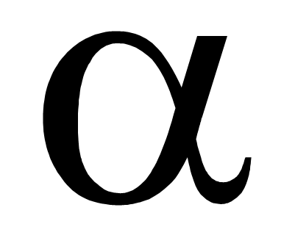
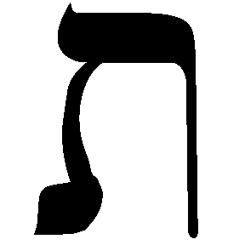
Did you notice Jesus quoted from the Septuagint?

Slide 8
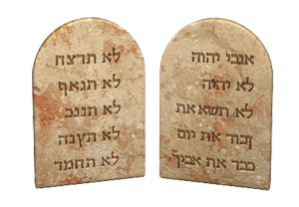
What About Translations?
1400 YEARS
JESUS AUTHORIZED TRANSLATIONS

Slide 9
How did the Gospel Message Spread?
Word of Mouth—(Mk. 16:15; Acts 20:27; Col. 1:23)
Written Word—(1 Cor. 14:37; Jn. 16:13; 2 Pet .1:3; 1 Thess. 2:13)
Letters Exchanged—(Col. 4:16)
Corruption Prevented—(2 Pet. 3:15-17; Gal. 1:8f; Titus 1:11)

Slide 10
What did we end up with?
2016
2000 YEARS
Can I Trust It?

Slide 11
2000

Slide 12
250
John’s
Death
Earliest Manuscripts
AD 100
AD 350

Slide 13
Greek Manuscripts
Codex Vaticanus (AD 325-350)
Codex Sinaiticus (AD 350)
Codex Alexandrinus (AD 400’s)
Codex Ephraemi (AD 400’s)
Codex Bezae (AD 450)
Codex Washingtonianus (AD 450)

Slide 14
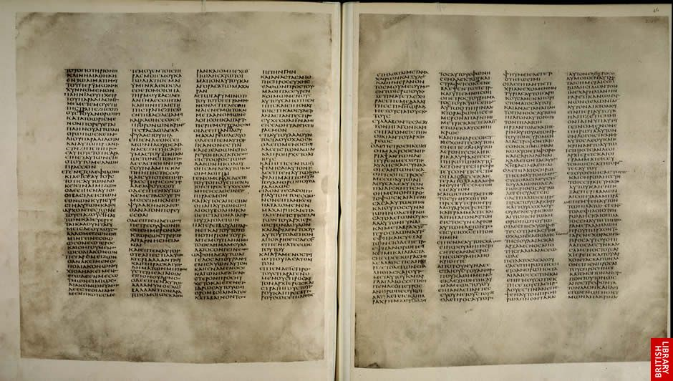
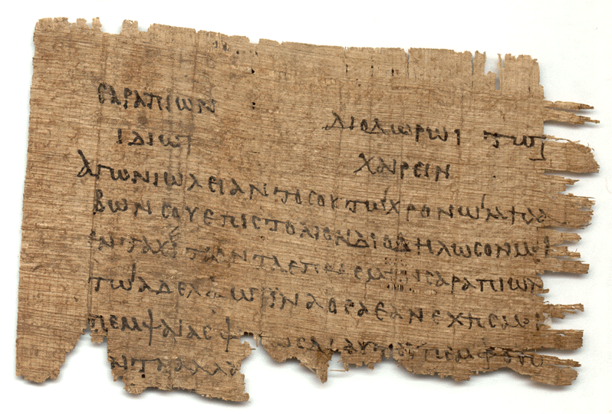
VELLUM
Animal Skins
PAPYRUS
“Plant Paper”

Slide 15
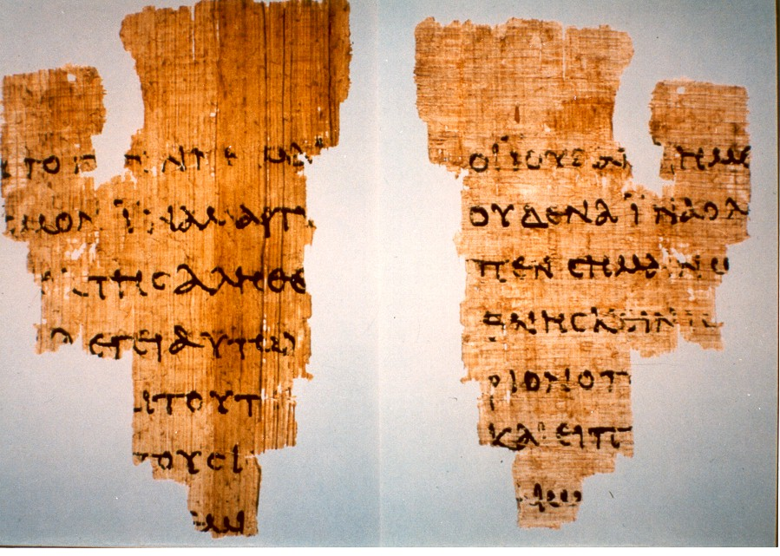
John Ryland’s Papyrus (P52) (AD 125)

Slide 16
Versions of Greek Manuscripts
Syriac Version (AD 150)
Old Latin Version (AD 150)
Muratorian Fragment (AD 170)
Egyptian Coptic Version (AD 200’s)

Slide 17
15,000+
Existing Versions Available

Slide 18
(John 12:48) He who rejects Me, and does not receive My words, has that which judges him—
THE WORD THAT I HAVE SPOKEN WILL JUDGE HIM IN THE LAST DAY.

Slide 19
