Slide 1
Today’s Reading: EPHESIANS 3:14-21

Slide 2
Ephesians 3:14-21
¹⁴ For this reason I bow my knees to the Father of our Lord Jesus Christ, ¹⁵ from whom the whole family in heaven and earth is named, ¹⁶ that He would grant you, according to the riches of His glory, to be strengthened with might through His Spirit in the inner man, ¹⁷ that Christ may dwell in your hearts through faith; that you, being rooted and grounded in love, ¹⁸ may be able to comprehend with all the saints what is the width and length and depth and height— ¹⁹ to know the love of Christ which passes knowledge; that you may be filled with all the fullness of God. ²⁰ Now to Him who is able to do exceedingly abundantly above all that we ask or think, according to the power that works in us, ²¹ to Him be glory in the church by Christ Jesus to all generations, forever and ever. Amen.

Slide 4


Slide 5

In Him we have redemption through His blood, the forgiveness of sins, according to the riches of His grace (Eph 1:7).
the eyes of your understanding being enlightened; that you may know what is the hope of His calling, what are the riches of the glory of His inheritance in the saints, (Eph 1:18).
that in the ages to come He might show the exceeding riches of His grace in His kindness toward us in Christ Jesus (Eph 2:7).
To me, who am less than the least of all the saints, this grace was given, that I should preach among the Gentiles the unsearchable riches of Christ, (Eph 3:8).
that He would grant you, according to the riches of His glory . . . (Eph 3:16).
Ephesians

Slide 6
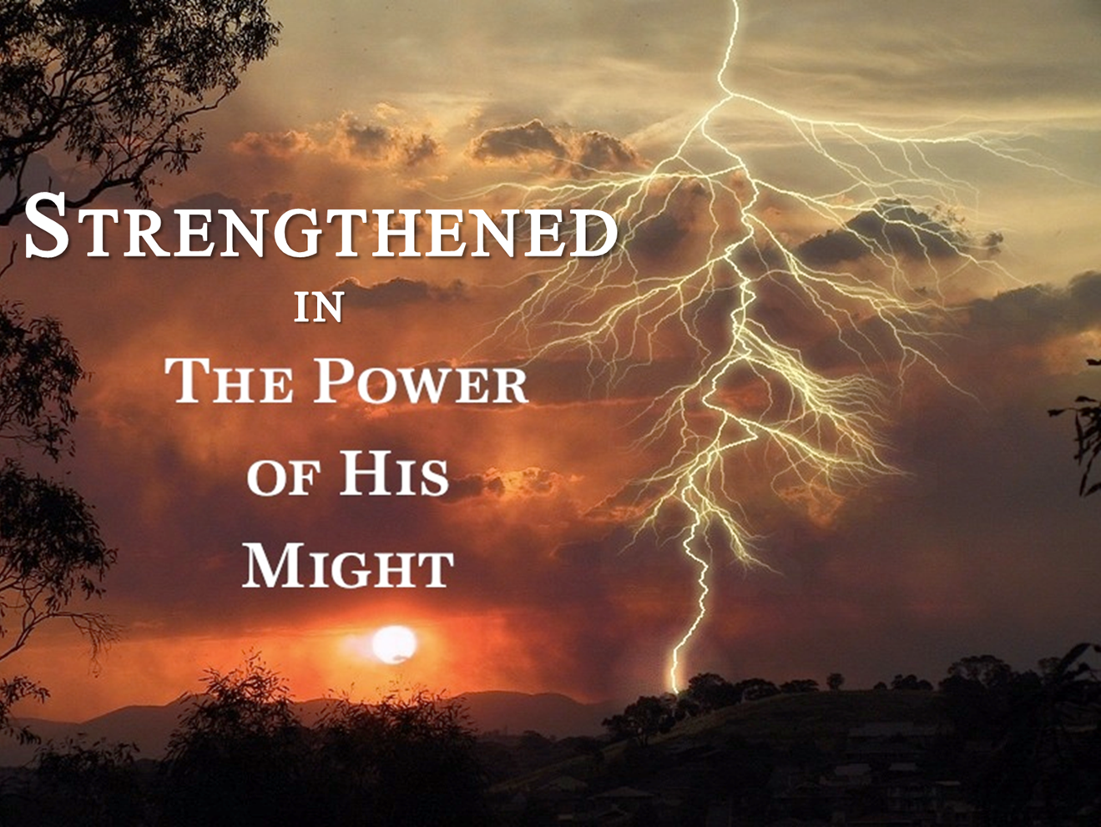

Slide 7

Behold, I stand at the door and knock. If anyone hears My voice and opens the door, I will come in to him and dine with him, and he with Me (Rev 3:20).

Slide 8


Slide 9
