Slide 1
Today’s Reading: John 15:11-17

Slide 2
John 15:11-17
¹¹ These things I have spoken to you, that My joy may remain in you, and that your joy may be full. ¹² This is My commandment, that you love one another as I have loved you. ¹³ Greater love has no one than this, than to lay down one’s life for his friends. ¹⁴ You are My friends if you do whatever I command you. ¹⁵ No longer do I call you servants, for a servant does not know what his master is doing; but I have called you friends, for all things that I heard from My Father I have made known to you. ¹⁶ You did not choose Me, but I chose you and appointed you that you should go and bear fruit, and that your fruit should remain, that whatever you ask the Father in My name He may give you. ¹⁷ These things I command you, that you love one another.

Slide 4
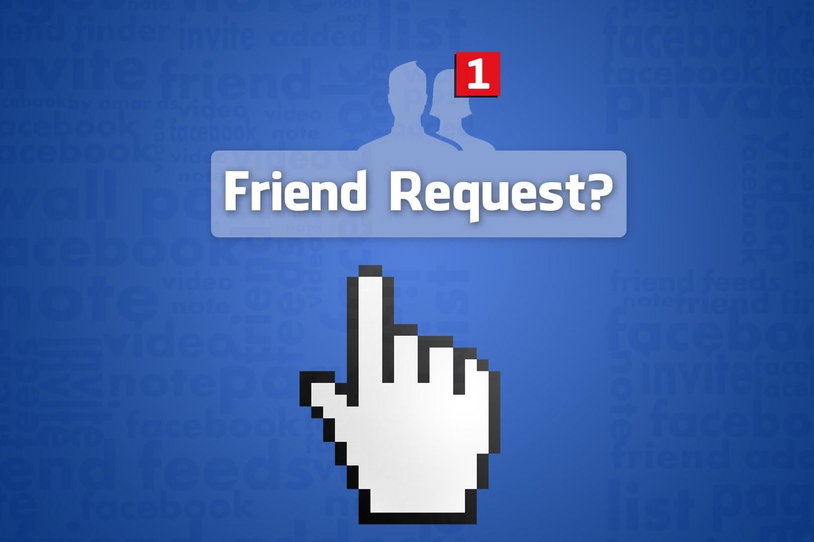

Slide 5
. . . a friend of tax collectors and sinners! (Matt 11:19).
This Man receives sinners and eats with them. (Lk 15:2).

Slide 6
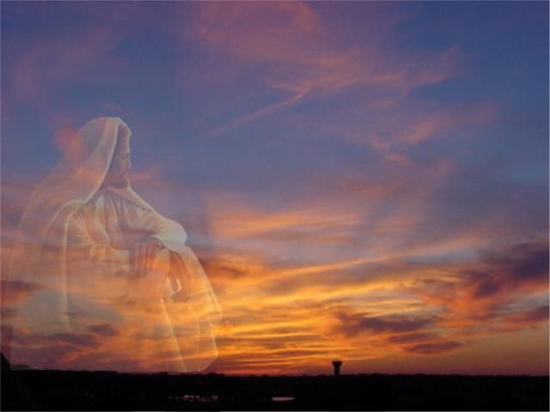
Jesus is a Friend that . . .
Dwelt Among Us
Died For Us
Delivers Us
Desires Us

