Slide 1
Scripture Reading: Matthew 9:18-31

Slide 2
Matthew 9:18-31
¹⁸ While He spoke these things to them, behold, a ruler came and worshiped Him, saying, my daughter has just died, but come and lay Your hand on her and she will live. ¹⁹ So Jesus arose and followed him, and so did His disciples. ²⁰ And suddenly, a woman who had a flow of blood for twelve years came from behind and touched the hem of His garment. ²¹ For she said to herself, if only I may touch His garment, I shall be made well. ²² But Jesus turned around, and when He saw her He said, be of good cheer, daughter; your faith has made you well. And the woman was made well from that hour. ²³ When Jesus came into the ruler’s house, and saw the flute players and the noisy crowd wailing, ²⁴ He said to them, make room, for the girl is not dead, but sleeping. And they ridiculed Him. ²⁵ But when the crowd was put outside, He went in and took her by the hand, and the girl arose. ²⁶ And the report of this went out into all that land. ²⁷ When Jesus departed from there, two blind men followed Him, crying out and saying, Son of David, have mercy on us! ²⁸ And when He had come into the house, the blind men came to Him. And Jesus said to them, do you believe that I am able to do this? They said to Him, yes, Lord. ²⁹ Then He touched their eyes, saying, according to your faith let it be to you. ³⁰ And their eyes were opened. And Jesus sternly warned them, saying, see that no one knows it. ³¹ But when they had departed, they spread the news about Him in all that country.

Slide 4
And suddenly, a woman who had a flow of blood for twelve years came from behind and touched the hem of His garment. For she said to herself, if only I may touch His garment, I shall be made well. But Jesus turned around, and when He saw her He said, be of good cheer, daughter; your faith has made you well. And the woman was made well from that hour (Matt 9:20-22).

Slide 5
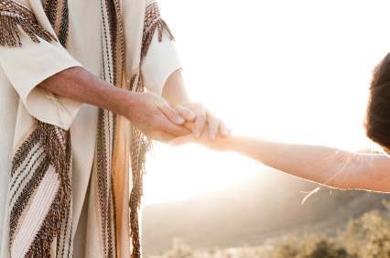
The Touch of Jesus
Jesus, moved with compassion, stretched out His hand and touched him (Mk 1:41)
Jesus put out His hand and touched him (Matt 8:3)
So He touched her hand (Matt 8:15)
He went in and took her by the hand (Matt 9:25)
Then He touched their eyes (Matt 9:29)
Jesus came and touched them (Matt 17:7)
Then little children were brought to Him that He might put His hands on them (Matt 19:13)
200 Times

Slide 6
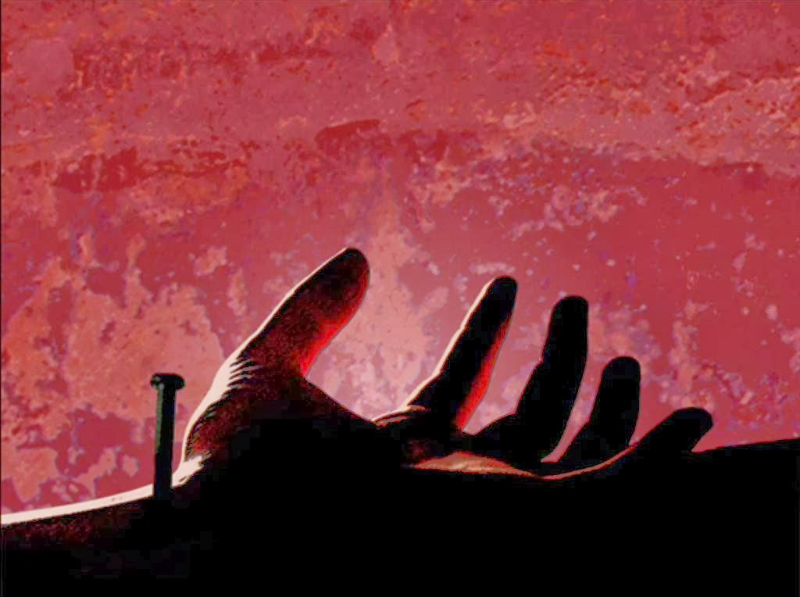
He touched me with His love—and taught me to love (Jn 15:13; 13:34-35; 1 Jn 3:16-18; Eph 5:25)
He touched me with His mercy—and taught me to forgive (Lk 23:34; Lk 7:40-43; Matt 18:21-35)
He touched me with His compassion—and taught me kindness (Mk 1:40-41; Eph 4:32; Col 3:12)
He touched me with eternity—and taught me to hope (Jn 14:1-3; Rom 8:22-24; Heb 11:1)
He touched me with His sacrifice—and taught me to serve (Matt 20:28; Jn 13:13-17; Mk 14:8)
He touched me with His faith—and taught me to trust (Jn 17:1-5; 1 Tim 4:10; Heb 12:1-2)
The Touch of Jesus

Slide 7
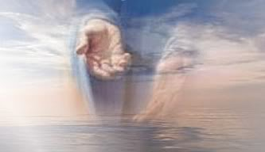
Shackled by a heavy burden,
'Neath a load of guilt and shame.
Then the hand of Jesus touched me,
And now I am no longer the same.
Since I met this blessed Savior,
Since He cleansed and made me whole,
I will never cease to praise Him,
I'll shout it while eternity rolls.
He touched me, Oh He touched me,
And oh the joy that floods my soul!
Something happened and now I know
He touched me and made me whole.
The Touch of Jesus

