Slide 2
Post WWII Germany

Slide 3
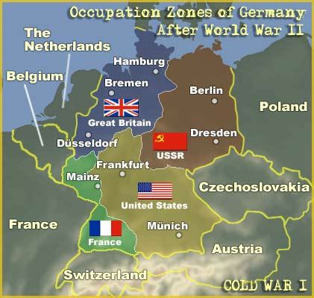
Post War Germany

Slide 4
Divided Berlin

Slide 5
German Children Just Outside Tempelhof Airport

Slide 6
The Candy Bomber

Slide 7
Is your hope worth sharing?
I Peter 1:3 “Blessed be the God and Father of our Lord Jesus Christ! According to his great mercy, he has caused us to be born again to a living hope through the resurrection of Jesus Christ from the dead,”

