Slide 1
Hosea 2:19-20

Slide 2
Hosea 2:19-20
19 “I will betroth you to Me forever;
Yes, I will betroth you to Me
In righteousness and justice,
In lovingkindness and mercy;
20 I will betroth you to Me in faithfulness,
And you shall know the Lord.

Slide 4
Hosea was a contemporary of Isaiah prophesying during the reigns of Uzziah, Jotham, Ahaz and Hezekiah in Judah and during the reign of Jeroboam, king of Israel (1:1)
The message of Hosea was of grace and love; a love that remained constant even though scorned by His unfaithful people, Israel.
The most memorable part of Hosea was his marriage to Gomer; which served as a symbolic message to Israel

Slide 5
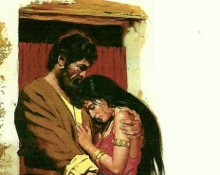
Go take yourself a wife of harlotry - 1:2
Hosea was commanded to marry a woman who was raised in the environment of idolatry (whoredom, harlotry) (1:2).
A tragic marriage—it mirrored Israel’s “marriage” to God.
She took for herself “lovers,” committing adultery (3:1).
She bore three children (1:3-9).
Jezreel (son) (1:3-4)
Lo-Ruhamah (daughter) (1:6)
Lo-Ammi (son) (1:8-9)
Hosea “redeemed” her and brought her home (3:2-3).

Slide 6
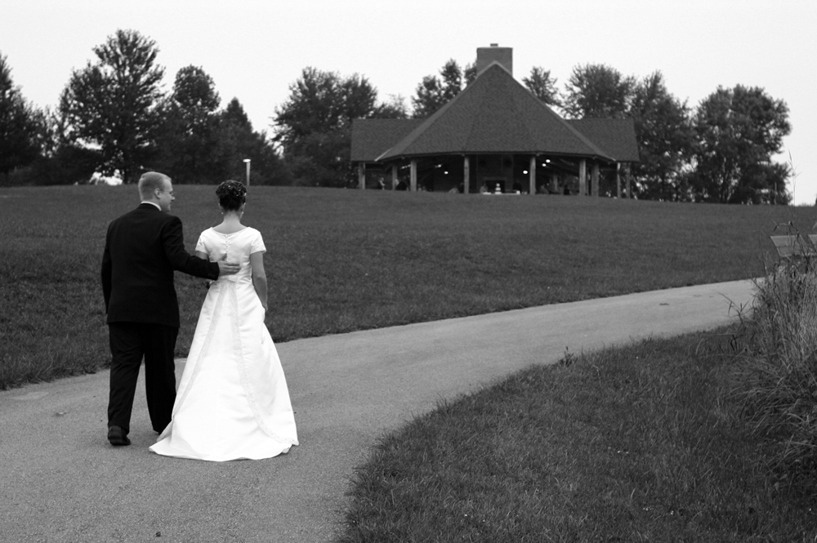
Hosea 2:19-20

Slide 7
Hosea 2:19-20
Building
a Storm-
Proof
Marriage
19 “I will betroth you to Me forever; Yes, I will betroth you to me in righteousness and in justice, In lovingkindness and in compassion,
20 And I will betroth you to Me in faithfulness. Then you will know the Lord

Slide 8
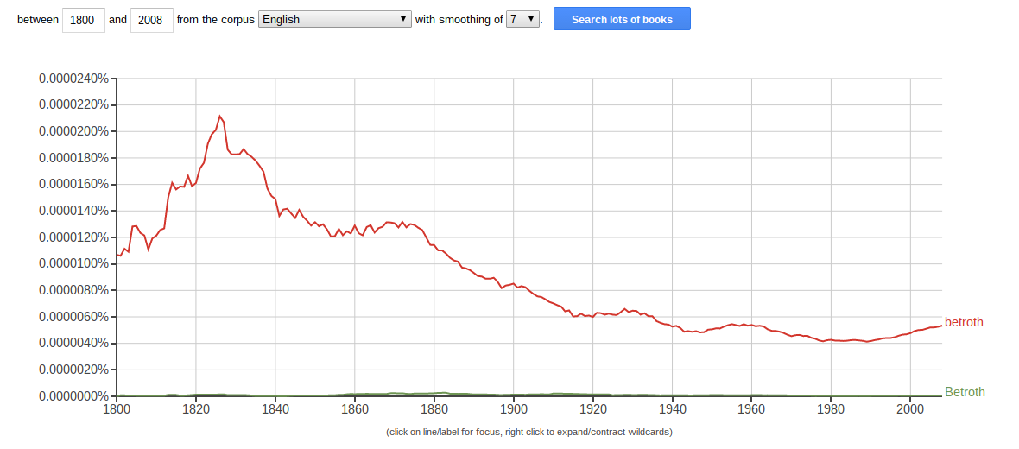
Hosea 2:19-20
“betroth”

Slide 9
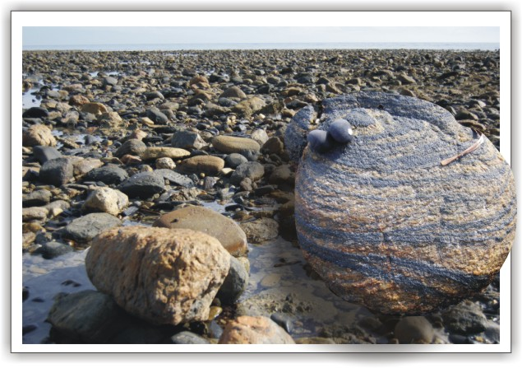
Building a Storm-Proof Marriage
1. Build on the rock of the COVENANT of marriage instead of the sand of a contract

Slide 10
Building a Storm-Proof Marriage
1. Build on the rock of the COVENANT of marriage instead of the sand of a contract
2. Build on the rock of RIGHTEOUSNESS and JUSTICE, instead of the sands of reproach and prejudice

Slide 11
Building a Storm-Proof Marriage
1. Build on the rock of the COVENANT of marriage instead of the sand of a contract
2. Build on the rock of RIGHTEOUSNESS and JUSTICE, instead of the sands of reproach and prejudice
3. Build on the rock of LOVINGKINDNESS, instead of the sand of conditional love

Slide 12
Building a Storm-Proof Marriage
1. Build on the rock of the COVENANT of marriage instead of the sand of a contract
2. Build on the rock of RIGHTEOUSNESS and JUSTICE, instead of the sands of reproach and prejudice
3. Build on the rock of LOVINGKINDNESS, instead of the sand of conditional love
4. Build on the rock of COMPASSION, instead of the sands of coldness and bitterness

Slide 13
Building a Storm-Proof Marriage
1. Build on the rock of the COVENANT of marriage instead of the sand of a contract
2. Build on the rock of RIGHTEOUSNESS and JUSTICE, instead of the sands of reproach and prejudice
3. Build on the rock of LOVINGKINDNESS, instead of the sand of conditional love
4. Build on the rock of COMPASSION, instead of the sands of coldness and bitterness
5. Build on the rock of FAITHFULNESS, instead of the sand of disloyalty

