Slide 2
Judges 16:18-22
¹⁸ When Delilah saw that he had told her all his heart, she sent and called for the lords of the Philistines, saying, come up once more, for he has told me all his heart. So the lords of the Philistines came up to her and brought the money in their hand. ¹⁹ Then she lulled him to sleep on her knees, and called for a man and had him shave off the seven locks of his head. Then she began to torment him, and his strength left him. ²⁰ And she said, the Philistines are upon you, Samson! So he awoke from his sleep, and said, I will go out as before, at other times, and shake myself free! But he did not know that the Lord had departed from him. ²¹ Then the Philistines took him and put out his eyes, and brought him down to Gaza. They bound him with bronze fetters, and he became a grinder in the prison. ²² However, the hair of his head began to grow again after it had been shaven.

Slide 5
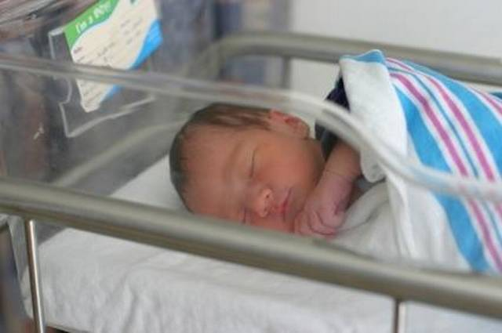
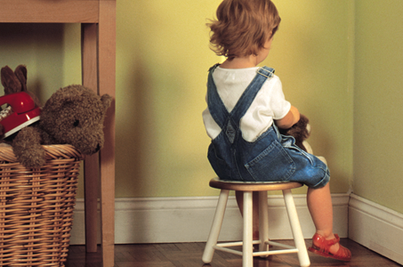
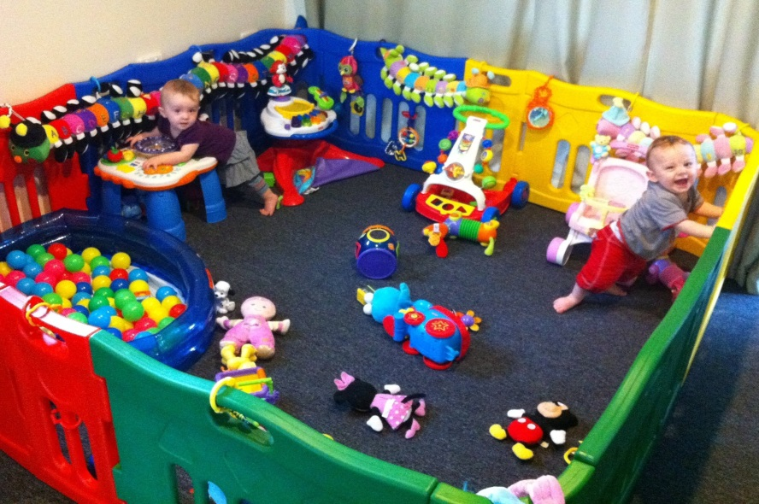
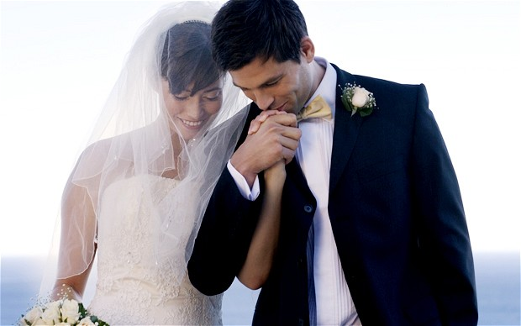
Boundaries

Slide 6
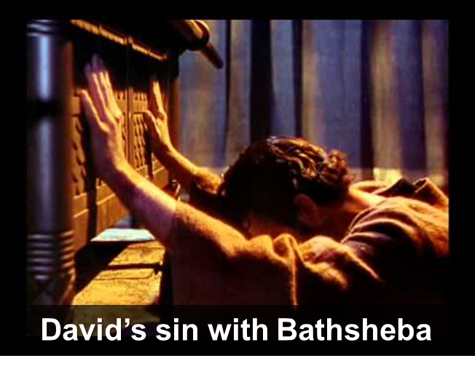

Slide 7
Rejected the boundaries of the Nazarite (Judg 13:5; Num 6:6; Judg 14:5-9)
Rejected the boundaries of his parents and God (Judg 13:2-3; Deut 7:3)

Slide 8
Blind to his need to observe Boundaries
Blind to the power of Temptation
Blind to the cost of Defiance

