Slide 2
Hebrews 7:11-17
¹¹ Therefore, if perfection were through the Levitical priesthood (for under it the people received the law), what further need was there that another priest should rise according to the order of Melchizedek, and not be called according to the order of Aaron? ¹² For the priesthood being changed, of necessity there is also a change of the law. ¹³ For He of whom these things are spoken belongs to another tribe, from which no man has officiated at the altar. ¹⁴ For it is evident that our Lord arose from Judah, of which tribe Moses spoke nothing concerning priesthood. ¹⁵ And it is yet far more evident if, in the likeness of Melchizedek, there arises another priest ¹⁶ who has come, not according to the law of a fleshly commandment, but according to the power of an endless life. ¹⁷ For He testifies: You are a priest forever according to the order of Melchizedek.

Slide 4
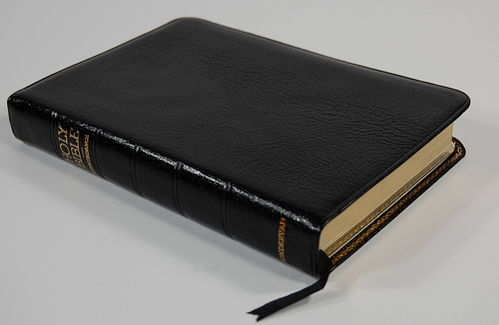
With Regard to the Silence of God
What should be our attitude toward the silence of the Scripture?
Are people allowed to decide what to say and do when the Bible is silent?
What about those things about which God has said nothing?

Slide 5
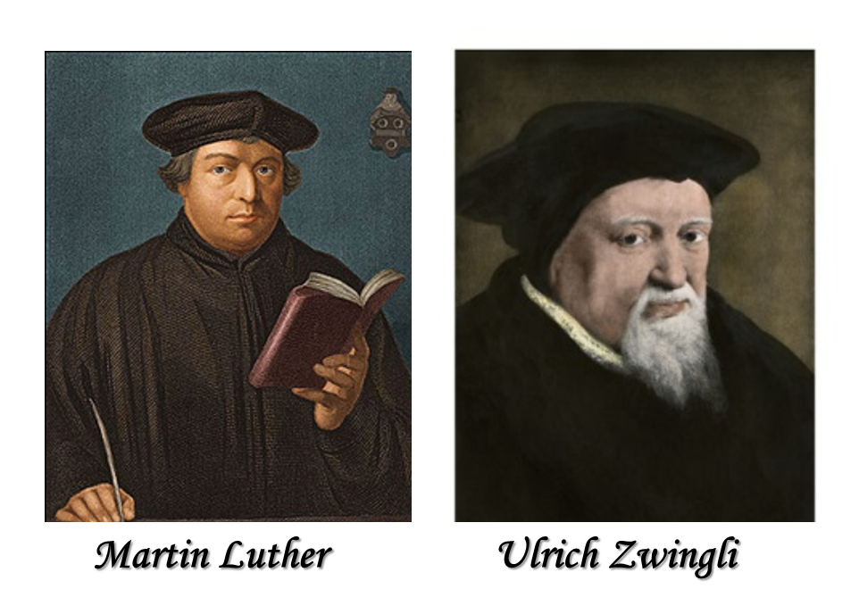
With Regard to the Silence of God
Silence
Permits
Silence
Prohibits
Unfortunately, the view of Luther became and remains the predominant attitude in Protestantism!
“Whatever is not against scripture
is for scripture and scripture for it”
“Whatever is not enjoined in Scripture is to be rejected”

Slide 6
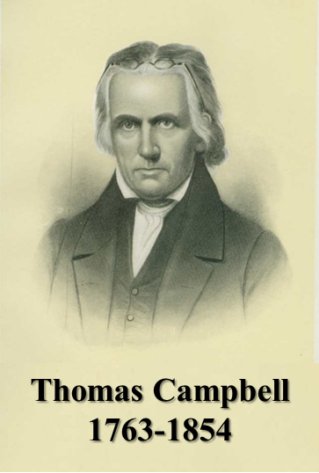
“Where the Scriptures speak, we speak; where the Scriptures are silent, we are silent.”
“If anyone speaks, let him speak as the oracles of God.”
1 Peter 4:11

Slide 7
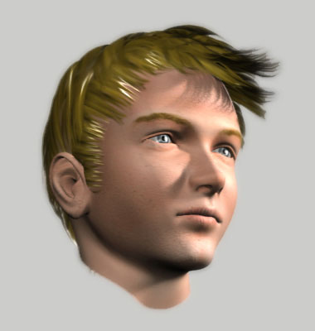
Silence Always Prohibits!
No one can presume to go beyond what is written ~ 1 Cor 4:6
1 Corinthians 2:9-11
But as it is written: Eye has not seen, nor ear heard, nor have entered into the heart of man the things which God has prepared for those who love Him.
But God has revealed them to us through His Spirit. For the Spirit searches all things, yes, the deep things of God.
For what man knows the things of a man except the spirit of the man which is in him? Even so no one knows the things of God except the Spirit of God.
Man could not see, hear or imagine the will of God!

Slide 8
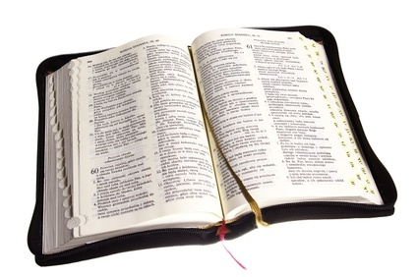
Silence Always Prohibits!
Deuteronomy 29:29
The secret things belong to the LORD our God, but those things which are revealed belong to us and to our children forever, that we may do all the words of this law.
Keep Out
Read & Obey

Slide 9
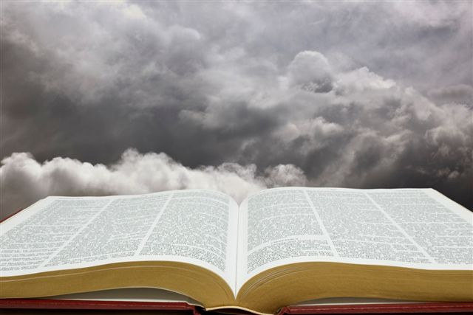
Respecting the Silence of God!
Numbers 22:18 ~ I could not go beyond the word of the LORD my God, to do less or more.
Deuteronomy 4:2 ~ You shall not add to the word which I command you, nor take anything from it . . .
Deuteronomy 12:32 ~ Whatever I command you, be careful to observe it; you shall not add to it nor take away from it.
1 Corinthians 4:6 ~ that you may learn in us not to think beyond what is written . . .
Revelation 22:18-19 ~ . . . If anyone adds to these things, God will add to him the plagues that are written in this book; and if anyone takes away from the words of the book of this prophecy, God shall take away his part from the Book of Life . . .

Slide 10
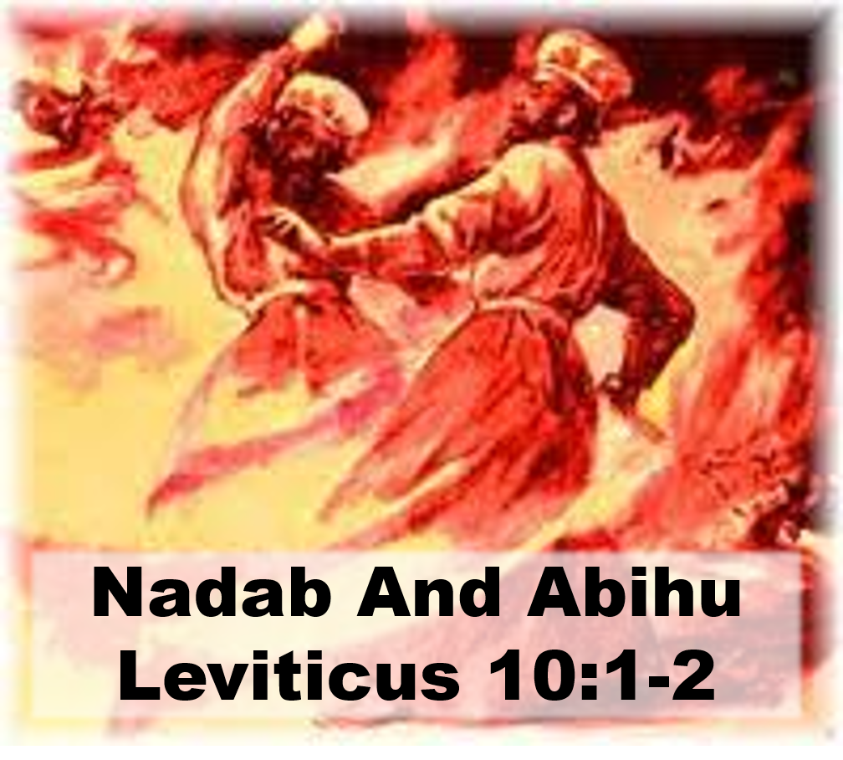
Those who Disrespected God’s Silence!

Slide 11
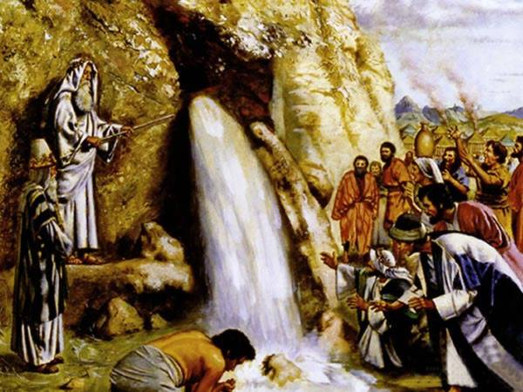
Those who Disrespected God’s Silence!
Moses Striking the Rock
Numbers 20:8-24

Slide 12
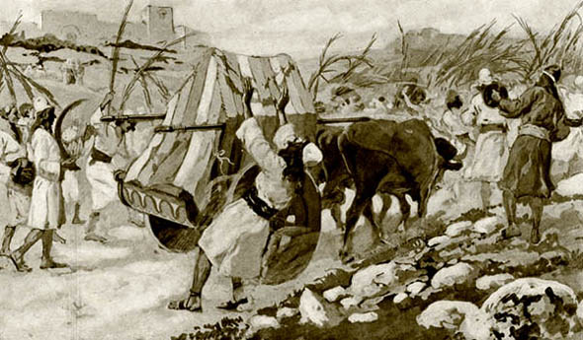
Those who Disrespected God’s Silence!
Transporting the Ark
1 Chronicles 13:7-12

Slide 13
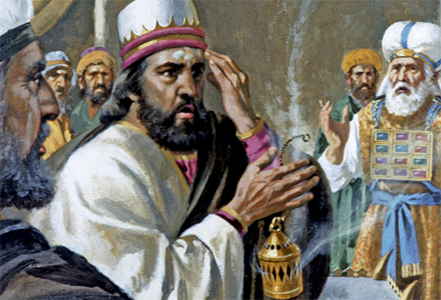
Those who Disrespected God’s Silence!
King Uzziah’s Sacrifice
2 Chronicles 26:16-23

Slide 14
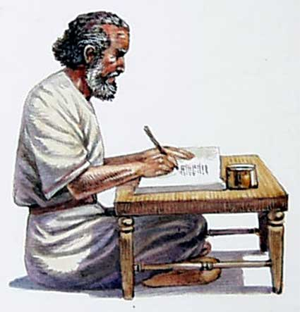
Those who Respected God’s Silence!
James
In
Jerusalem
Acts 15:24

Slide 15
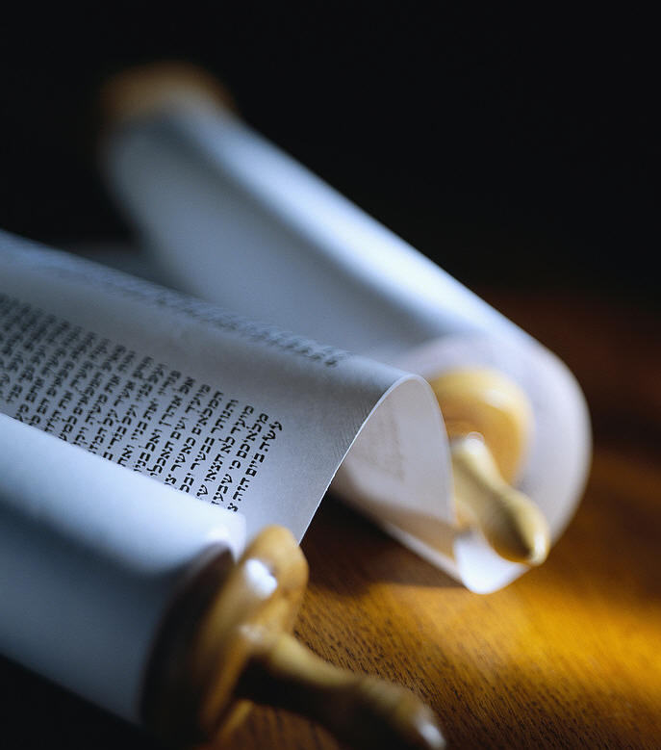
Those who Respected God’s Silence!
The Jewish Priesthood
Hebrews 7:11-14

Slide 16
Lessons Learned
God’s Silence Always Forbids
Do not Need a “Thou Shalt Not”
Men Still disobey God’s Prohibitions
If it is not revealed - it is not a good work
Respect for God prevents Presumption
Authority is never: “What’s wrong with it?”

