Slide 2
1 Samuel 16:7-13
⁷ But the Lord said to Samuel, do not look at his appearance or at his physical stature, because I have refused him. For the Lord does not see as man sees; for man looks at the outward appearance, but the Lord looks at the heart. ⁸ So Jesse called Abinadab, and made him pass before Samuel. And he said, neither has the Lord chosen this one. ⁹ Then Jesse made Shammah pass by. And he said, neither has the Lord chosen this one. ¹⁰ Thus Jesse made seven of his sons pass before Samuel. And Samuel said to Jesse, the Lord has not chosen these. ¹¹ And Samuel said to Jesse, are all the young men here? Then he said, there remains yet the youngest, and there he is, keeping the sheep.
And Samuel said to Jesse, send and bring him. For we will not sit down till he comes here. ¹² So he sent and brought him in. Now he was ruddy, with bright eyes, and good-looking. And the Lord said, arise, anoint him; for this is the one! ¹³ Then Samuel took the horn of oil and anointed him in the midst of his brothers; and the Spirit of the Lord came upon David from that day forward. So Samuel arose and went to Ramah.

Slide 4
The Shepherd Boy who became King
“Therefore all the elders of Israel came to the king at Hebron, and King David made a covenant with them at Hebron before the Lord. And they anointed David king over Israel. David was thirty years old when he began to reign, and he reigned forty years. In Hebron he reigned over Judah seven years and six months, and in Jerusalem he reigned thirty-three years over all Israel and Judah.”
2 Samuel 5:3-5

Slide 5
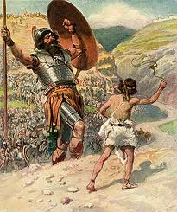
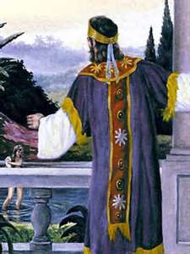
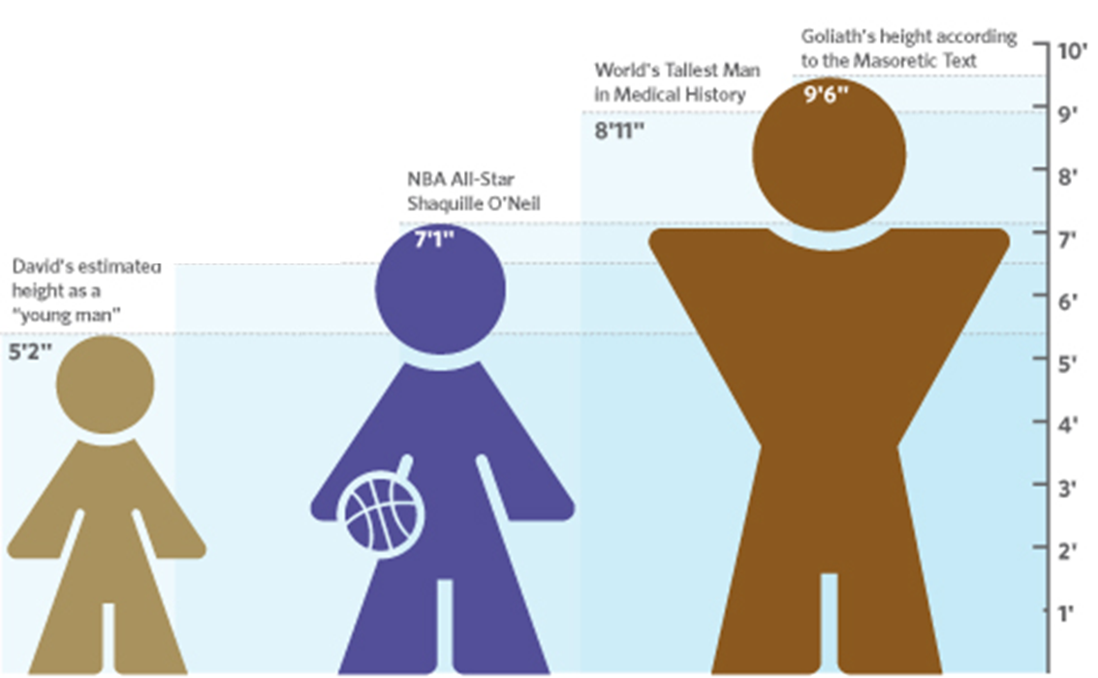
David Slays the Giant
The Giant slays David
REMEMBERING
David and Goliath
David and Bathsheba

Slide 6
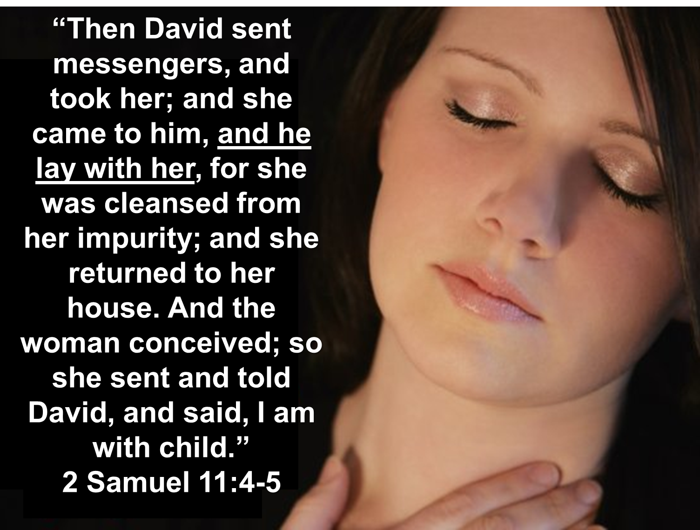
Lust
Very Successful (1 Samuel 18:7; 2 Samuel 8, 10)
Arrogance/Pride (2 Samuel 5:12; Proverbs 16:18)
Neglected His Duty (2 Samuel 11:1)
Too Much Idle Time (2 Samuel 11:2)
Neglected His Spiritual Needs (Psalm 119:11-16; 2 Samuel 12:9)

Slide 7
Alcohol
Drugs
Lust
Hate
Anger
Prejudice
Unforgiveness
Self-Righteousness

