Slide 3
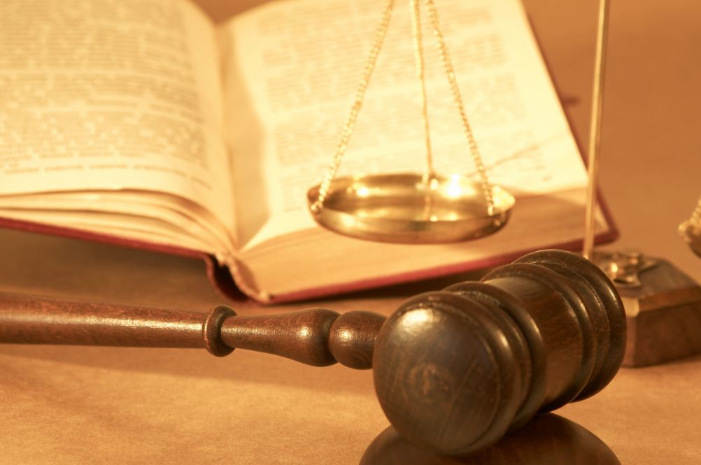
The Unrighteous Cannot go to Heaven
1 Corinthians 6:1-20

Slide 4
Why do conflicts arise among Christians?
Hebrews 12:1-4 Therefore we also, since we are surrounded by so great a cloud of witnesses, let us lay aside every weight, and the sin which so easily ensnares us, and let us run with endurance the race that is set before us, looking unto Jesus, the author and finisher of our faith, who for the joy that was set before Him endured the cross, despising the shame, and has sat down at the right hand of the throne of God. For consider Him who endured such hostility from sinners against Himself, lest you become weary and discouraged in your souls. You have not yet resisted to bloodshed, striving against sin.
1 Corinthians 13:4-8 Love suffers long and is kind; love does not envy; love does not parade itself, is not puffed up; does not behave rudely, does not seek its own, is not provoked, thinks no evil; does not rejoice in iniquity, but rejoices in the truth; bears all things, believes all things, hopes all things, endures all things.
Love never fails. But whether there are prophecies, they will fail; whether there are tongues, they will cease; whether there is knowledge, it will vanish away.
1 Cor 6:7 Now therefore, it is already an utter failure for you that you go to law against one another. Why do you not rather accept wrong? Why do you not rather let yourselves be cheated?
Matt 5:38-42 “You have heard that it was said, ‘An eye for an eye and a tooth for a tooth.’ But I tell you not to resist an evil person. But whoever slaps you on your right cheek, turn the other to him also. If anyone wants to sue you and take away your tunic, let him have your cloak also. And whoever compels you to go one mile, go with him two. Give to him who asks you, and from him who wants to borrow from you do not turn away.
Luke 9:23-24 Then He said to them all, “If anyone desires to come after Me, let him deny himself, and take up his cross daily, and follow Me. For whoever desires to save his life will lose it, but whoever loses his life for My sake will save it.
SIN
What biblical principles will prevent conflicts among Christians?
Godly Love 1 Cor 13:4-8
Better to be wronged 1 Cor 6:7; Matt 5:38-42
Deny yourself Luke 9:23-24
Remember Jesus Hebrews 12:1-4

Slide 5
1. What is Paul faulting the Corinthians for doing?
Matthew 18:15-17 “Moreover if your brother sins against you, go and tell him his fault between you and him alone. If he hears you, you have gained your brother. But if he will not hear, take with you one or two more, that ‘by the mouth of two or three witnesses every word may be established.’ And if he refuses to hear them, tell it to the church. But if he refuses even to hear the church, let him be to you like a heathen and a tax collector.
Taking a brother to court instead of keeping the issue within the church

Slide 6
2. How can v.2 be reconciled with what Paul said previously in 5:12-13?
On Judgment Day, the world will be judged by the same standard Christians faithfully live by.
1 Corinthians 5:12-13 For what have I to do with judging those also who are outside? Do you not judge those who are inside? But those who are outside God judges. Therefore “put away from yourselves the evil person.”
Romans 2:27 And will not the physically uncircumcised, if he fulfills the law, judge you who, even with your written code and circumcision, are a transgressor of the law?
Hebrews 11:7 By faith Noah, being divinely warned of things not yet seen, moved with godly fear, prepared an ark for the saving of his household, by which he condemned the world and became heir of the righteousness which is according to faith.

Slide 7
3. What is the result of Christians taking their cases before the courts? Why?
To their shame, they are proclaiming there is not a wise man among them to judge their case.

Slide 8
4. What does Paul say they should do instead?
Be wronged rather than bringing shame upon the church
Matthew 5:39-40 But I tell you not to resist an evil person. But whoever slaps you on your right cheek, turn the other to him also. If anyone wants to sue you and take away your tunic, let him have your cloak also.
Rom 12:17-19 Repay no one evil for evil. Have regard for good things in the sight of all men. If it is possible, as much as depends on you, live peaceably with all men. Beloved, do not avenge yourselves, but rather give place to wrath; for it is written, “Vengeance is Mine, I will repay,” says the Lord.

Slide 9
Rom 13:1-5 Let every soul be subject to the governing authorities. For there is no authority except from God, and the authorities that exist are appointed by God. Therefore whoever resists the authority resists the ordinance of God, and those who resist will bring judgment on themselves. For rulers are not a terror to good works, but to evil. Do you want to be unafraid of the authority? Do what is good, and you will have praise from the same. For he is God’s minister to you for good. But if you do evil, be afraid; for he does not bear the sword in vain; for he is God’s minister, an avenger to execute wrath on him who practices evil. Therefore you must be subject, not only because of wrath but also for conscience’ sake.
5. Does this mean that Christians are prohibited from using the courts?
No

Slide 10
6. Why does Paul proceed to point out that the unrighteous will not inherit the kingdom of God?
Some were defrauding their brother – vs 8
1 Cor 6:8-10 No, you yourselves do wrong and cheat, and you do these things to your brethren! Do you not know that the unrighteous will not inherit the kingdom of God? Do not be deceived. Neither fornicators, nor idolaters, nor adulterers, nor homosexuals, nor sodomites, nor thieves, nor covetous, nor drunkards, nor revilers, nor extortioners will inherit the kingdom of God.

Slide 11
Rom 3:23-26 for all have sinned and fall short of the glory of God, being justified freely by His grace through the redemption that is in Christ Jesus, whom God set forth as a propitiation by His blood, through faith, to demonstrate His righteousness, because in His forbearance God had passed over the sins that were previously committed, to demonstrate at the present time His righteousness, that He might be just and the justifier of the one who has faith in Jesus.
7. Despite being former partakers in these sins, what had the Corinthians been able to accomplish through Christ?
Washed - Baptized
Sanctified – Set apart to God at the time of baptism
Acts 22:16 And now why are you waiting? Arise and be baptized, and wash away your sins, calling on the name of the Lord.’
Eph 5:25-26 Husbands, love your wives, just as Christ also loved the church and gave Himself for her, that He might sanctify and cleanse her with the washing of water by the word,
Justified in the name of the Lord Jesus and by the Spirit of God

Slide 12
8. What does Paul mean by, “All things are lawful for me, but not all things are profitable?”
1 Cor 8:8-13 But food does not commend us to God; for neither if we eat are we the better, nor if we do not eat are we the worse. But beware lest somehow this liberty of yours become a stumbling block to those who are weak. For if anyone sees you who have knowledge eating in an idol’s temple, will not the conscience of him who is weak be emboldened to eat those things offered to idols? And because of your knowledge shall the weak brother perish, for whom Christ died? But when you thus sin against the brethren, and wound their weak conscience, you sin against Christ. Therefore, if food makes my brother stumble, I will never again eat meat, lest I make my brother stumble.
Even in matters of liberty, restraint is sometimes needed.

Slide 13
9. What does Paul say the purpose of the body is?
vs 19-20 Glorify God

Slide 14
10. How should understanding that our bodies are members of Christ effect the way that we behave?
John 15:1-8 “I am the true vine, and My Father is the vinedresser. Every branch in Me that does not bear fruit He takes away; and every branch that bears fruit He prunes, that it may bear more fruit. You are already clean because of the word which I have spoken to you. Abide in Me, and I in you. As the branch cannot bear fruit of itself, unless it abides in the vine, neither can you, unless you abide in Me.
“I am the vine, you are the branches. He who abides in Me, and I in him, bears much fruit; for without Me you can do nothing. If anyone does not abide in Me, he is cast out as a branch and is withered; and they gather them and throw them into the fire, and they are burned. If you abide in Me, and My words abide in you, you will ask what you desire, and it shall be done for you. By this My Father is glorified, that you bear much fruit; so you will be My disciples.
Should not be joined to a harlot in the flesh
We are one spirit with Jesus

Slide 15
11. We often view sin as a transgression towards God, but who does the immoral man also sin against?
vs 18 – Someone who commits sexual immorality sins agains their own body
What does Paul state in verse 18 regarding the control Satan has over us?
“Flee” – We can choose not to sin – Jesus (Matt 4:1-11); Joseph (Gen 39)

Slide 16
12. Why do we owe our service to God?
Jesus paid the price to redeem us from sin
Eph 1:7-8 In Him we have redemption through His blood, the forgiveness of sins, according to the riches of His grace which He made to abound toward us in all wisdom and prudence,

