Slide 2
To get the most from this study:
Spend time reading the Bible (our text in Corinthians)
Be aware of the context (surrounding words, phrases)
Train your eyes to spot repeated words (“wisdom” 16 times in 2 chapters)
Compare versions
Write down your observations
Look to make applications
Partner Up
Join your study with prayer
Always come to class prepared

Slide 3
Acts 15:39-18:22
Acts 18:1-17
“After these things Paul departed from Athens and went to Corinth”

Slide 4
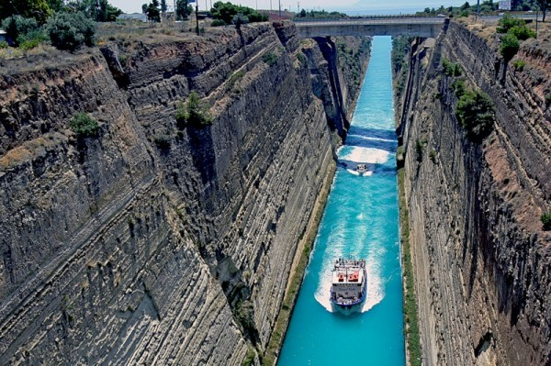
Corinth: The City
Inhabitants both Jew & Gentile (Acts 18:4; 1 Cor 6:9-10)
Major pagan religion was worship of Aphrodite (Roman Venus)
Her “worship” would have included fornication with “sacred temple prostitutes (male & female)
Such decadence permeated Corinthian culture
To be called “A Corinthian” was synonymous with being called “a degenerate”
Paul may have had the “Corinthian culture” in mind when he wrote Romans 1:18-32
“Old Corinth” named for Korinthos (son of Zeus)
Captured for Rome in 146 B.C. by Julius Caesar
Rebuilt in 46 B.C. and granted the status of a Roman Colony
When Paul went there it would have had a population of more than 500,000
Built at foot of high hill, on a peninsula—an important commercial city; shipping brought wealth and diversity
Had Greek heritage (culture). Known for its emphasis on education, philosophy, sciences and sports.

Slide 5
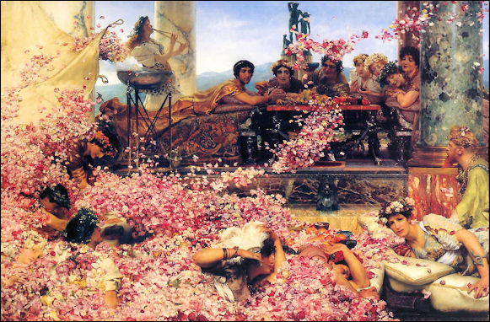
Corinth: The Church
Do you think the “moral climate” of Corinth would have been discouraging?
1 Corinthians 2:1-3 & Acts 18:9-10
The NEB(18:5): “Now when Silas and Timothy arrived from Macedonia, Paul became wholly absorbed with proclaiming the word . . .” What about their arrival would have caused Paul to become “wholly absorbed” with preaching?
Brought support—Now he could fully devote himself to preaching—2 Cor 11:8-9; Phil 4:15
“He who believes and is baptized will be saved; but he who does not believe will be condemned” (Mk 16:16). What verse in Acts 18 parallels Mk 16:16?
Acts 18:8
Corinthian Decadence

Slide 6
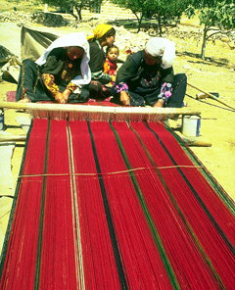
Corinth: The Church
Who did Paul stay with while in Corinth?
Aquila & Priscilla, Ac 18:2
Follow Up
Why did he stay with them?
Were they already Christians?

Slide 7
Corinth: The Church
What did Paul do each Sabbath Day?
Reasoned in the synagogue, Vs 4
Follow Up
What does it mean to “reason”?
Same as it did when he was in Thessalonica—Acts 17:1-3

Slide 8
Corinth: The Church
What did Paul do after Silas and Timothy came to Corinth?
Gave himself to “full time” preaching, Vs 5
Follow Up
Paul would later be forced to address this issue? What did he say about preachers being fully supported in 1 Cor 9:14?

Slide 9
Corinth: The Church
How does verse 8 describe the conversion of many of the Corinthians?
Hearing, believed and baptized

Slide 10
Corinth: The Church
What did the Lord say to Paul, and how long did he stay at Corinth?
Don’t fear, 18 months—Vss 9-11
Follow Up
What is said in the “great commission” (Matt 28:20) that is comparable to the promise made to Paul?
“I am with you always”

Slide 11
Corinth: The Church
Why did Gallio (proconsul of Achaia) refuse to prosecute Paul?
Proconsul = A military governer
Paul is accused of blaspheming the Law of Moses (12-13)
Gallio refuse to get involved in what he considered a trivial dispute (15)
If it were a matter of Roman law he would have become involved (14)
The Jews were beaten for bringing the charge and Gallio ignores the beatings (16-17)

Slide 12
When Paul departed Corinth he left behind a church of Christ in one of the most immoral and wicked of cities.
Its members came from both the Jewish and Pagan faiths.
Paul wrote the first letter (1 Corinthians) about 4 or 5 years later from Ephesus addressing many problems.
He wrote the second letter (2 Corinthians) a year or so after writing the first.

Slide 13
Apollos followed Paul in Corinth (Acts 18:27) but he was gone by the time Paul wrote the first letter (1 Cor 16:12).
It seems that the letter was sent to address the problems the Corinthians wrote to ask Paul about: “Now concerning the things of which you wrote to me” (1 Cor 7:1).
Other questions are assumed because of Paul’s phrases (7:25; 8:1; 12:1; 16:1, “now concerning”).
But he also got some first hand reports of problems (1:11, “Chloe’s household”).
Paul is not just giving “wise advice;” instead his writings are “the commandments of the Lord” (14:37).

Slide 14
Does the fact that Paul refers to these people in this way imply (suggest) that their moral and doctrinal failings are overlooked by God?
How does Paul refer to the Christians at Corinth according to verse 2?
1 Cor 5:5 (deliver sinner to Satan)
1 Cor 6:8 (you do wrong to a brother)
1 Cor 6:9-10 (unrighteous are unsaved)
1 Cor 8:12 (sin against a weak brother)
1 Cor 11:17 (coming together for the worse)
1 Cor 11:30 (abuses are spiritually killing you)
Church of God
Sanctified in Christ Jesus
Called to be saints
Call on the name of Jesus Christ
NO

Slide 15
(4) “You” the Corinthians (2 Cor 11:28, “all the churches”)
(4) Grace given them (God’s gift of salvation, Eph 2:8)
(5) Their enriching (1 Cor 1:26, but 2 Cor 8:9)
(5-7) The “gifts” given to them (1 Cor 12:1-11)
(7) Their waiting (patience) for the Lord (Phil 3:20)
(8) They may be confirmed (grounded) to the end (1 Cor 10:13)
(8) To be blameless (not condemned), i.e., correct sins and forgiven (2 Cor 7:10)
Paul exposes his heartfelt concern for the Corinthians beginning in verse 4. He expresses his thanks to God. Considering verses 4-9 list all for which Paul is thankful?

